Slide 1


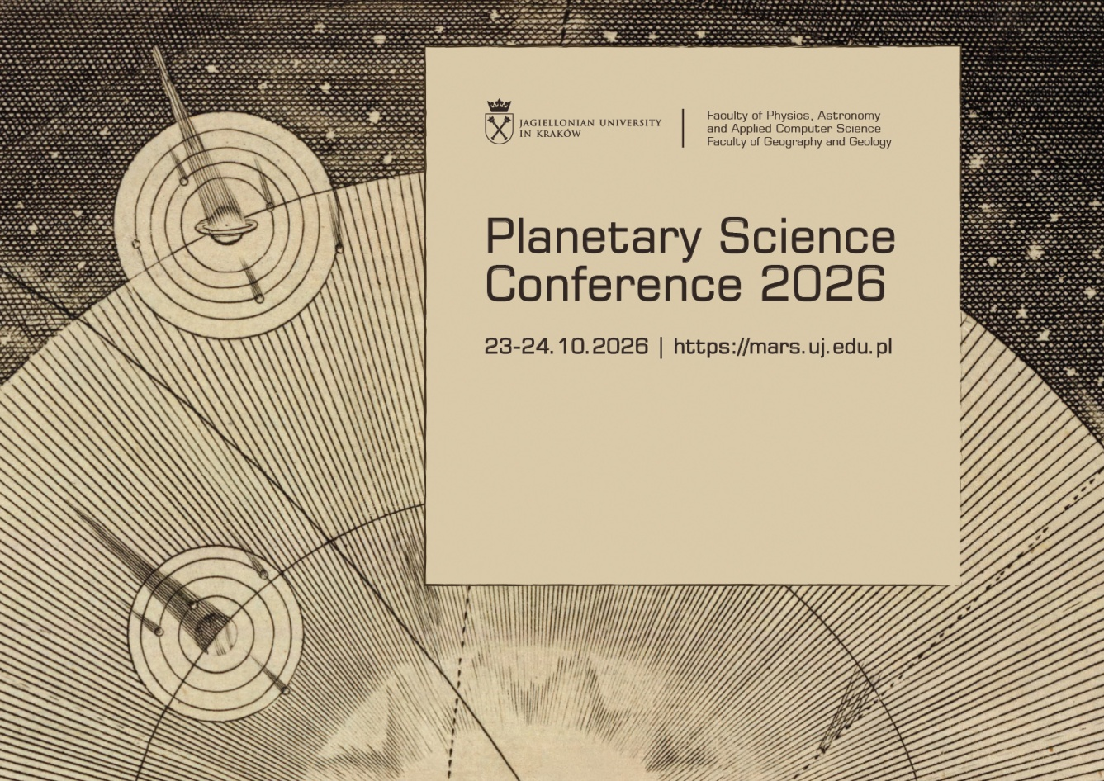


Session: Exoplanets, Icy moons, Asteroids
Thisari Kulathunga
Ceylon Institute of Space Science
Sri Lanka

Slide 2


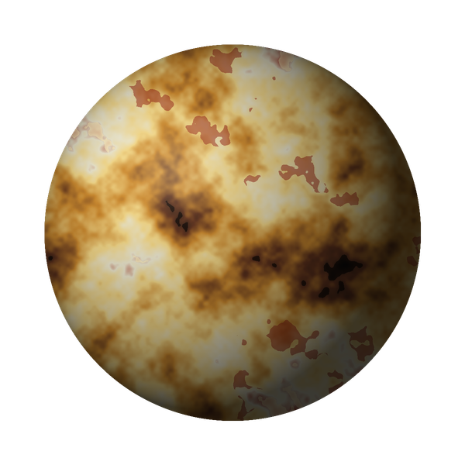
SPACE RESEARCH PRESENTATION
PLANETARY
VOLCANISM
Venus • Io • L 98-59 d
Comparative analysis of geodynamic drivers and magmatic mechanisms
From mantle convection to tidal heating—and a possible magma ocean beyond our Solar System.
MAGMA OCEAN?
THERMAL EVOLUTION
TIDAL HEATING
Illustrative planetary renders • not spacecraft imagery

Slide 3
RESEARCH FRAMEWORK
One Question. Three Energy Systems.
How does a world’s energy budget control melting, magma transport, and the signals we observe?
VENUS
IO
L 98-59 d
Internal heat
Tidal dissipation
Coupled interior–atmosphere
Mantle convection + uncertain lithospheric regime
Orbital resonance → repeated deformation → heat
Possible tidal heating + atmospheric insulation
A COMMON COMPARATIVE FRAMEWORK
ENERGY SOURCE
INTERNAL HEATING
PARTIAL MELTING
MAGMA TRANSPORT
OBSERVABLE SIGNALS
The same broad chain does not mean the same interior physics.
Framework synthesized from Turcotte & Schubert (2002); Rolf et al. (2022); Ghail et al. (2024); Nicholls et al. (2026).
COMPARATIVE PLANETOLOGY • SPACE RESEARCH
02

Slide 4
SOLAR SYSTEM CASE STUDY 01
Venus: Heat Beneath a Stagnant lid
INTERIOR
TECTONIC REGIME
Metallic core • silicate mantle • crust
No established global Earth-like plate tectonics
CANDIDATE MECHANISMS
STAGNANT LID
MANTLE PLUMES
EPISODIC / REGIONAL RESURFACING
Key uncertainty
How efficiently does Venus lose heat—and how much volcanism is occurring today?
CONCEPTUAL RENDER
NOT A MAGELLAN IMAGE
Coronae and tesserae record interactions between volcanism and lithospheric deformation.
Rolf et al. (2022); Ghail et al. (2024); Magellan radar archive, NASA Planetary Data System.
COMPARATIVE PLANETOLOGY • SPACE RESEARCH
03

Slide 5
SOLAR SYSTEM CASE STUDY 02
Io: The Orbit itself Powers Geology
ORBITAL RESONANCE → TIDAL DEFORMATION → HEAT
266
18–25
~28%
hotspots identified
TW
of global thermal emission
Juno / JIRAM analysis
Estimated emission from observed hotspots; method-dependent
Estimated contribution from the observed hotspots
Europa
Io
Where is the heat dissipated?
Ganymede
Mantle? Shallow asthenosphere? A partially molten layer?
JUPITER
Changing tidal force repeatedly flexes Io.
SCHEMATIC ORBITS — NOT TO SCALE
The hotspot map constrains models; it does not uniquely prove a global magma ocean.
Peale et al. (1979); Segatz et al. (1988); Matsuyama et al. (2022); Davies et al. (2024), doi:10.1038/s41550-023-02123-5.
COMPARATIVE PLANETOLOGY • SPACE RESEARCH
04

Slide 6
SHARED PROCESS • DIFFERENT CONTROLS
From Internal Energy to Eruption
VENUS
IO
Thermal evolution + mantle dynamics
Tidal dissipation + magma heat transport
1
Mantle upwelling
Hotter material rises
1
Repeated tidal flexing
Mechanical energy dissipates
2
Partial melting
Pressure / temperature cross melt conditions
2
Partial / extensive melting
Hot silicate interior
3
Lithosphere pathways
Fractures and weak zones
3
Magmatic heat pipe
Magma carries energy upward
4
Surface expression
Plains, edifices, coronae
4
Surface expression
Paterae, lava flows, hotspots
Energy source matters—but lithospheric strength, melt fraction, and transport pathways determine what reaches the surface.
Turcotte & Schubert (2002); Collinet et al. (2025); Williams et al. (2011); Matsuyama et al. (2022).
COMPARATIVE PLANETOLOGY • SPACE RESEARCH
05

Slide 7
SURFACE EVIDENCE • FIGURES 1–2
Two Surfaces, two Geological Records
FIGURE 1
FIGURE 2
Venus • Radar Morphology
Io • Colour Diversity
Sulfur-bearing deposits, lava fields, dark volcanic units and bright young materials.
Volcanic plains, coronae, fracture belts and highly deformed tessera terrain.
Paterae • lava flows • mountains
Volcanism + tectonic deformation
Rapid resurfacing leaves little recognizable impact-crater record.
Impact craters are sparse; exact resurfacing chronology remains debated.
Figures 1–2 are conceptual renderings for orientation—not the original NASA / spacecraft images.
Io surface morphology: Williams et al. (2011), USGS SIM 3168. Venus surface context: Magellan / NASA PDS; Ghail et al. (2024).
COMPARATIVE PLANETOLOGY • SPACE RESEARCH
06

Slide 8
IO • GEOLOGICAL MAPPING • FIGURES 3–4
A Small Area can Carry a Big Thermal Signal
FIGURE 3
FIGURE 4
Mapped surface units on Io
Volcanic and tectonic terrain
Approximate fraction of mapped surface
Plains
65.8%
Lava-flow fields
28.5%
PATERA
LAVA FLOWS
TECTONIC MOUNTAIN
Mountains
3.2%
Why it matters
Patera floors
2.5%
Paterae occupy only ~2.5% of the mapped surface, yet are strongly associated with thermal hotspots. Many mountains also show evidence of tectonic deformation.
425 paterae identified in the USGS global map
Figure 3 is a quantitative redraw from published mapping; Figure 4 is a schematic, not a reproduced geological map.
Williams et al. (2011), U.S. Geological Survey Scientific Investigations Map 3168.
COMPARATIVE PLANETOLOGY • SPACE RESEARCH
07

Slide 9
OBSERVATION STRATEGY
The Signal Depends on How We Observe the World
VENUS
IO
L 98-59 D
RADAR BACKSCATTER
VISIBLE + INFRARED
TRANSIT SPECTROSCOPY
Dense cloud cover blocks ordinary surface imaging. Magellan radar and radar-derived topography reveal plains, fractures, and volcanic structures.
Visible imagery reveals colour and morphology. Infrared emission locates active thermal hotspots and helps estimate volcanic heat flow.
Starlight filtered through the atmosphere produces a transmission spectrum. Molecular signatures are inferred using retrieval models.
INTERPRETATION LIMIT
INTERPRETATION LIMIT
INTERPRETATION LIMIT
Brightness can change with viewing geometry; change detection requires care.
Hotspot catalogues depend on instrument sensitivity and analysis methods.
Atmospheric molecules are indirect evidence—not a photograph of the surface or proof of eruptions.
Radar brightness ≠ visible colour ≠ an atmospheric absorption feature.
NASA Magellan / PDS; Davies et al. (2024); Banerjee et al. (2024).
COMPARATIVE PLANETOLOGY • SPACE RESEARCH
08

Slide 10
EXOPLANET EXTENSION
L 98-59 d: A World Inferred from Light
THE PLANET AT A GLANCE
~35 ly
7.45 d
~1.63 R⊕
distance from Earth
orbital period
estimated radius
Approximately 10.6 parsecs
Close orbit around an M-type star
Published estimates vary
Low estimated bulk density
~2.2 g cm⁻³ in one 2025 analysis
2025 estimate: ~1.64 M⊕; low density may imply substantial volatiles.
CONCEPTUAL ART
The key question: can the interior leave a detectable chemical signature in the atmosphere?
No direct surface image exists.
Kostov et al. (2019); Cadieux et al. (2025); conceptual art only—not a resolved image of L 98-59 d.
COMPARATIVE PLANETOLOGY • SPACE RESEARCH
09

Slide 11
L 98-59 D • INTERIOR–ATMOSPHERE COUPLING
A Possible Permanent Magma Ocean
MODELLED FEEDBACK
ILLUSTRATIVE MODEL DIAGRAM
1
Tidal dissipation
Adds energy to the interior
2
Atmospheric insulation
Slows planetary cooling
~45%
3
Persistent molten mantle
modelled mantle melt fraction
Volatiles can remain in a magma reservoir
Nicholls et al. (2026); not directly measured
4
Degassing + photochemistry
Interior chemistry may shape atmospheric gases
A model prediction is a testable explanation—not direct imaging of a magma ocean.
FIGURE 5 • Conceptual summary of modelled volatile evolution; not the original model figure.
Nicholls et al. (2025), MNRAS; Nicholls et al. (2026), Nature Astronomy, doi:10.1038/s41550-026-02815-8.
COMPARATIVE PLANETOLOGY • SPACE RESEARCH
10

Slide 12
L 98-59 D • ATMOSPHERIC CHEMISTRY
Sulfur is a Clue—Not Proof of Active Volcanism
FIGURE 6
H₂S
Hydrogen sulfide
How transmission spectroscopy works
Tentative JWST retrieval; a later Gemini-South study reported evidence near 3.9σ.
STAR
ATMOSPHERE
TELESCOPE
Possible sulfur dioxide; photochemical production is proposed in models.
SO₂
Observed: a transmission spectrum
Retrieved molecules depend on the data and atmospheric model.
Interpretation guardrail
SCHEMATIC — NOT MEASURED SPECTRAL DATA
Sulfur-bearing gas can be consistent with outgassing—but does not independently confirm eruptions.
Banerjee et al. (2024), arXiv:2408.15707; Cheverall et al. (2026); Nicholls et al. (2026).
COMPARATIVE PLANETOLOGY • SPACE RESEARCH
11

Slide 13
SYNTHESIS • TABLE 2
Three Worlds, Three Interior–Atmosphere Systems
CHARACTERISTIC
VENUS
IO
L 98-59 d
Dominant energy
Internal thermal evolution; mantle dynamics
Tidal heating from orbital resonance
Tidal heating + atmospheric insulation in models
Geological environment
Volcanic plains, coronae, tesserae, tectonic belts
Paterae, lava flows, mountains; rapid resurfacing
Surface volcanism not directly observed
Atmosphere / chemistry
Dense CO₂ atmosphere; sulfur dioxide trace gas
Tenuous atmosphere dominated by SO₂
Volatile-rich atmosphere; H₂S and possible SO₂
Interior state
Rocky core–mantle–crust; heat-loss regime uncertain
Partially molten interior; dissipation depth debated
Models support a possible persistent magma ocean
Main uncertainty
Timing of resurfacing and present-day activity
Where tidal energy is dissipated
How uniquely atmospheric chemistry traces interior activity
TABLE 2 • This is a framework for comparison—not a claim that the three worlds have identical volcanic systems.
Rolf et al. (2022); Ghail et al. (2024); Williams et al. (2011); Davies et al. (2024); Nicholls et al. (2026).
COMPARATIVE PLANETOLOGY • SPACE RESEARCH
12

Slide 14
SCIENTIFIC LIMITS
What We Can—and Cannot—Claim
VENUS
IO
L 98-59 d
OBSERVED
OBSERVED
OBSERVED / INFERRED
Extensive volcanic / tectonic landforms; radar-based surface record.
Widespread thermal hotspots and rapid surface renewal.
Mass-radius estimates and atmospheric spectral features.
STILL DEBATED
STILL DEBATED
STILL DEBATED
Whether reported radar changes prove new lava flows; geometry is a competing explanation.
The depth and spatial pattern of dominant tidal dissipation.
Magma-ocean persistence and whether sulfur indicates interior degassing.
NEXT STEP
NEXT STEP
NEXT STEP
Future radar, topography and in-situ chemistry.
More thermal mapping + integrated interior models.
Repeated JWST / high-resolution spectra; refined mass, radius and orbit.
Evidence consistent with a mechanism is not automatically proof of that mechanism.
Sulcanese et al. (2024); Bhiravarasu et al. (2026); Sulcanese et al. (2026); Davies et al. (2024); Nicholls et al. (2026).
COMPARATIVE PLANETOLOGY • SPACE RESEARCH
13

Slide 15
TAKE-HOME MESSAGE
Different Engines. Shared Planetary Physics.
VENUS
IO
L 98-59 d
Internal heat + lithosphere
Tidal heating + magma transport
Possible magma ocean + atmospheric clues
A planet’s atmosphere may preserve clues about processes happening deep inside it.
Compare the mechanisms. Test the models. Keep observations distinct from interpretation.
All planetary renders on this deck are illustrative; quantitative claims are attributed on the relevant slides and reference slides.
COMPARATIVE PLANETOLOGY • SPACE RESEARCH
14

Slide 16
SELECTED REFERENCES • 1 OF 2
Sources for Venus, Io, and Planetary interiors
Turcotte, D. L., & Schubert, G. (2002).
Davies et al. (2024).
Geodynamics (2nd ed.). Cambridge University Press.
Io’s polar volcanic thermal emission indicative of magma ocean and shallow tidal heating models. Nature Astronomy. doi:10.1038/s41550-023-02123-5
Rolf et al. (2022); Ghail et al. (2024).
Williams et al. (2011).
Venus interior dynamics, lithospheric behaviour and resurfacing; cited in the project bibliography.
Geologic map of Io. U.S. Geological Survey Scientific Investigations Map 3168.
Peale, S. J., Cassen, P., & Reynolds, R. T. (1979).
NASA Planetary Data System.
Melting of Io by tidal dissipation. Science, 203(4383), 892–894. doi:10.1126/science.203.4383.892
Magellan Venus radar data archive and global radar mosaic. science.nasa.gov/photojournal/venus-global-view-centered-at-180-degrees/
Segatz et al. (1988).
Matsuyama et al. (2022); Collinet et al. (2025).
Tidal dissipation, surface heat flow, and figure of viscoelastic models of Io. Icarus, 75, 187–206. doi:10.1016/0019-1035(88)90001-2
Tidal heating / magmatic heat transport on Io; possible diversity in Venusian magmatism, as cited in the project.
Scientific facts and numerical estimates are attributed to their original studies; illustrations in this deck are newly created conceptual visuals.
COMPARATIVE PLANETOLOGY • SPACE RESEARCH
15

Slide 17
SELECTED REFERENCES • 2 OF 2
Sources for L 98-59 d and Current Uncertainty
Kostov et al. (2019); Cadieux et al. (2025).
Nicholls et al. (2026).
Discovery and bulk properties of planets in the L 98-59 system.
Volatile-rich evolution of molten super-Earth L 98-59 d. Nature Astronomy, 10, 809–817. doi:10.1038/s41550-026-02815-8.
Banerjee et al. (2024).
Cheverall et al. (2026).
Atmospheric retrievals suggest the presence of a secondary atmosphere and possible sulfur species on L 98-59 d from JWST NIRSpec G395H transmission spectroscopy. arXiv:2408.15707.
High-resolution ground-based spectroscopy and reported H₂S evidence for L 98-59 d, as cited in the project bibliography.
Nicholls et al. (2025).
Sulcanese et al. (2024); Bhiravarasu et al. (2026); Sulcanese et al. (2026).
Self-limited tidal heating and prolonged magma oceans in the L 98-59 system. Monthly Notices of the Royal Astronomical Society, 541, 2566 onward.
Evidence and subsequent debate over radar-based claims of ongoing volcanism on Venus. Nature Astronomy. doi:10.1038/s41550-024-02272-1; 10.1038/s41550-026-02832-7; 10.1038/s41550-026-02833-6.
COMPARATIVE PLANETOLOGY • SPACE RESEARCH
16

