Slide 1

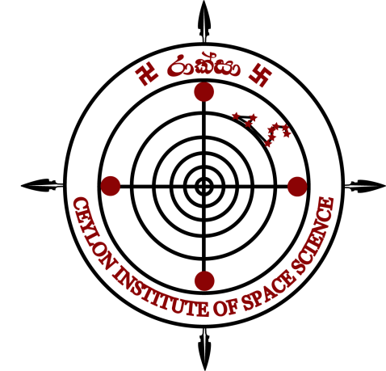

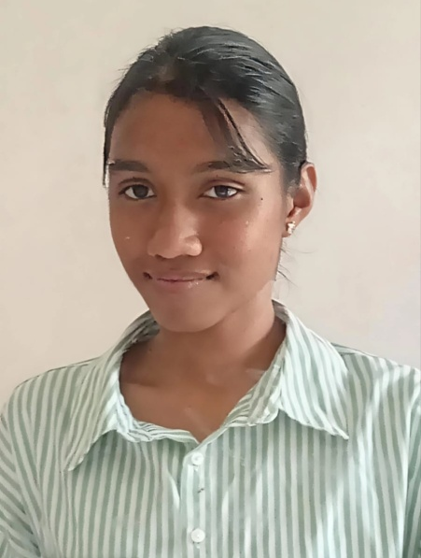
Session: Exoplanets, Icy moons, Asteroids
Thinuri Gawesha Rajapaksha
Ceylon Institute of Space Science
Sri Lanka
PCS 2026
23 - 10 - 2026

Slide 2
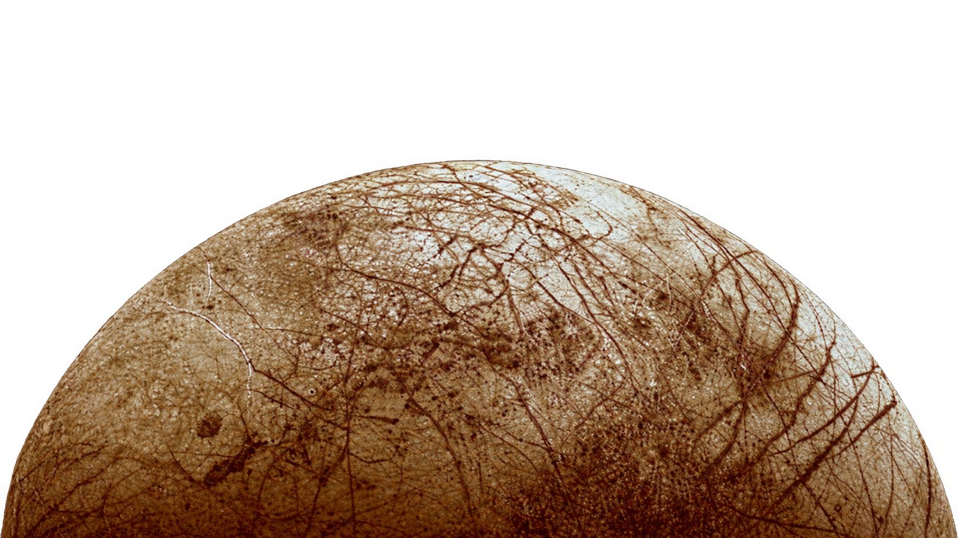
A Computational model to generate artificial L4/L5 states via auxiliary mass systems in the Jovian circular restricted three body problem to investigate Europa
By: Saumya Pathirana & Thinuri Rajapaksha
Speaker: Thinuri Rajapaksha
PCS 2026
23 - 10 - 2026

Slide 3
TABLE OF CONTENTS
Introduction……………………………………………………………………………………………….03
Stage 1 – First successful configuration………………………………………………………….04
Stage 2 – Search for smaller masses……………………………………………………………….05
Stage 3 – Stability test………………………………………………………………………………….06
Stage 4 – Natural system control…………………………………………………………………...07
Stage 5 – Simultaneous search……………………………………………………………………...08
Stage 6 – Sanity check and refined search………………………………………………………09
Stage 7 – Coarse to fine minimum mass search………………………………………………10
Summary……………………………………………………………………………………………………11
PCS 2026
23 - 10 - 2026

Slide 4
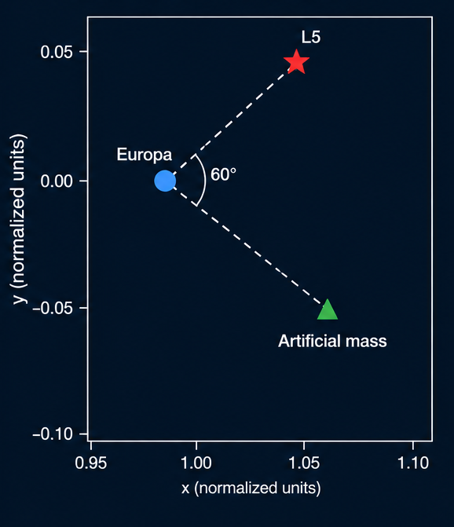
introduction
A simplified Jupiter–Europa rotating-frame model
Criteria for a successful configuration;
Positioning: equilibrium position < 5000km from the target.(L5-like point)
Stability: At a slight perturbation, maximum excursion < 0.05 normalized distance units
PCS 2026
23 - 10 - 2026

Slide 5
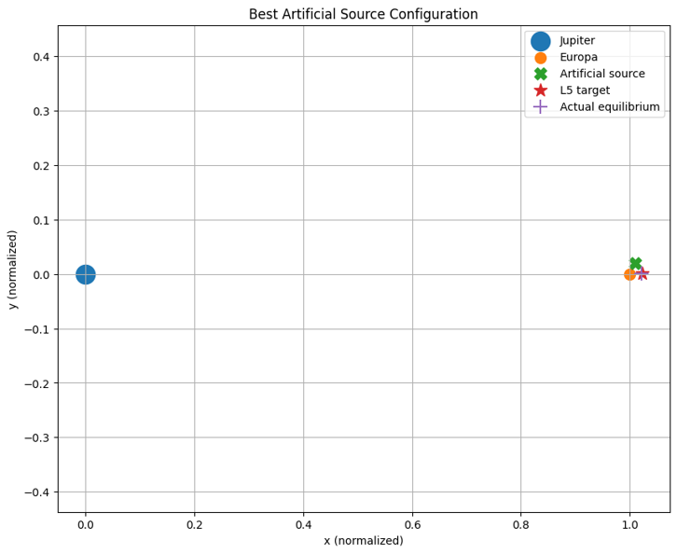
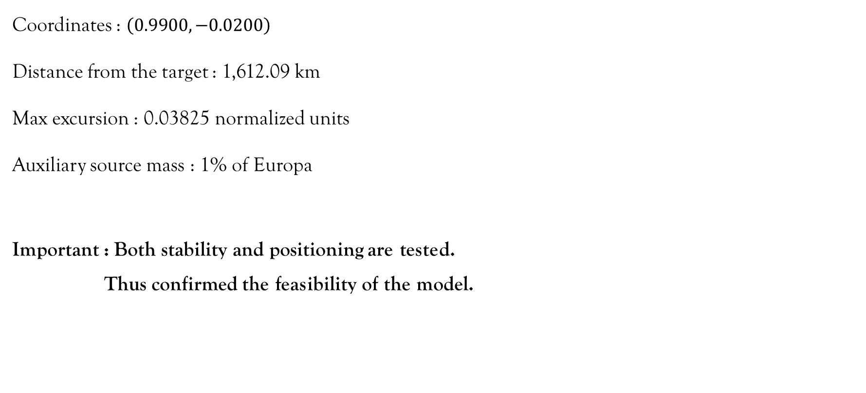
Stage 1 - First successful configuration
Coordinates : $\left(0.9900,−0.0200\right)$
Distance from the target : 1,612.09 km
Max excursion : 0.03825 normalized units
Auxiliary source mass : 1% of Europa
Important : Both stability and positioning are tested.
Thus confirmed the feasibility of the model.
PCS 2026
23 - 10 - 2026

Slide 6
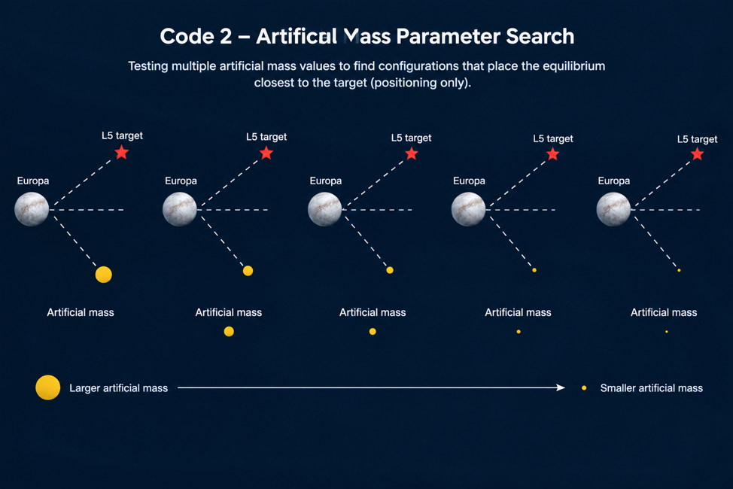
Stage 2 - Search for smaller masses
Tested 11 masses of range 1% to 0.01% of Europa.
Results
Coordinates :(0.9970,-0.0050).
Distance from the target : 548.64 km
Auxiliary source mass : 0.01% of Europa
Important : No stability test is performed.
PCS 2026
23 - 10 - 2026

Slide 7
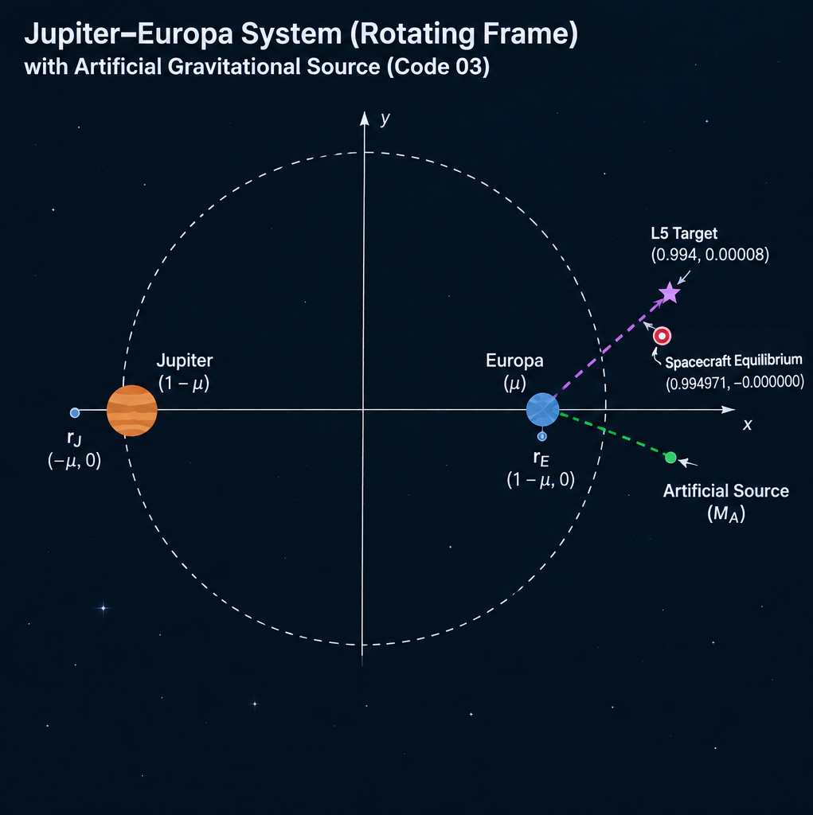
Stage 3 - Stability test
Stability test for configurations obtained in stage 2.
Results
Max excursions range : 130.49 to 132.79 normalized units. (results > 0.05 normalized units.)
All configurations failed.
Important : Only stability tests are carried out.
PCS 2026
23 - 10 - 2026

Slide 8
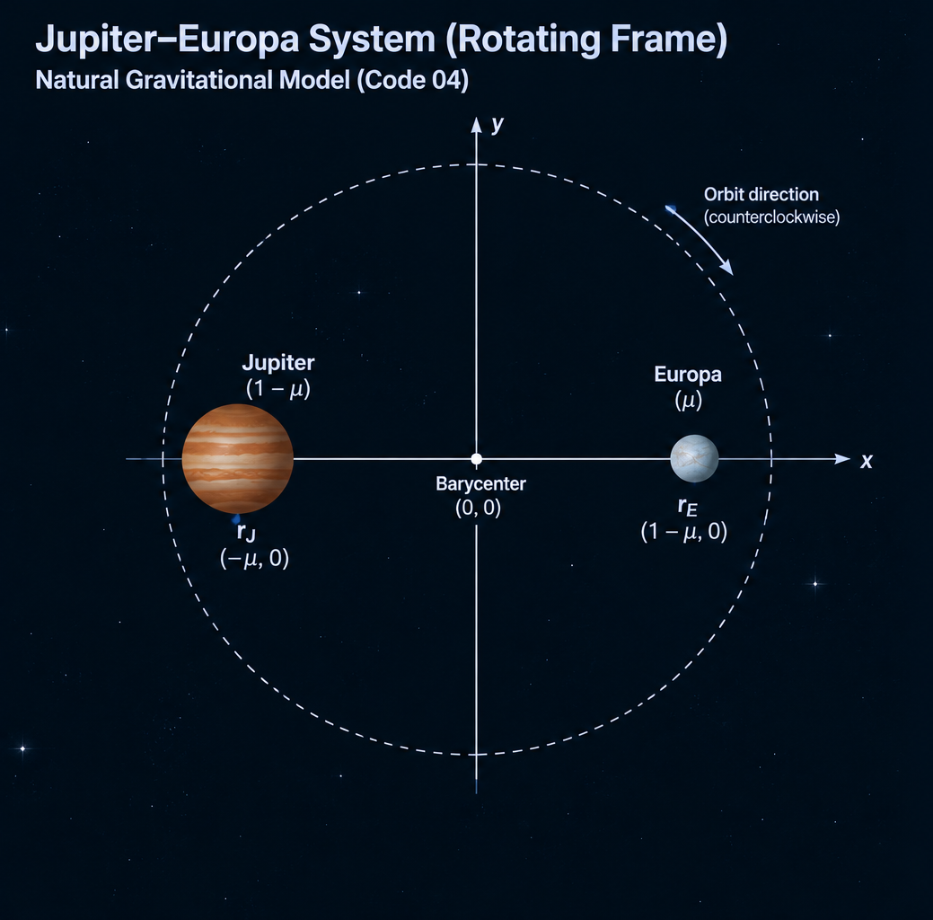
Stage 4 – natural system control
Results
Natural equilibrium: (1.754850, 0.000000)
Distance from target L5: 510,501.23 km (> 5000km)
Maximum excursion: 128.27893 normalized units (>0.05)
Maximum excursion: 86,087,986.59 km
Important : Confirms the effect of the auxiliary mass
on the previous results.
PCS 2026
23 - 10 - 2026

Slide 9
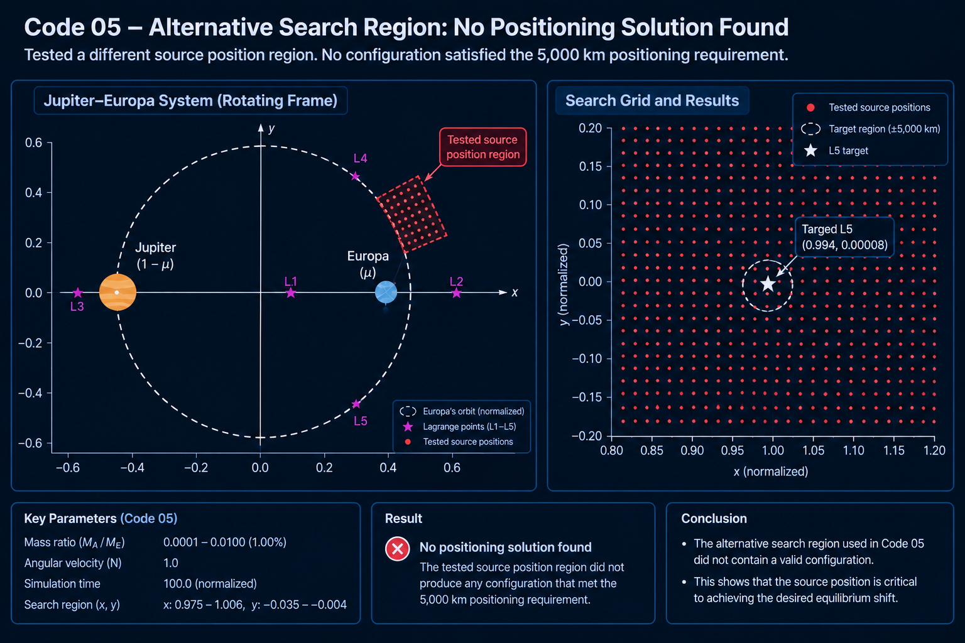
Stage 5 – simultaneous search
Performed in 2 steps.
1. Equilibria search 2. Stability test
21 artificial-source masses and 256 source positions per mass.
Closest configuration : 955,000 km from target. (> 5000km)
Important : Since positioning failed,
no stability tests were performed.
PCS 2026
23 - 10 - 2026

Slide 10
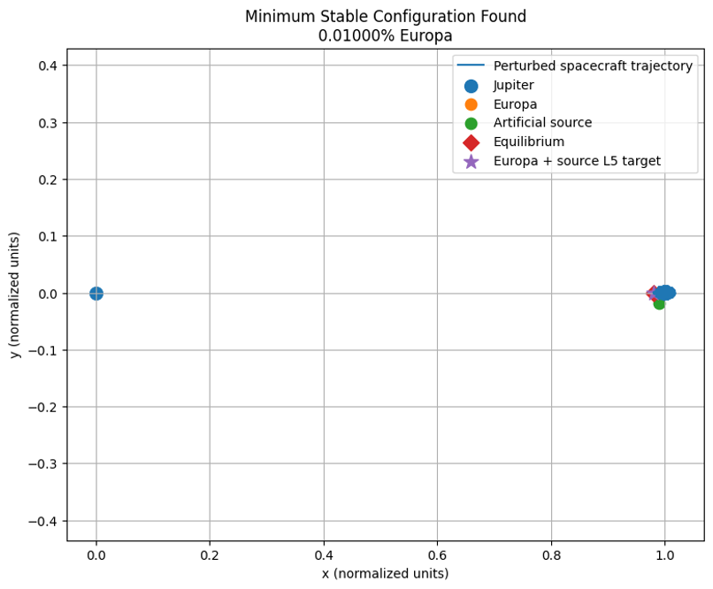
Stage 6 – sanity check & refined search
Mass range : 0.0100% - 0.0001% of Europa.
Step 1 : Sanity check for 1% mass configuration. (passed)
Step 2 : Refined the search around the previously successful region.
Results
Coordinates : (0.9900,-0.0175)
Distance from the target : 87.41 km
Max excursion : 25,691.87 km
Auxiliary source mass : 0.01% of Europa
PCS 2026
23 - 10 - 2026

Slide 11
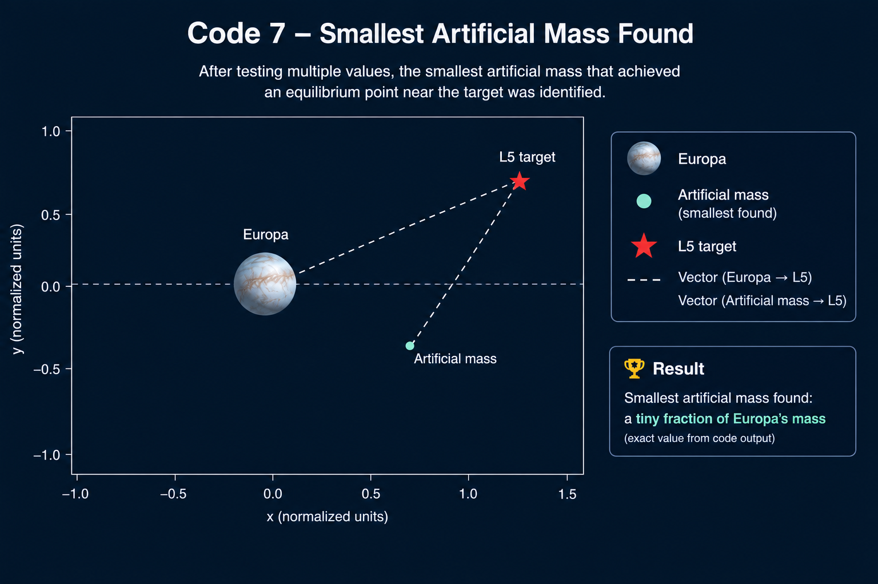
Stage 7 – coarse to fine minimum mass search
Results (coarse search)
Coordinates : (0.9900, -0.0175).
Distance from the target : 88.26 km
Max excursion : 25,711.47 km
Auxiliary source mass: 0.00001%
Results (Refined search)
Coordinates : (0.9797624073, −0.0000000008)
Distance from the target : 79.620 km
Max excursion : 25,710.888 km
Auxiliary source mass: 0.000005%
PCS 2026
23 - 10 - 2026

Slide 12
summary
Objective: Shift a spacecraft equilibrium toward a predefined L5-like target near Europa.
Method: Simplified Jupiter–Europa CR3BP model using Python simulations.
Coarse search: 0.00001%.
Fine refinement: 0.000005%.
Best result: Equilibrium - target 79.62 km
Stability test: Maximum simulated excursion, 25,711 km.
Conclusion: A theoretical proof of concept within the tested model and conditions.
PCS 2026
23 - 10 - 2026

