Slide 1
Some early History in Neutrino Physics; Cerca 1960s
Reducing Background in Germanium Detectors
Early Developments, Recent Applications
Some Issues for CUPID
Frank Avignone
University of South Carolina
Columbia, South Carolina, USA
1

Slide 2
2

Slide 3
3

Slide 4
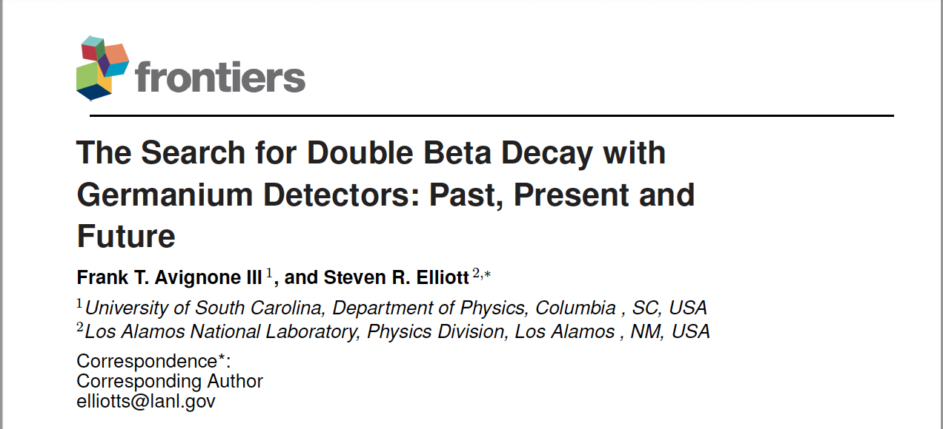
4

Slide 5
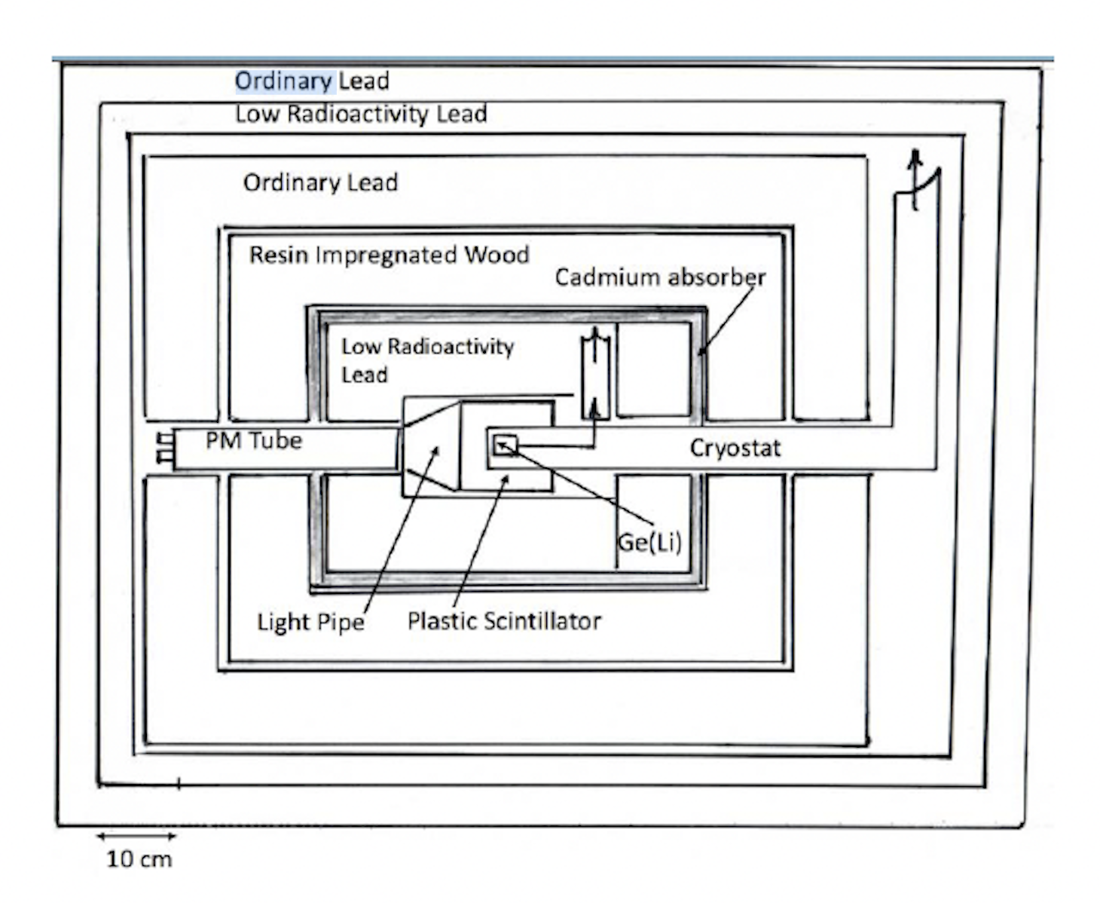
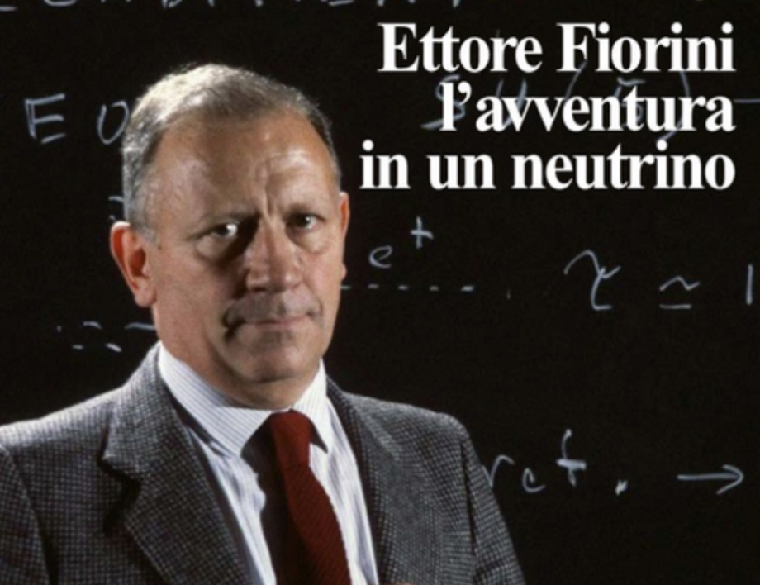
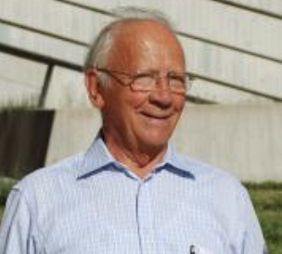
The Beginning of my story was reading the article by Ettore Fiorini et al., “A search for lepton non-conservation in double beta decay with a germanium detector.” Physics Letters B 25 (1967) 602
This started a long series of experiments finally ending with isotopic enrichment with: GERDA, MAJORANA and LEGEND-200 and the projected future LEGEND-1000.
The Mont Blanc Tunnel Experiment
5
April 1933 to April 2023

Slide 6
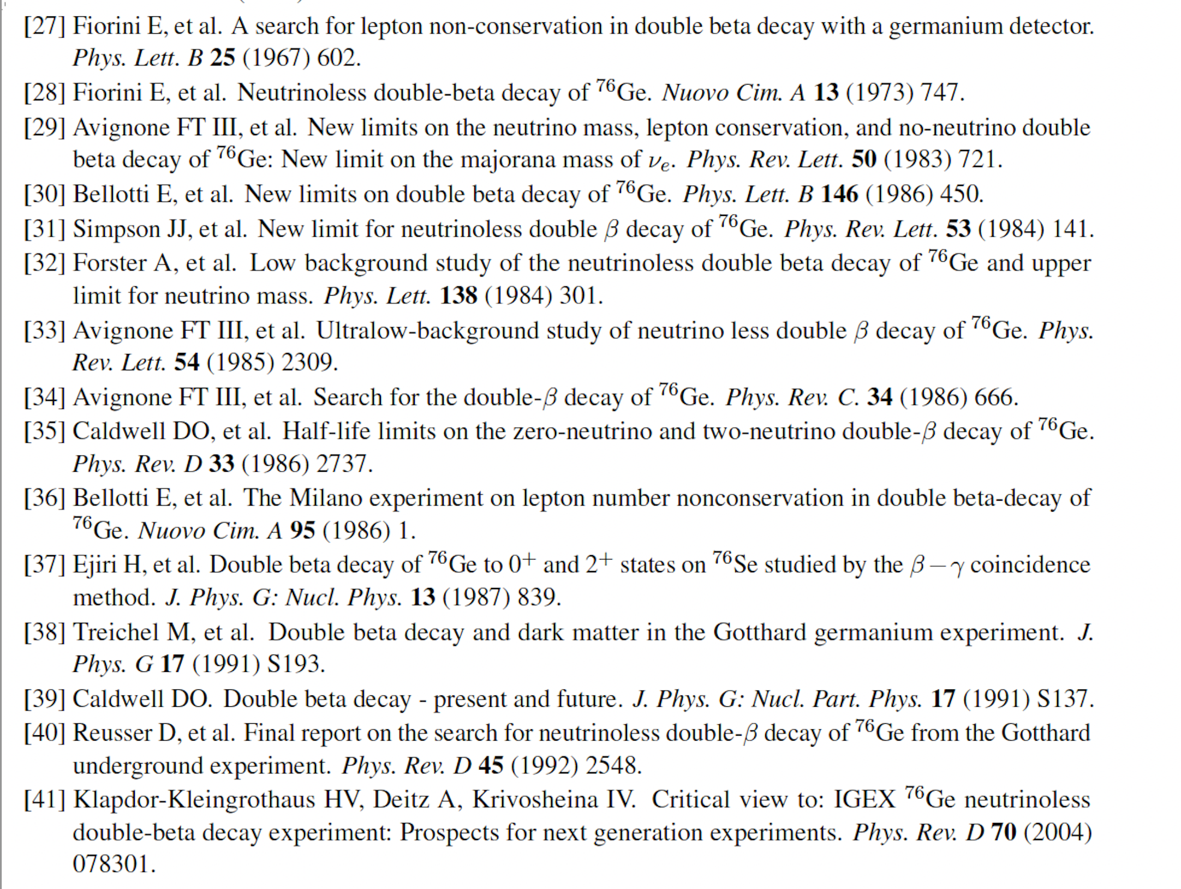
6

Slide 7
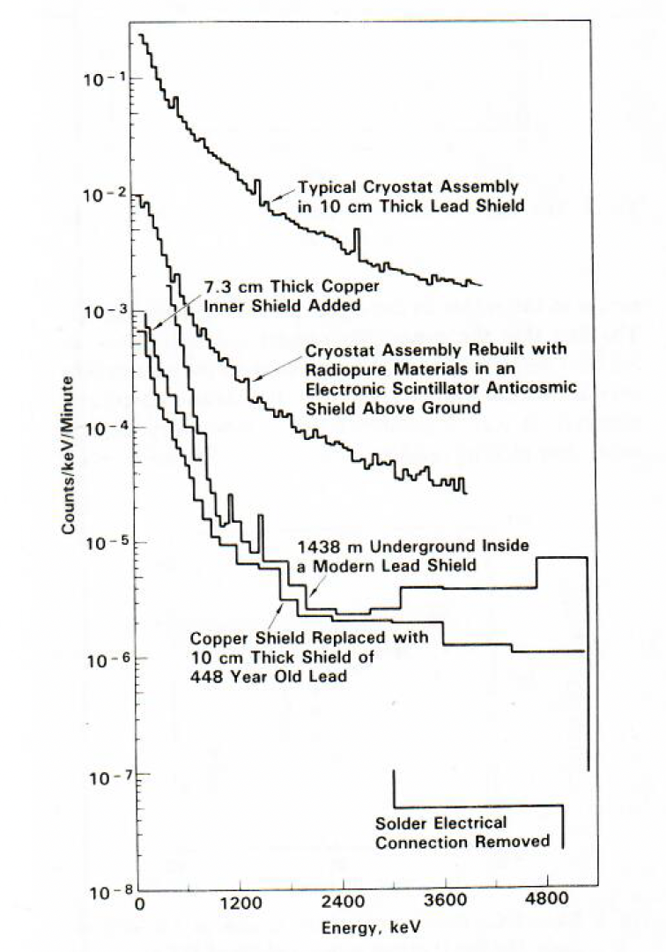
PNL-USC 1980 - 1983
A. Ordinary Cryostat Assembly and 10 cm of lead
B. New Cryostat, Selected Materials, Anti-cosmic Shield, Above Ground
C. 4000 Meter Water Equivalent Overburden, Modern Lead & Copper
Inner Shield
D. Replace Copper Shield With 10 cm of 448 Year old Spanish Galleon
Ballast Lead
E. Replace a Lead Solder Connection with a Crimp Connector.
A
B
C
D
E
7

Slide 8
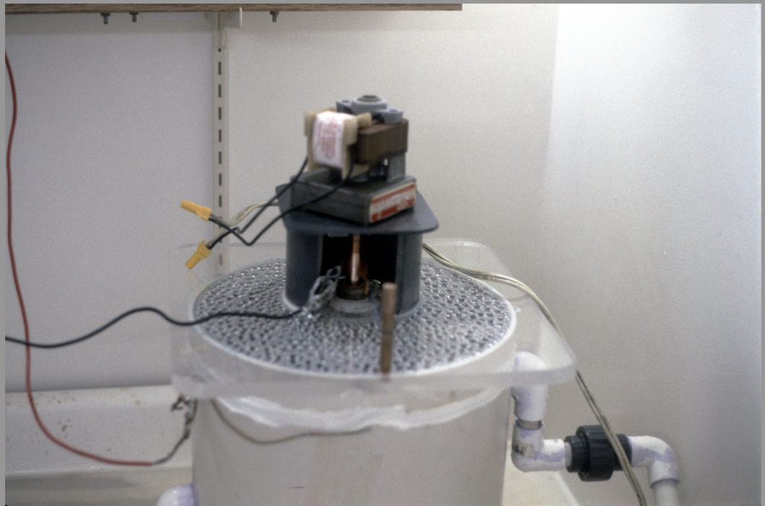
Let’s Try Electroforming a Copper Cryostat!
8

Slide 9
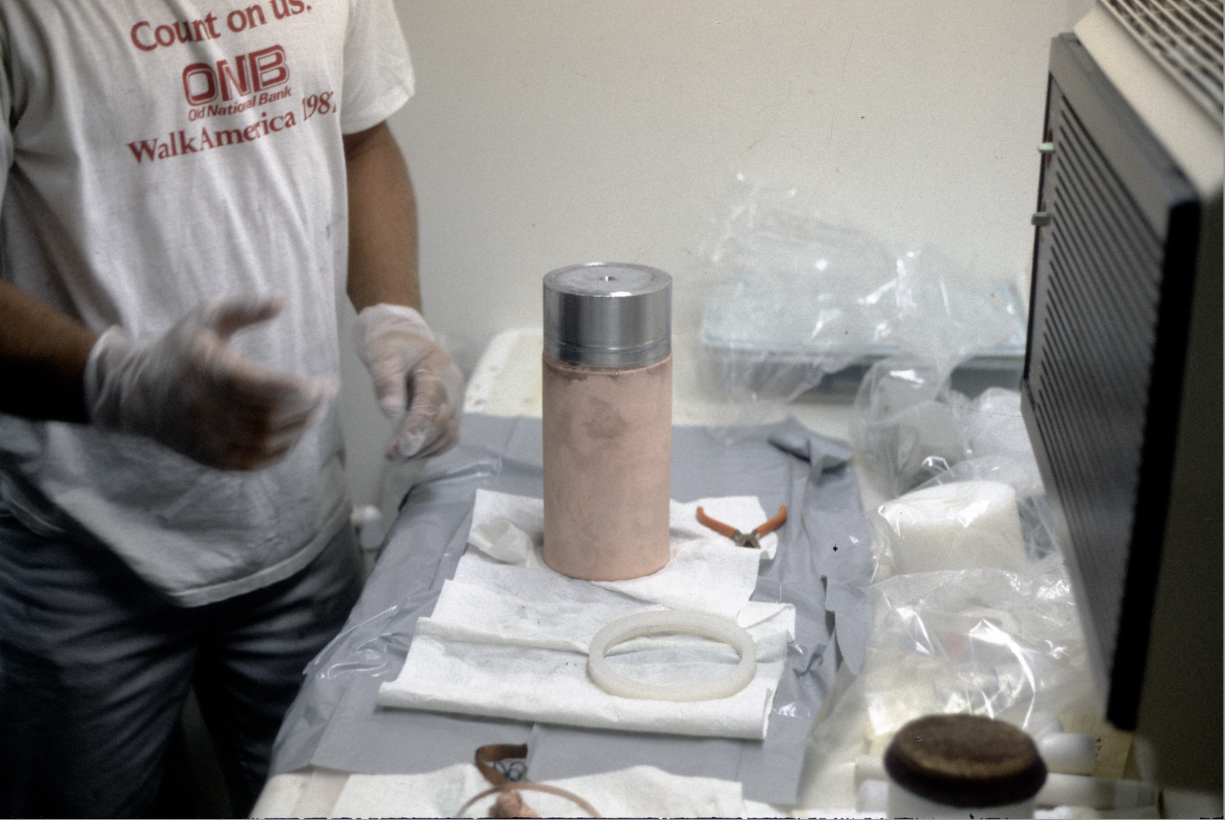
Looks Promising!
9

Slide 10
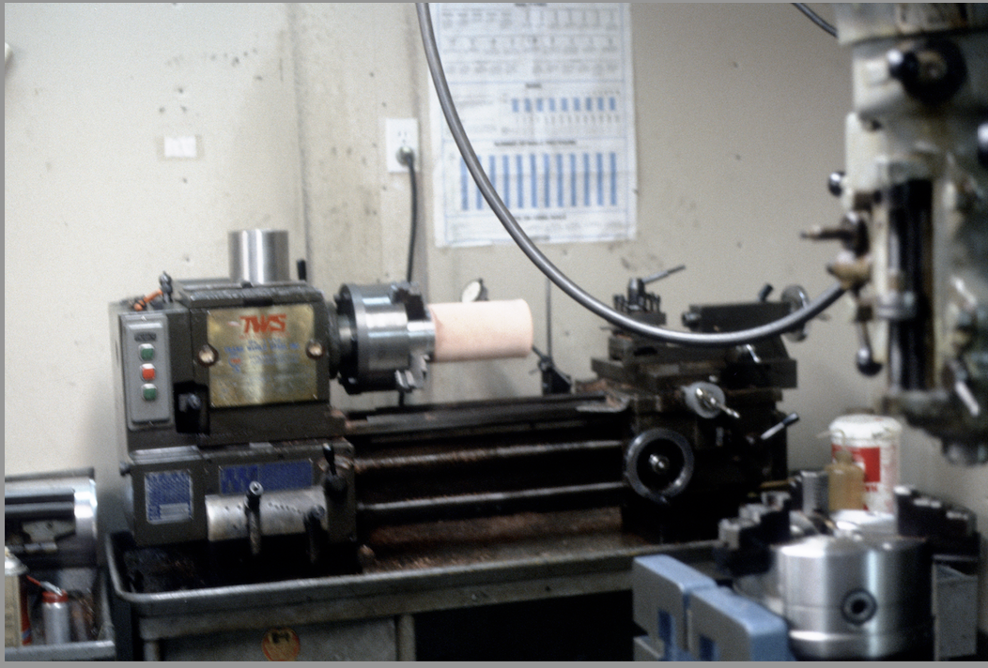
Cerca 1983, Jim Reeves’ Garage
10

Slide 11
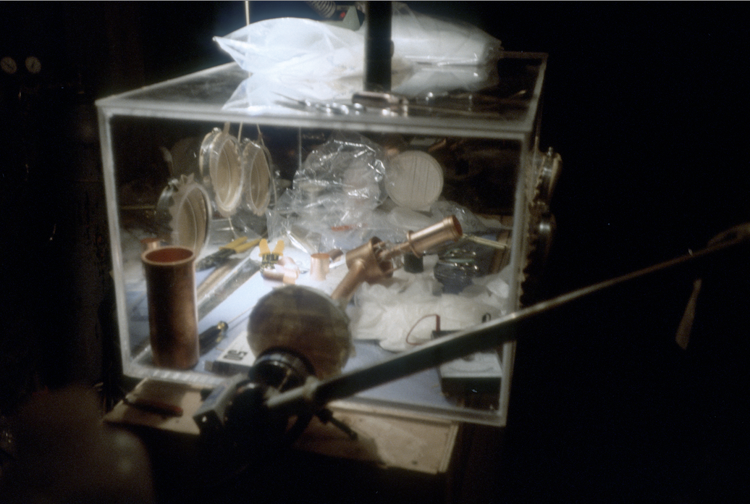
This Was Our First Attempt Made in the Early 1980s For the First Dark=Matter Search
11

Slide 12
12

Slide 13
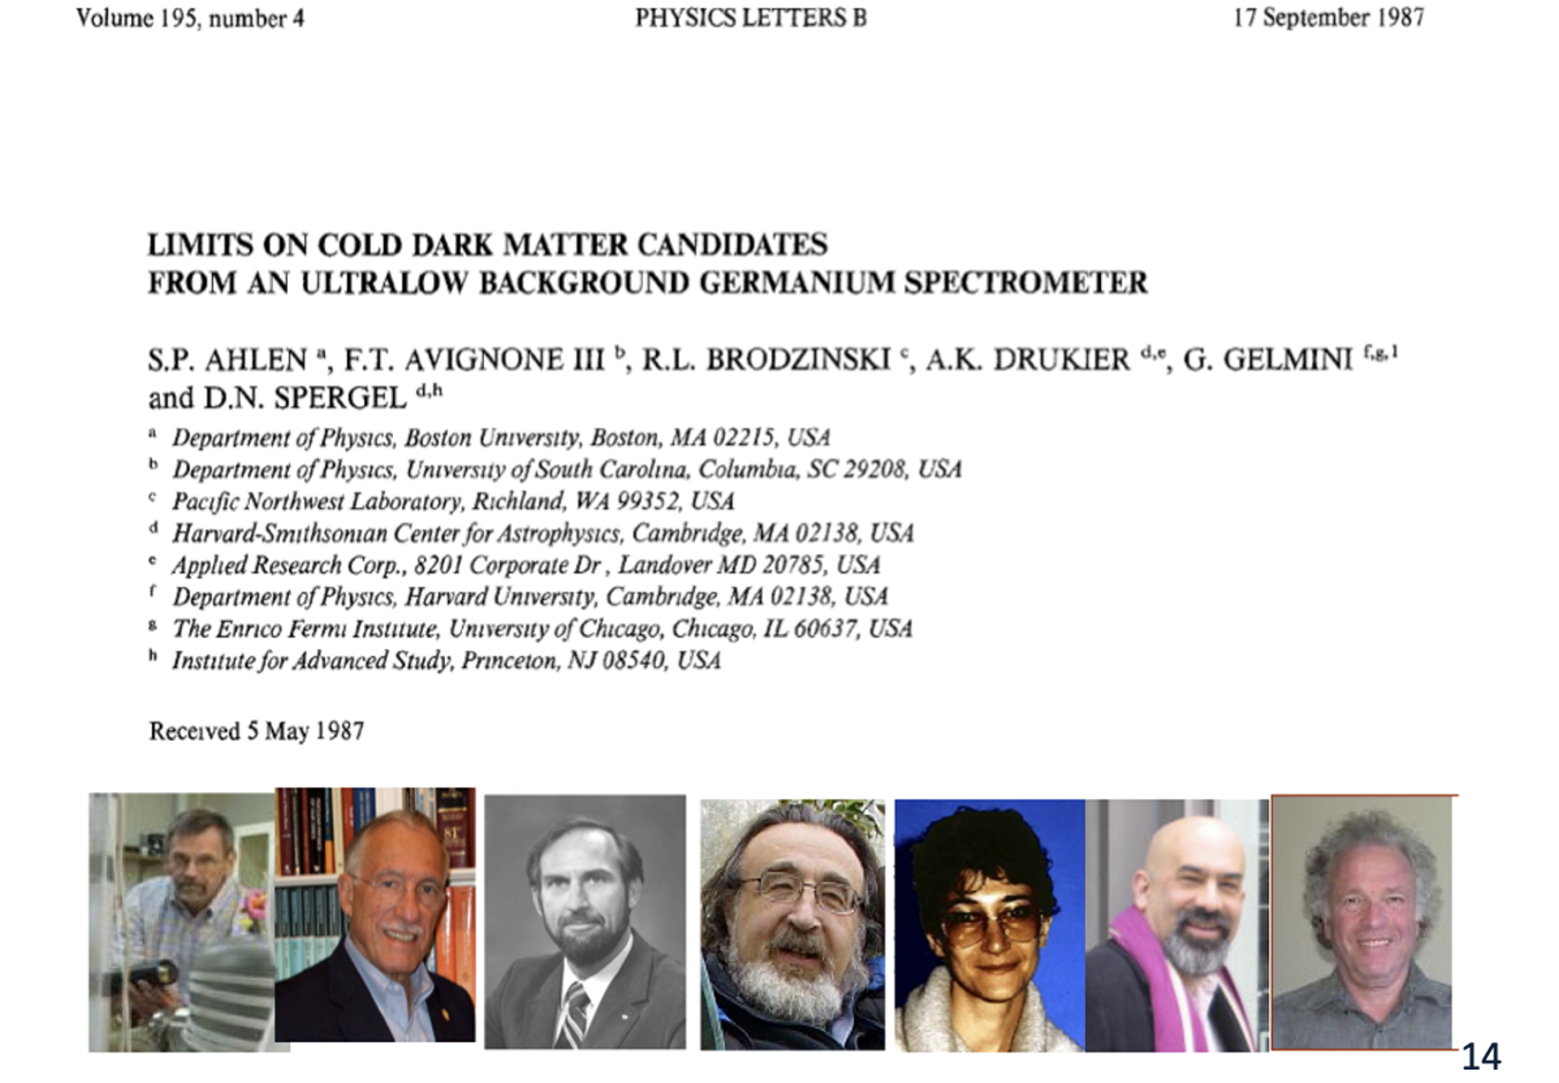
13

Slide 14
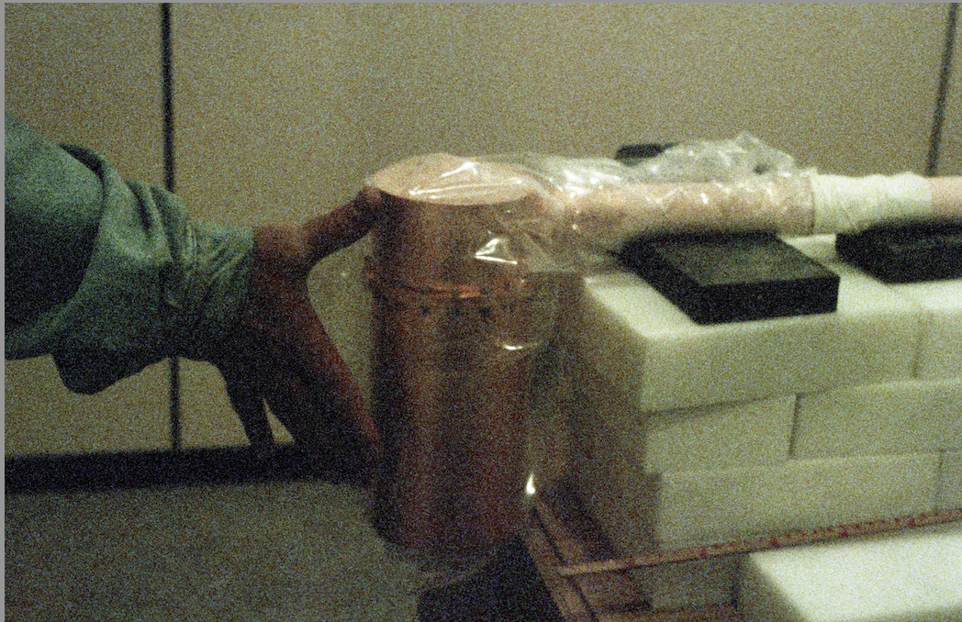
The First Attempt at an IGEX Cryostat.
14

Slide 15
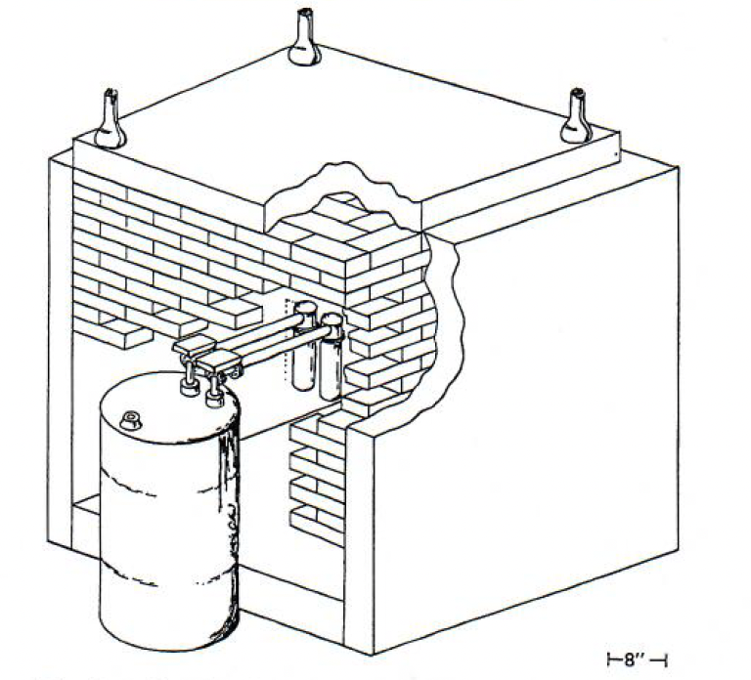
Pacific Northwest-Univ. South Carolina
~1988
The International Germanium
Experiment “IGEX” Format.. Two 100% Efficient Ge Detectors in Electroformed Copper Cryostats.
15

Slide 16
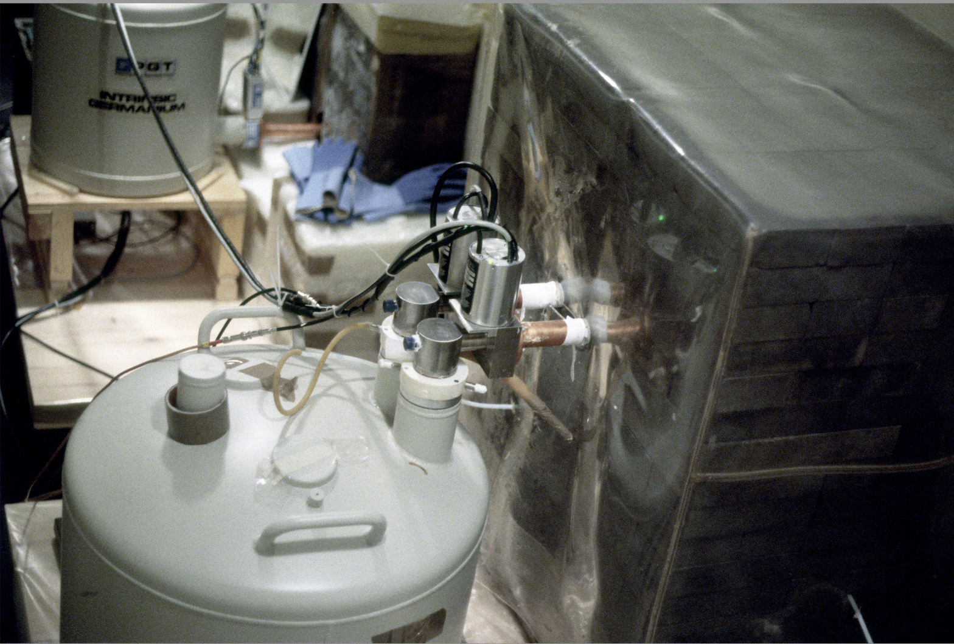
Pacific Northwest-Univ. South Carolina
~1988
The International Germanium
Experiment “IGEX” Format.. Two 100% Efficient Ge Detectors in Electroformed Copper Cryostats.
16

Slide 17
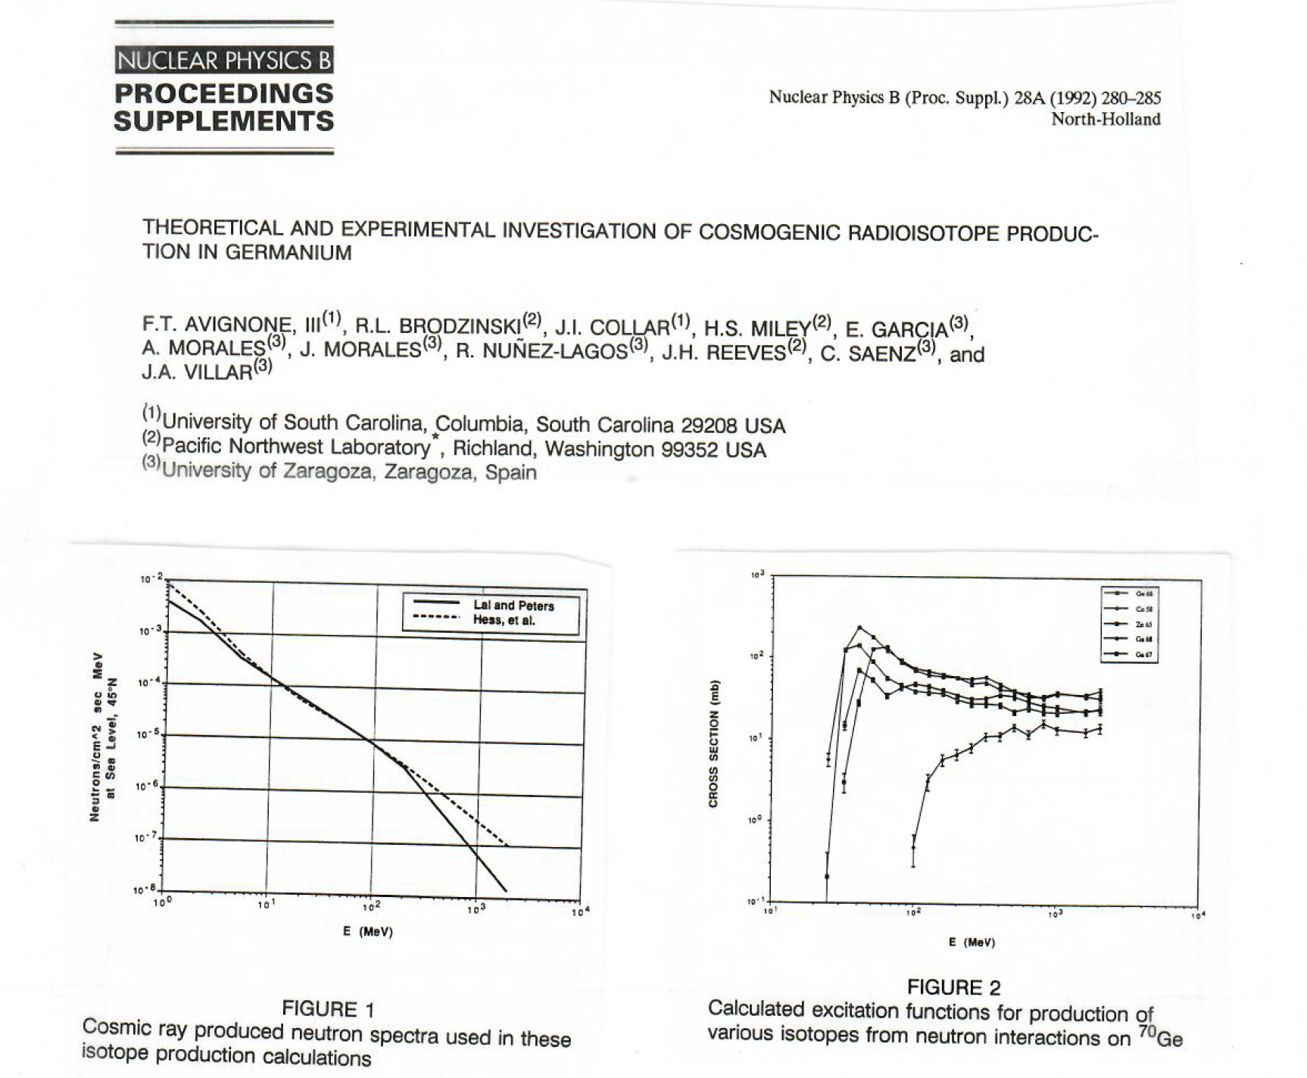
17

Slide 18
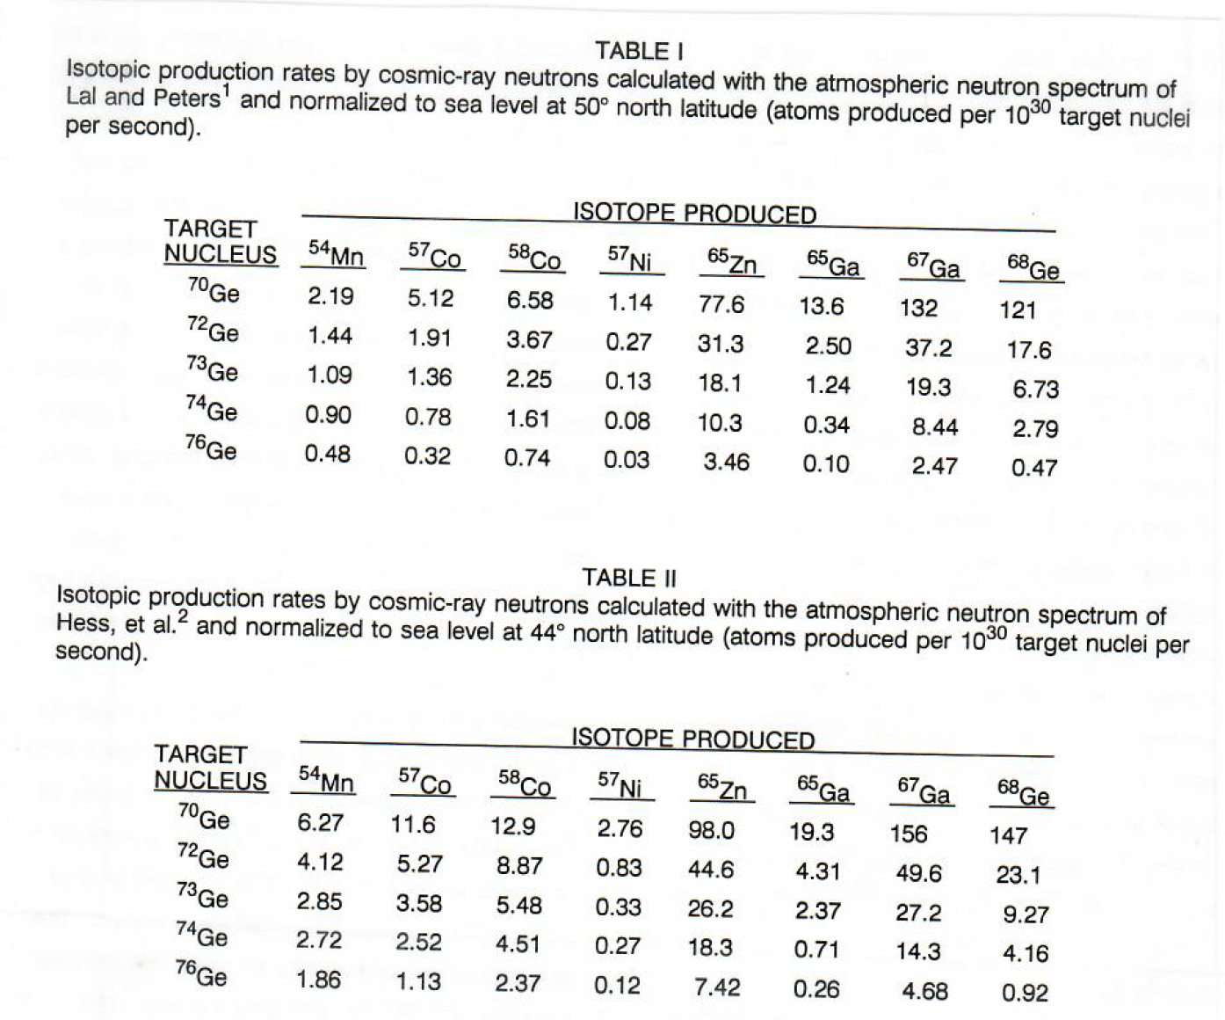
18

Slide 19
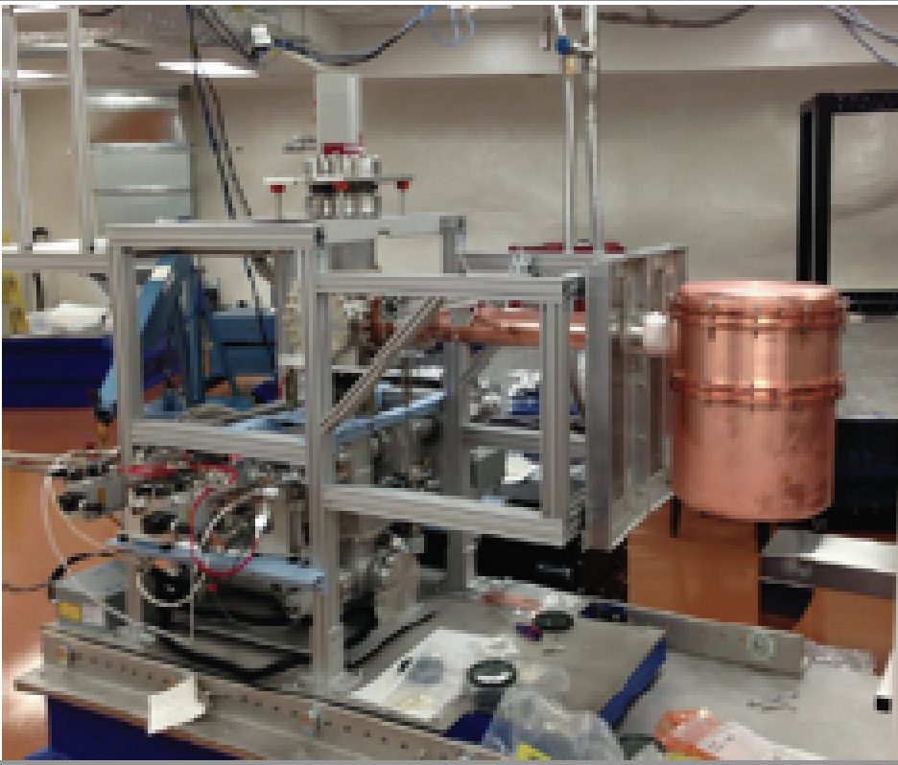
The MAJORANA DEMONSTRATOR Collaboration via PNNL Grows Major Copper Parts
19

Slide 20
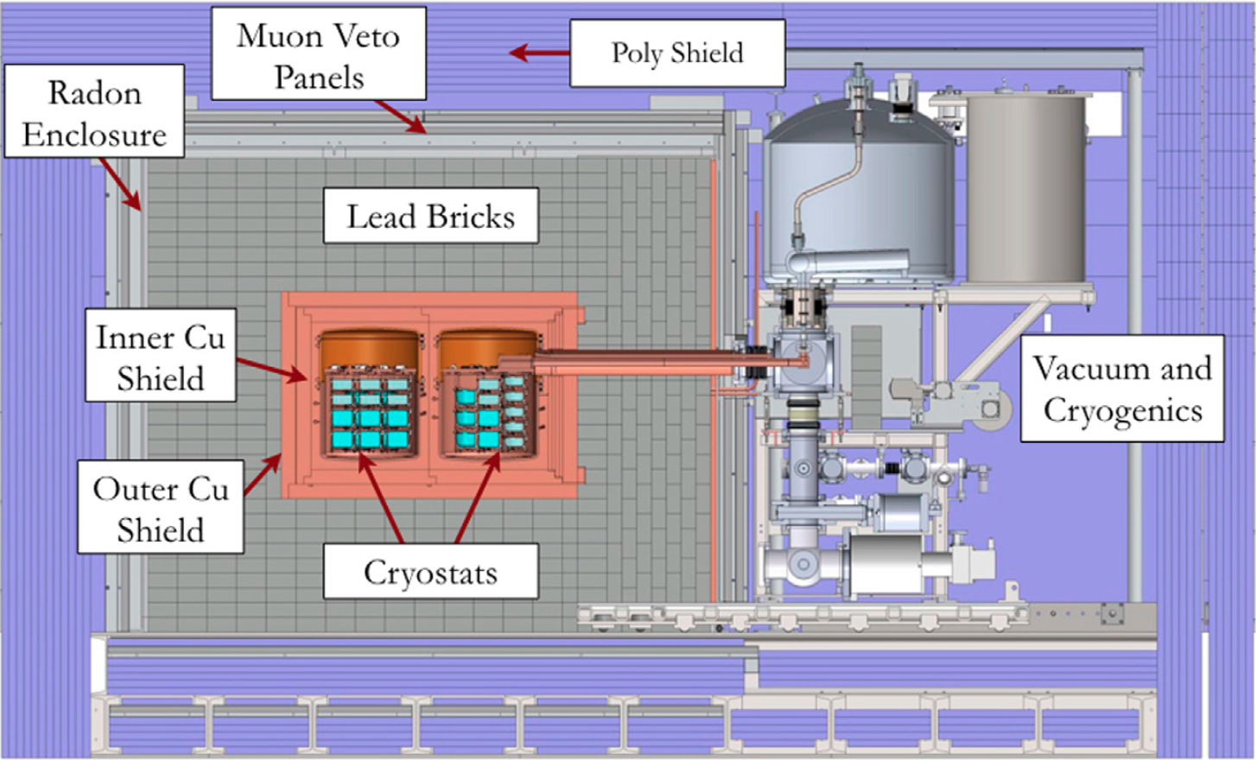
In MAJORANA, Even Large Pieces of Inner Shielding Were of Electroformed Copper!
20

Slide 21
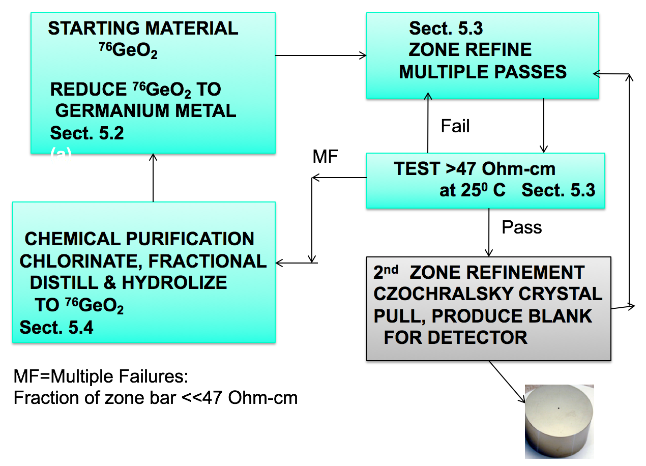
21

Slide 22
50 KW RF
22

Slide 23
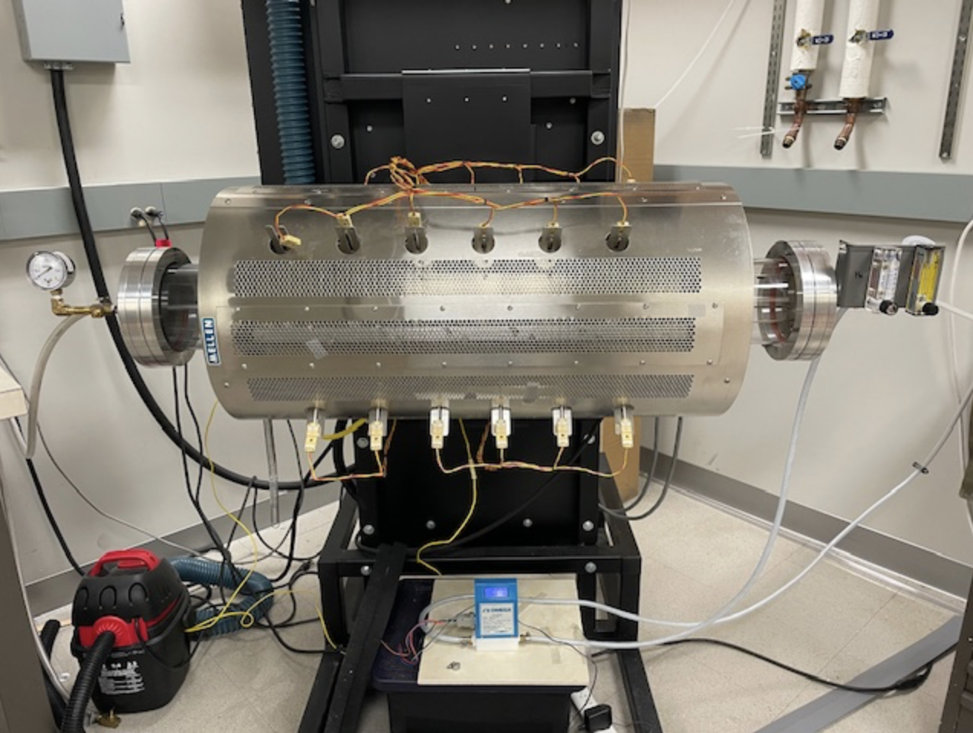
The MELLEN Sunfire Furnace
Purchased be the University of South Carolina with NSF Funding.
It is about 7 ft between Flanges.
It Runs by Heating Coils that are Programmed to Move Heat Zones at Selected Speeds over the Sample.
It needs 80 Amps of 240 V
Single Phase power.
For Pure N² Gas, One Uses Gas from a LN-Tank
That lasts for more than 30 d.
23

Slide 24
This is a Perfectly Safe Device!
Any Undergraduate or Graduate Student can Master its Operation in a very Brief Time.
The Contacts Shown are Low-Voltage Thermistor Wires.
Touching The Main Body During Operation is safe.
Very minor Burns Can Occur by Touching the End Flanges During Operation.
24

Slide 25
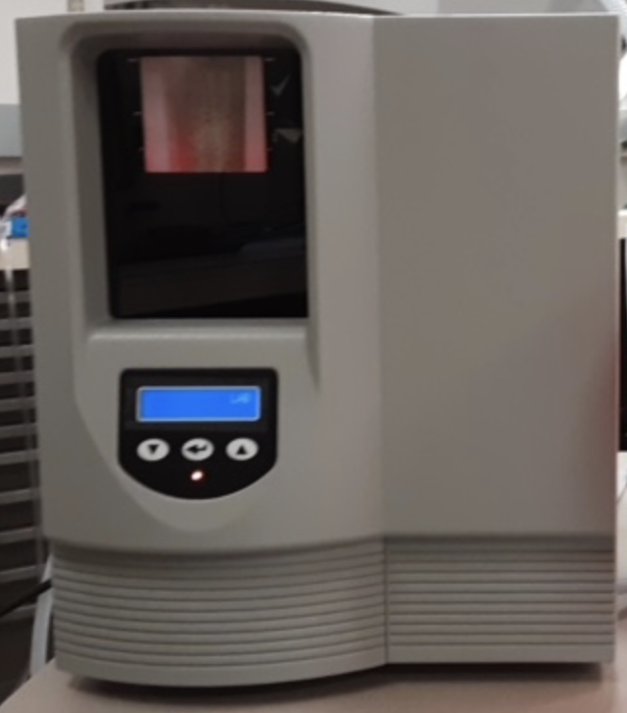
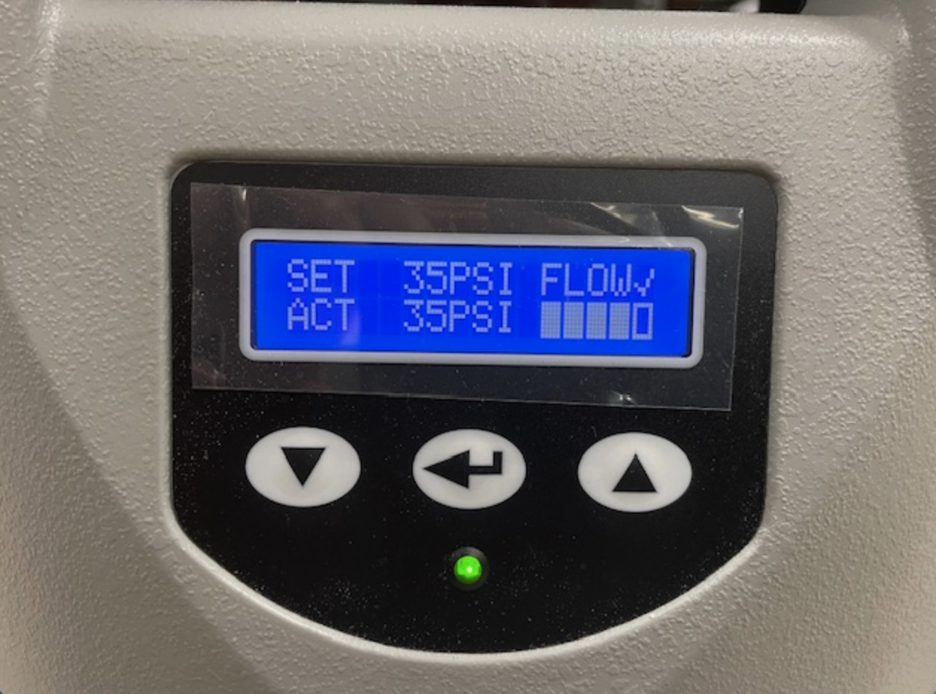
For Hydrogen we use a Parker-Hannaford 100 cc/min generator.
The price is < 10 K$
It eats only Deionized Water.
25

Slide 26
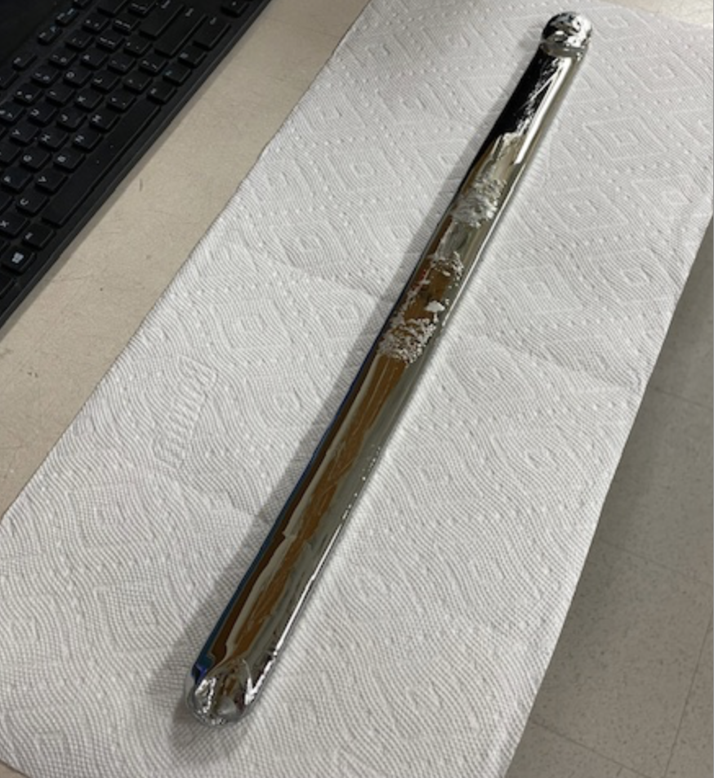
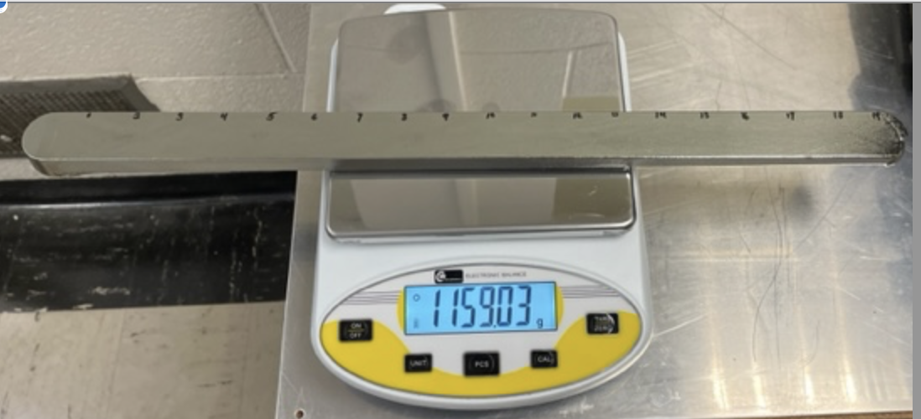
A 1.16 kg bar of Zone-refined Ge ready to be M Measured for Resistivity
26

Slide 27
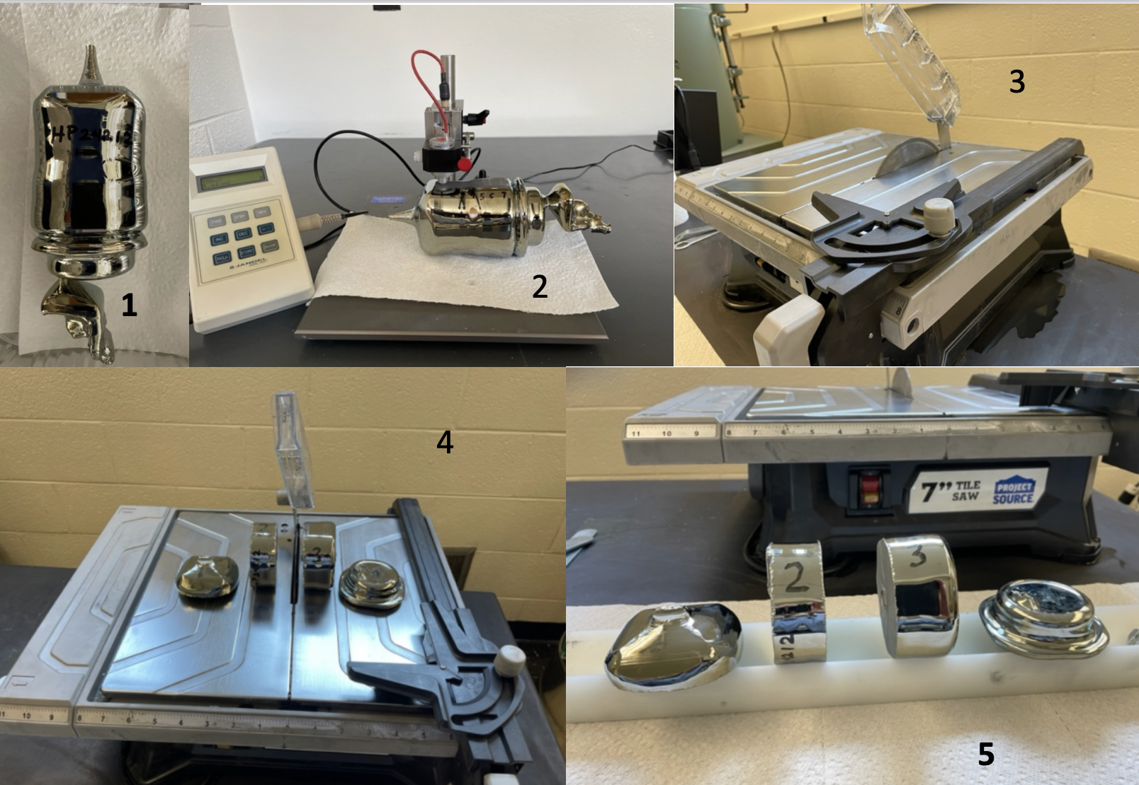
50 KW RF
27

Slide 28
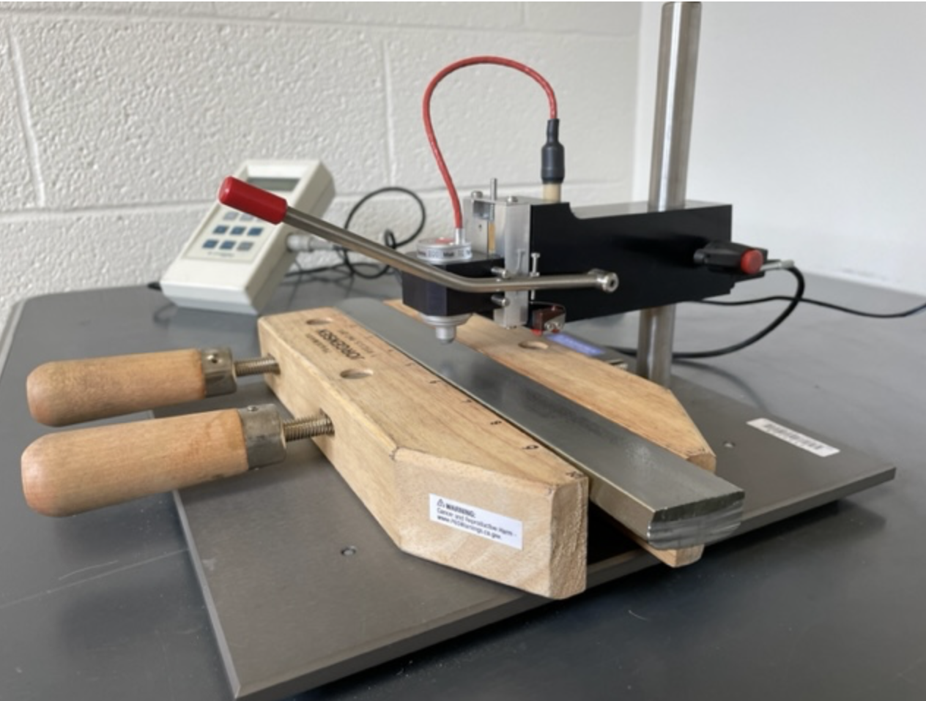
A Jandel Four-Probe Resistivity Measurement set-up.
What about temperature control?
28

Slide 29
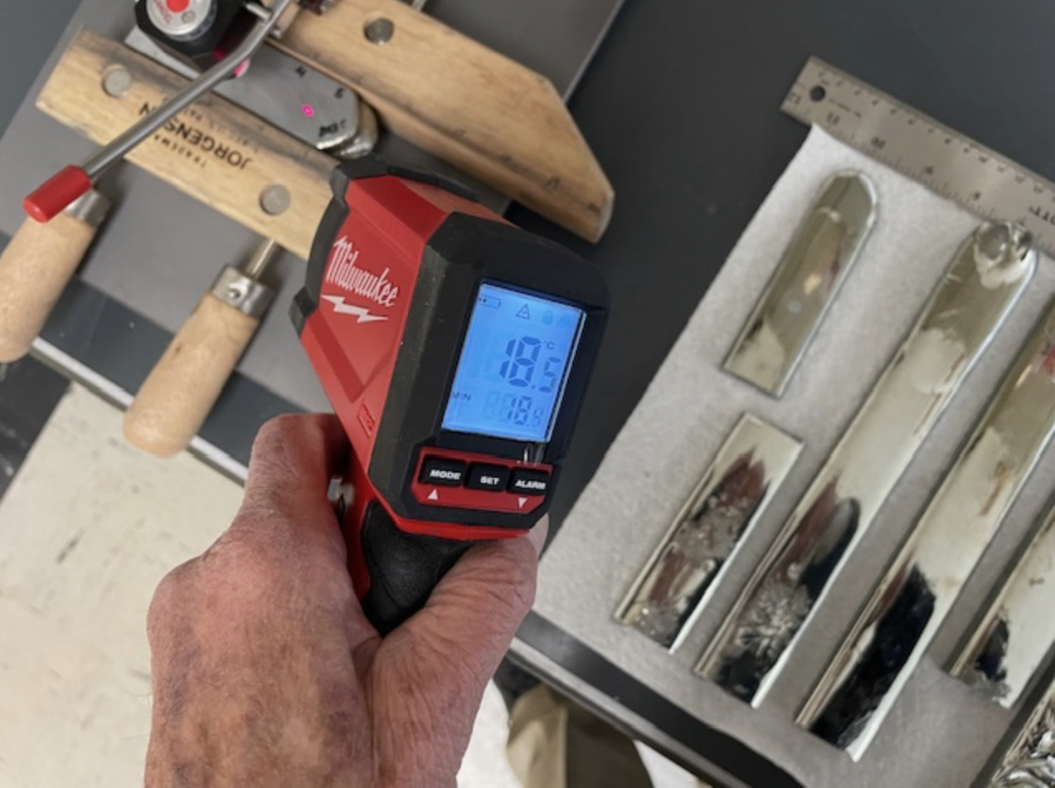
The Industrial standard is to have a temperature-controlled room to keep everything at 20C.
This is costly and unnecessary!
Instead, just use High-quality Laser Thermometer. Then make the small corrections given in the Table on the next view.
29

Slide 30
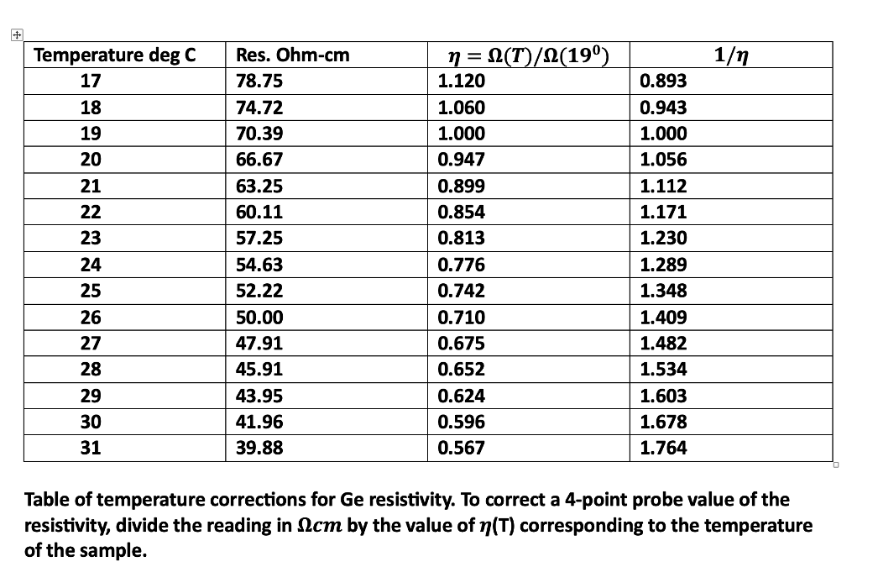
29

Slide 31
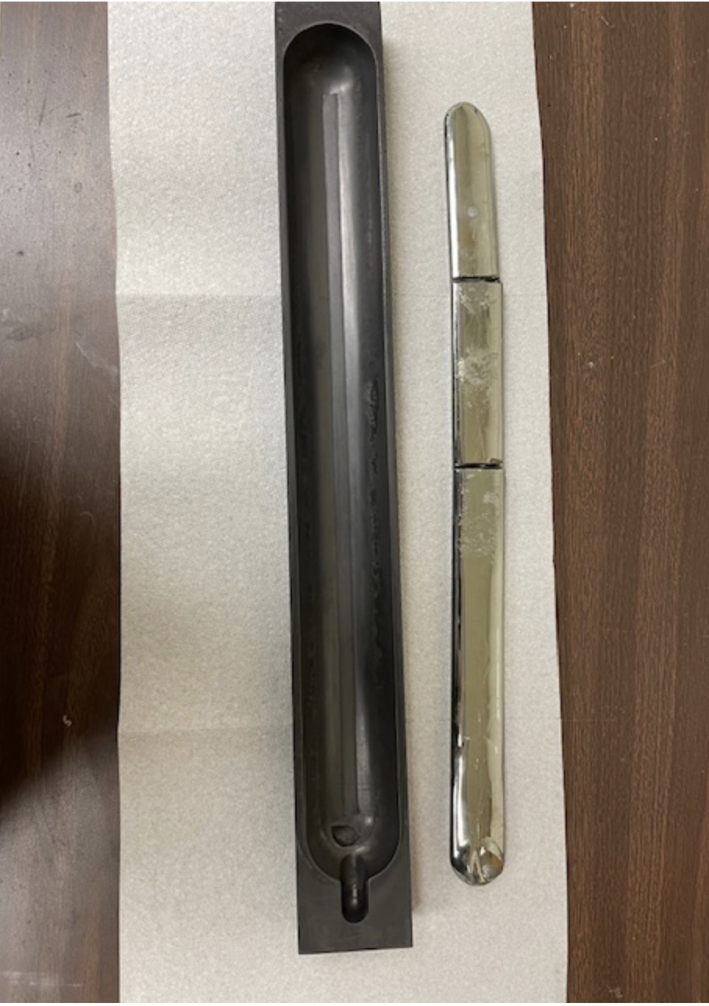
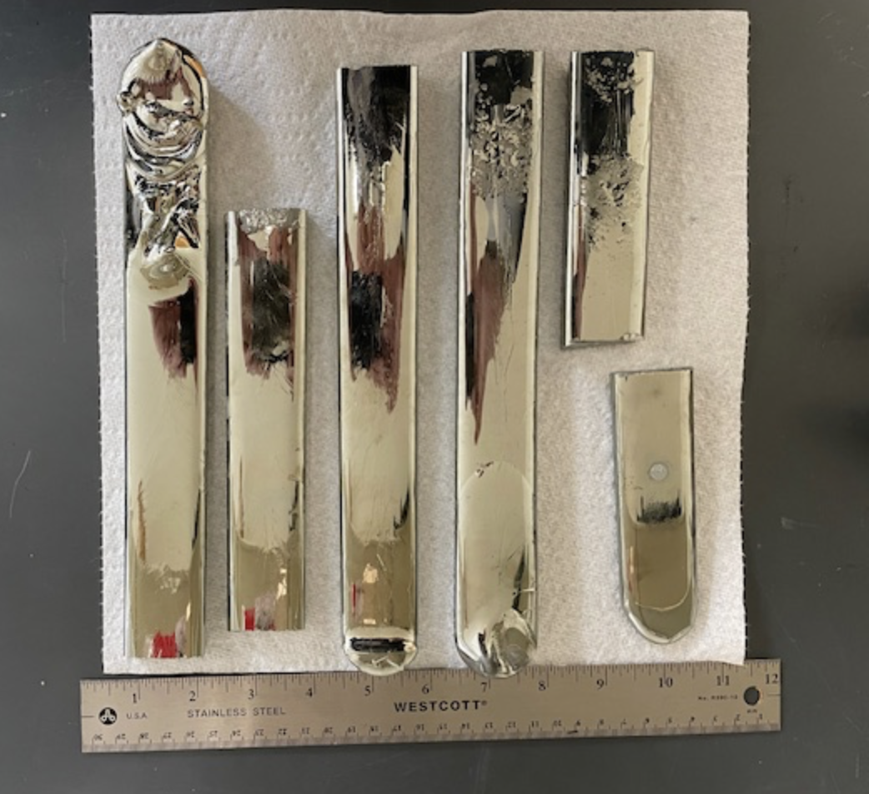
30

Slide 32
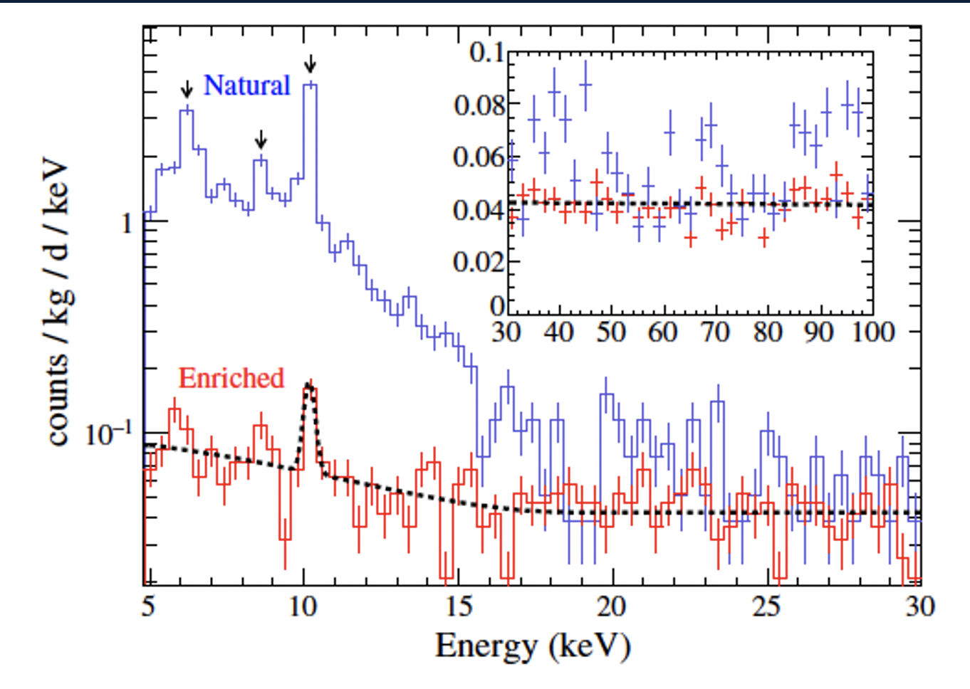
Tritium Production in Ge by Cosmic-Ray Neutrons; How to Minimize it.
The SUNFIRE could be placed underground, or near an underground space, with some overburden to reduce cosmic-ray activation of the Ge.
The plot shows spectra from (red) Ge detectors made from Ge that remained underground whenever not in production. The ³H-beta spectrum is significantly Reduced.
Figure taken from the MAJORANA
Publication-NIM, A 877,314 (2018)
31

Slide 33
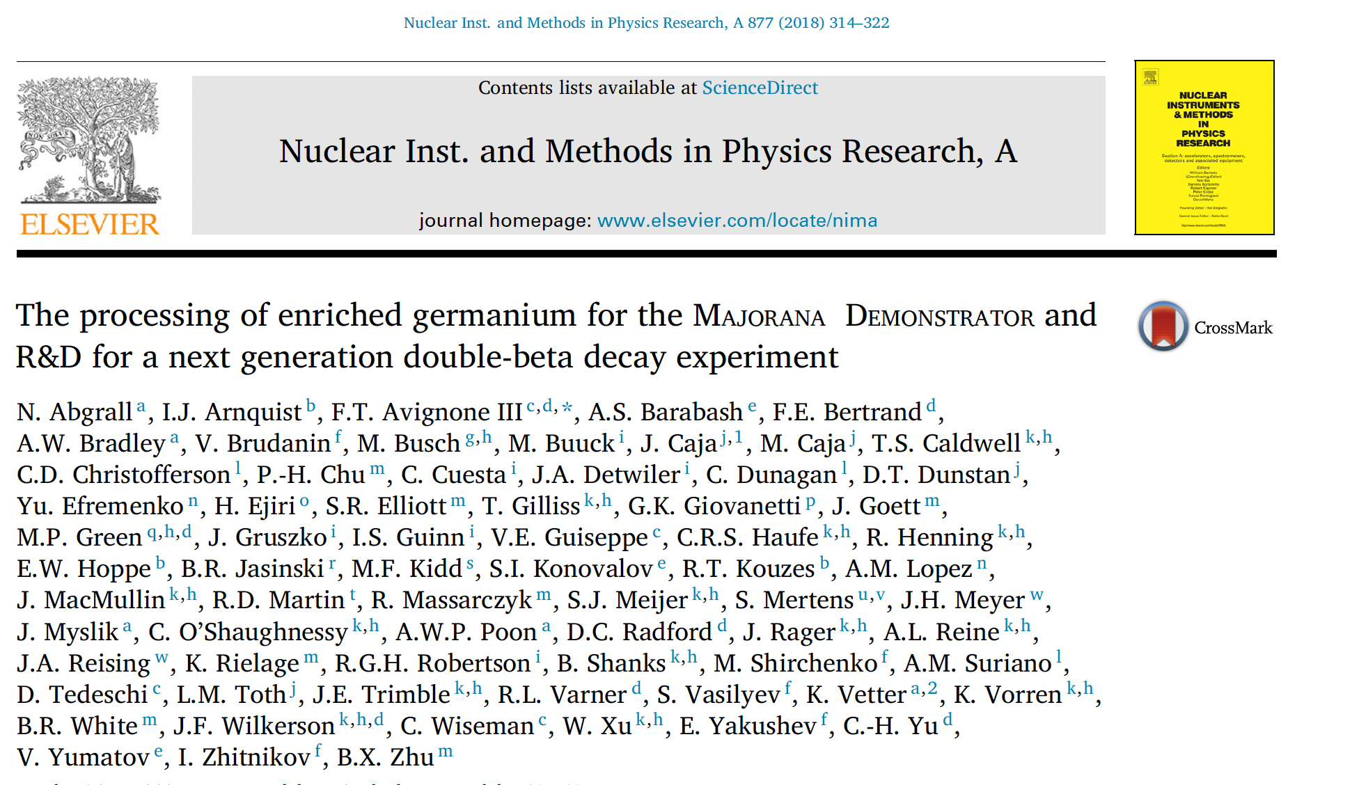
32

Slide 34
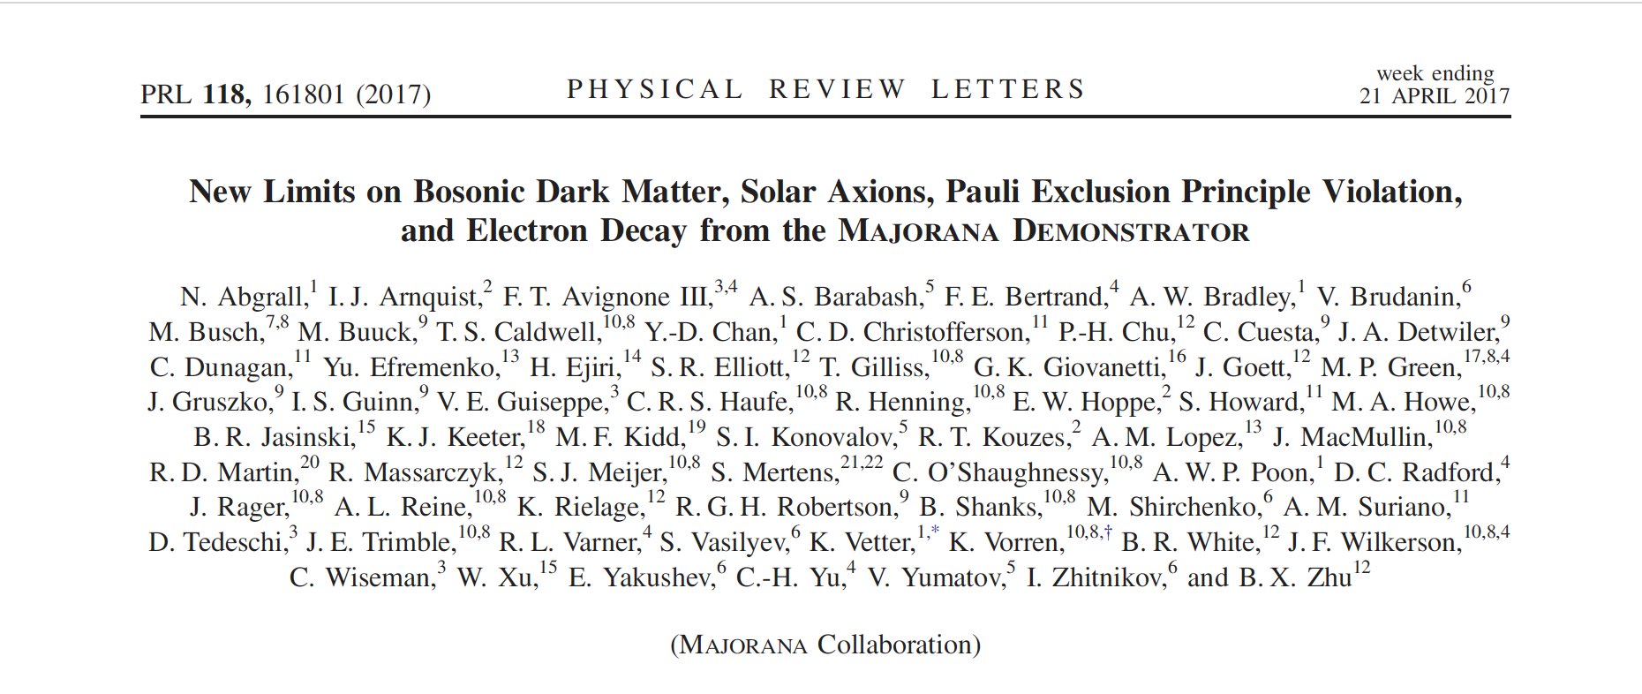
33

Slide 35
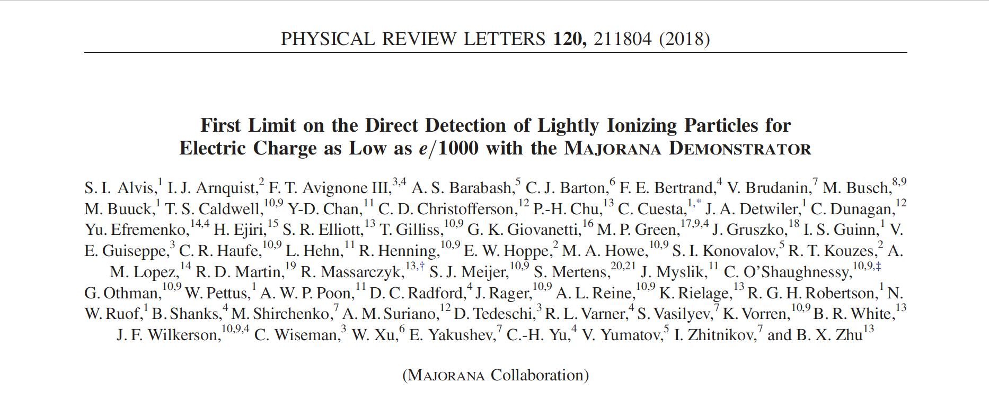
34

Slide 36
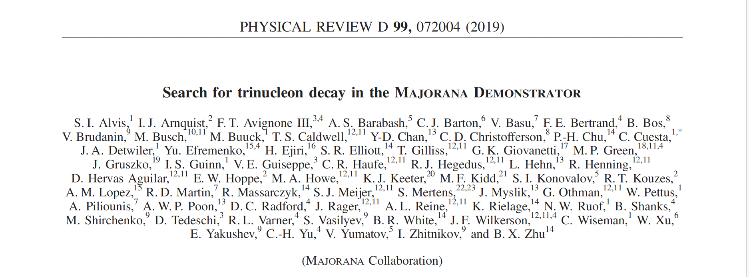
35

Slide 37
How about purification of the initial materials for the Li₂MoO₄ for CUPID?
36

Slide 38
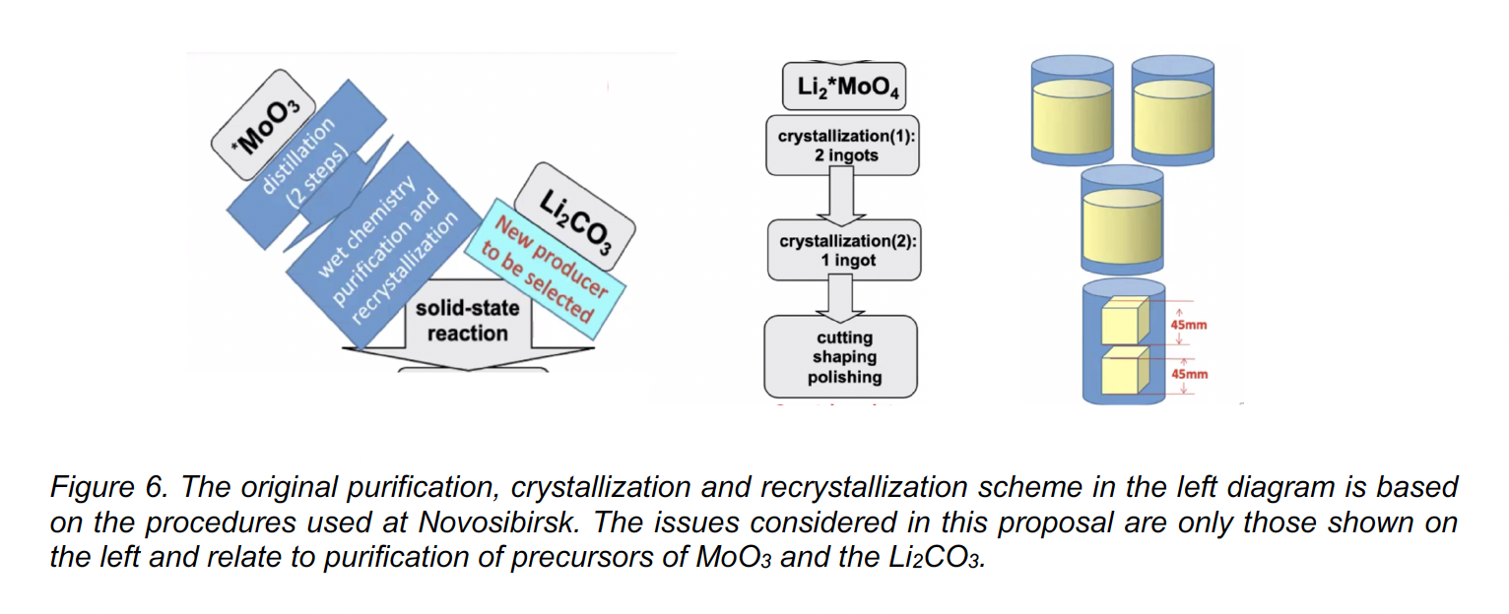
37

Slide 39
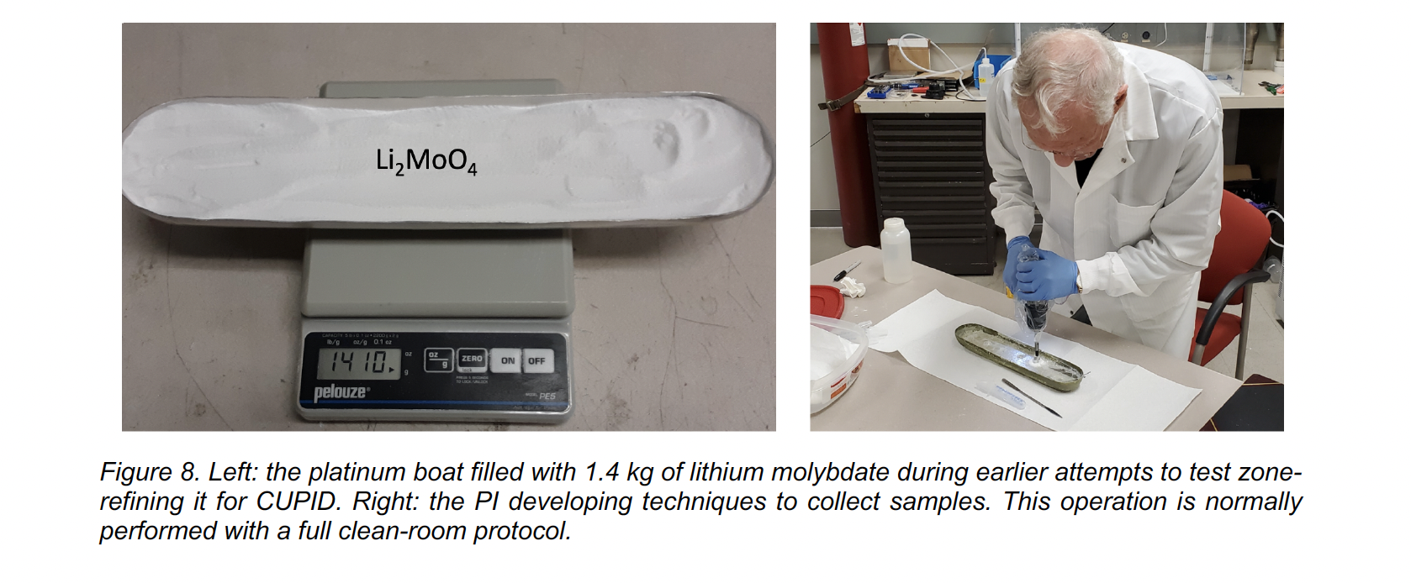
38

Slide 40
39

Slide 41
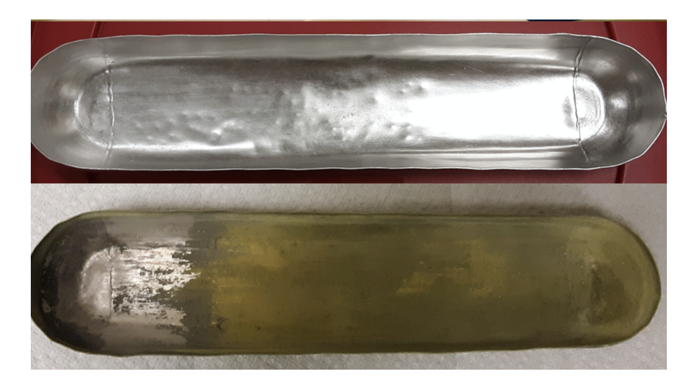
After several zonings we loose stoichiometry and form another Li Compound ???
40

Slide 42
Our TeO₂ crystals for CUORE were grown with the Bridgman growth technique, but with seed crystals to grow single crystals.
Growing single crystals maintains stoichiometry and the CUORE crystals did show evidence of good stoichiometry.
Bridgeman single crystal growth requires a large single crystal as a seed. This is not practical with isotopically enriched MoO₃; The seeds must be grown by the Czochralski method that requires only a tiny seed.
A small CUORE team tested using a natural abundance TeO₂ seed for a Bridgman crystal growth with enriched TeO₂. The total crystal suffered significant isotopic dilution.
41

Slide 43
CONCLUSION
Many of the LEGEND-1000 Ge-Detector Blanks will likely be grown in the Oak Ridge, Tennessee region. Therefore, reprocessing of scrap should be done nearby.
Using new developments built on our experience from the MAJORANA DEMONSTRATOR Project, it may be wise to consider alternative approaches developed since.
A MELLEN SUNFIRE could be located in a university laboratory or in a small building, and operated by students trained in the techniques including the careful preservation of valuable isotopically enriched Ge.
For CUPID, zone-refining and re-zone-refining can cause the loss of Stoichiometry.
For high level of purification, a single-crystal growth method will probably be required; Czochralsky for large seeds, or for the purification growth itself.
42

