Slide 1
Measurement of trace radioactivity with Neutron Activation Analysis
Andreas Piepke
University of Alabama

Slide 2
The problem
Analysis of trace impurities in materials is of interest in many areas of science.
Materials to be used in the construction of ultra-low rate, low energy experiments need to be tested for very low specific activities to prevent background.
Many radio nuclides have to be considered, I will focus in this presentation on the ever present natural radioactivity: (⁴⁰K), ²³²Th, ²³⁸U.

Slide 3
The problem
Isaac Arnquist already introduced the two approaches to the problem:
Decay counting: often the most direct approach, results can be interpreted free of assumptions BUT are often not sensitive enough for the most demanding tasks.
Atom counting: sensitive enough for even the most challenging sample BUT often requires assumptions on decay chain equilibrium to be useful for background estimation (see Tyler Schlieder’s talk). Two principal approaches:
ICPM-MS (see Isaac Arnquist’s and Laura Cid-Barrio’s talks)
Neutron Activation Analysis (NAA)
Using both approaches as needed worked well for a number of previous experiments: KamLAND, EXO-200, LZ and others

Slide 4
Atom counting via NAA
Basis:
Boost sample activity by converting sufficient fraction of meta stable ⁴⁰K, ²³²Th, ²³⁸U atoms into the into short-lived nuclides ⁴²K, ²³³Pa, ²³⁹Np via capture of neutrons.
Measure radiation emitted in delayed β-decay of product species.
Using activities, times, reactor neutron flux and cross sections, calculate elemental concentrations of target nuclides.
Advantages:
At high-neutron flux research reactors, substantial activities can be created, even in small samples and at low target species concentrations.
No chemical pre-processing with risk of contaminant introduction $→$ Robustness
Good selectivity via double differential γ–energy and decay time measurement
Can reach ppt and even sub-ppt sensitivity for ²³²Th and ²³⁸U

Slide 5
Atom counting via NAA
Disadvantages:
Only usable for materials (matrices) that won’t activate themselves
Material must not disintegrate in high γ and neutron flux environment $→$Can lead to pressurization of encapsulation and even rupture
Needs access to research reactor, irradiations are costly
Analysis takes longer than ICP-MS
Sensitivity often limited by co-activated impurities $→$ sample-related background. $→$ Post-activation separation of analyte from background creators $→$ Ion exchange $→$ γ-γ-coincidence counting to suppress background (covered here)

Slide 6
NAA basics
We are using the following radiative capture reactions offering:
sufficient cross sections (thermal average cross sections given)
Sufficiently long-live of γ–emitting products (mean live times given)
$$n+{}_{}^{41}K→{}_{}^{42}K+γ\begin{matrix}β \\ → \\ 17.8 h\end{matrix}{}_{}^{42}{Ca}+γ$$
1.46 barn
$$n+{}_{}^{232}{Th}→{}_{}^{233}{Th}+γ\begin{matrix}β \\ → \\ 31.5 m\end{matrix}{}_{}^{233}{Pa}\begin{matrix}β \\ → \\ 38.9 d\end{matrix}{}_{}^{233}{U+γ}$$
7.3 barn
$$n+{}_{}^{238}U→{}_{}^{239}{U+γ\begin{matrix}β \\ → \\ 33.8 m\end{matrix}{}_{}^{239}{Np}\begin{matrix}β \\ → \\ 3.40 d\end{matrix}{}_{}^{239}{Pu}+γ}$$
2.69 barn

Slide 7
NAA work flow
A typical activation campaign consists of several work phases:
Clean sample preparation for activation, package, ship to reactor
Activate at a research reactor at MIT, ship back to UA
Unpackage activated samples, count γ–radiation with Ge detectors
Interpret data, convert energy and time dependent counting rates into activities and then elemental concentrations

Slide 8
Sample preparation and activation

Slide 9
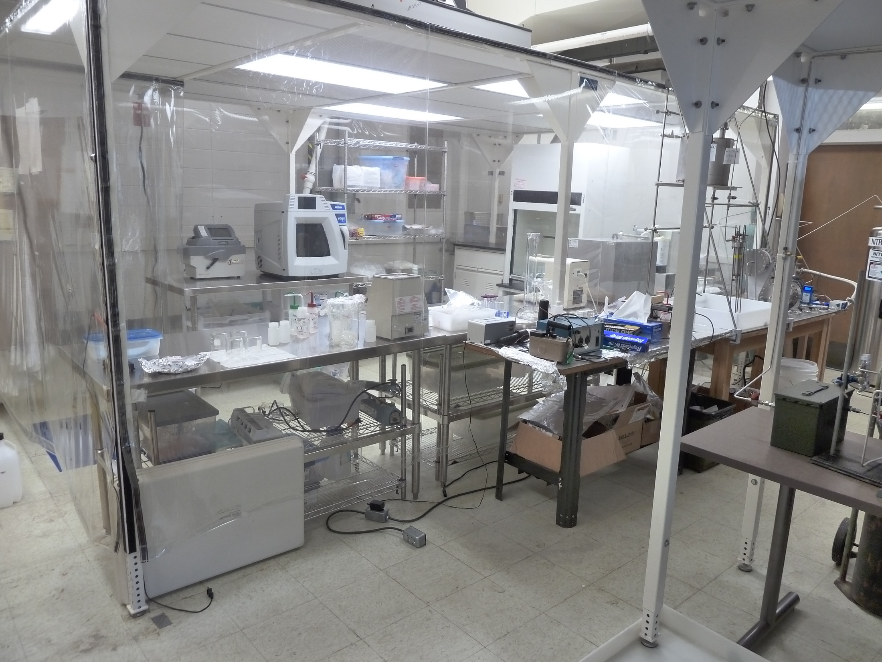
Small, 2-3 g (both a benefit and a problem), samples are surface cleaned with organic solvents, radio-clean acids (etched or leached), rinsed, dried and then packaged in small cleaned PE bottles. These bottles limit the duration of the activation as they disintegrate. We have done long activations with quartz containers.
We have a class 500 soft-wall clean room for this work.
Ship to the reactor

Slide 10
Activation
We typically us the MIT research reactor, a pool-type reactor with highly enriched fuel element, rated for 6 MW thermal power.
Typical neutron fluxes (May 2024 activation, 5.52 MW):
Thermal neutrons: $Φ_{th}=\left(4.90±0.09\right)∙{10}^{13} \frac{neutrons}{s^{2}∙s}$
Epi-thermal neutrons: $Φ_{et}=\left(1.50±0.12\right)∙{10}^{13} \frac{neutrons}{s^{2}∙s}$
Fast fission neutrons: $Φ_{ff}=\left(7.39±0.88\right)∙{10}^{12} \frac{neutrons}{s^{2}∙s}$
We determine the flux (most of the time) by co-activating a NIST reference material called fly ash.

Slide 11
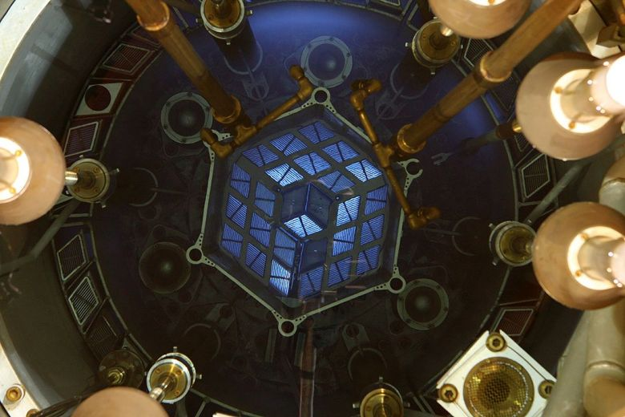
MITR core, image taken from:
https://nrl.mit.edu/reactor/core-description

Slide 12
Reactor neutron spectra
Thermal component, $Φ_{th}$follows Maxwell-Boltzmann distribution, describes neutrons at low kinetic energy $\left(E_{n}<1 eV\right)$. Responsible for bulk of the activation
Epi-thermal neutron flux $Φ_{et} dE_{n}\sim \frac{dE_{n}}{E_{n}}$, important for $0.5 eV< E_{n}<10 MeV$. Important for n capture on ²³²Th, ²³⁸U, unimportant for most other elements.
Fast fission neutrons, use Watt spectrum for ²³⁵U fission, for $E_{n}$ of up to $20 MeV$. Only important to estimate backgrounds due to (n, p) and (n, α) reactions.

Slide 13
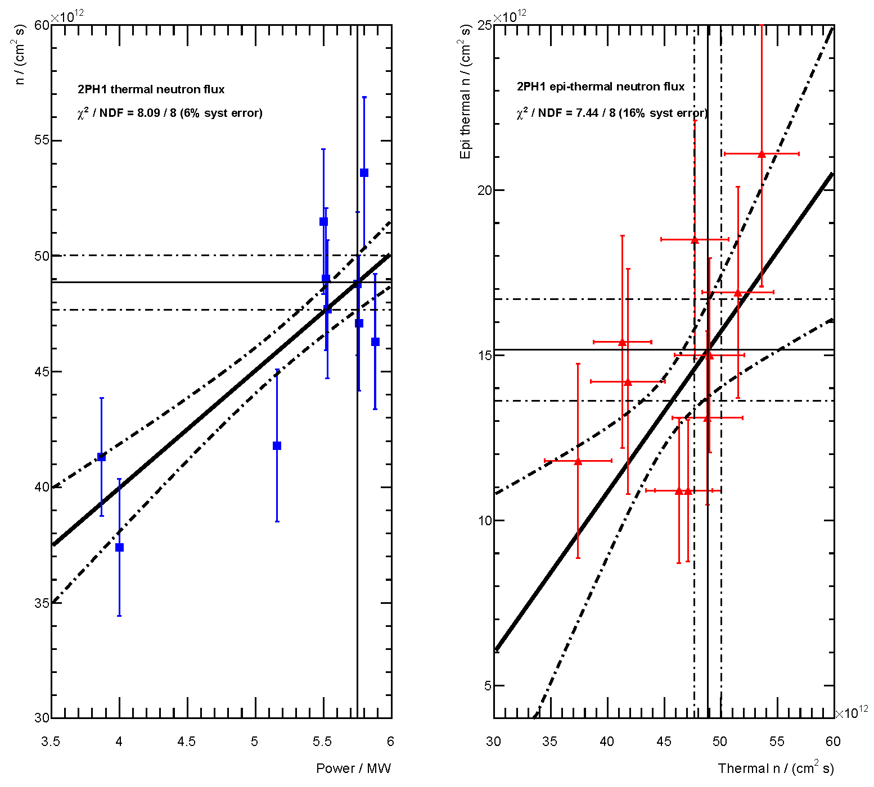
Neutron flux determination
For 10 activation campaigns at MITR, using their pneumatic sample insertion facility 2PH1:
NIST standard material fly ash derived neutron fluxes correlate with reactor power.
Thermal power fit assumes additional 6% point-wise systematic error, epi-thermal flux 16% syst. error.

Slide 14
Sample recovery and counting

Slide 15
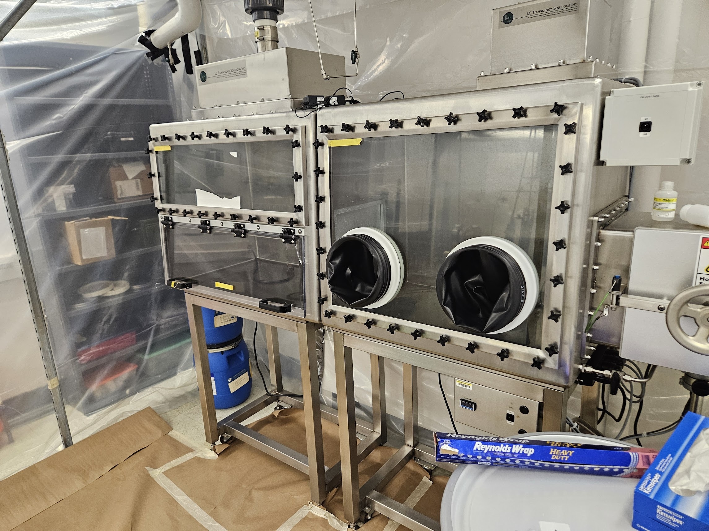
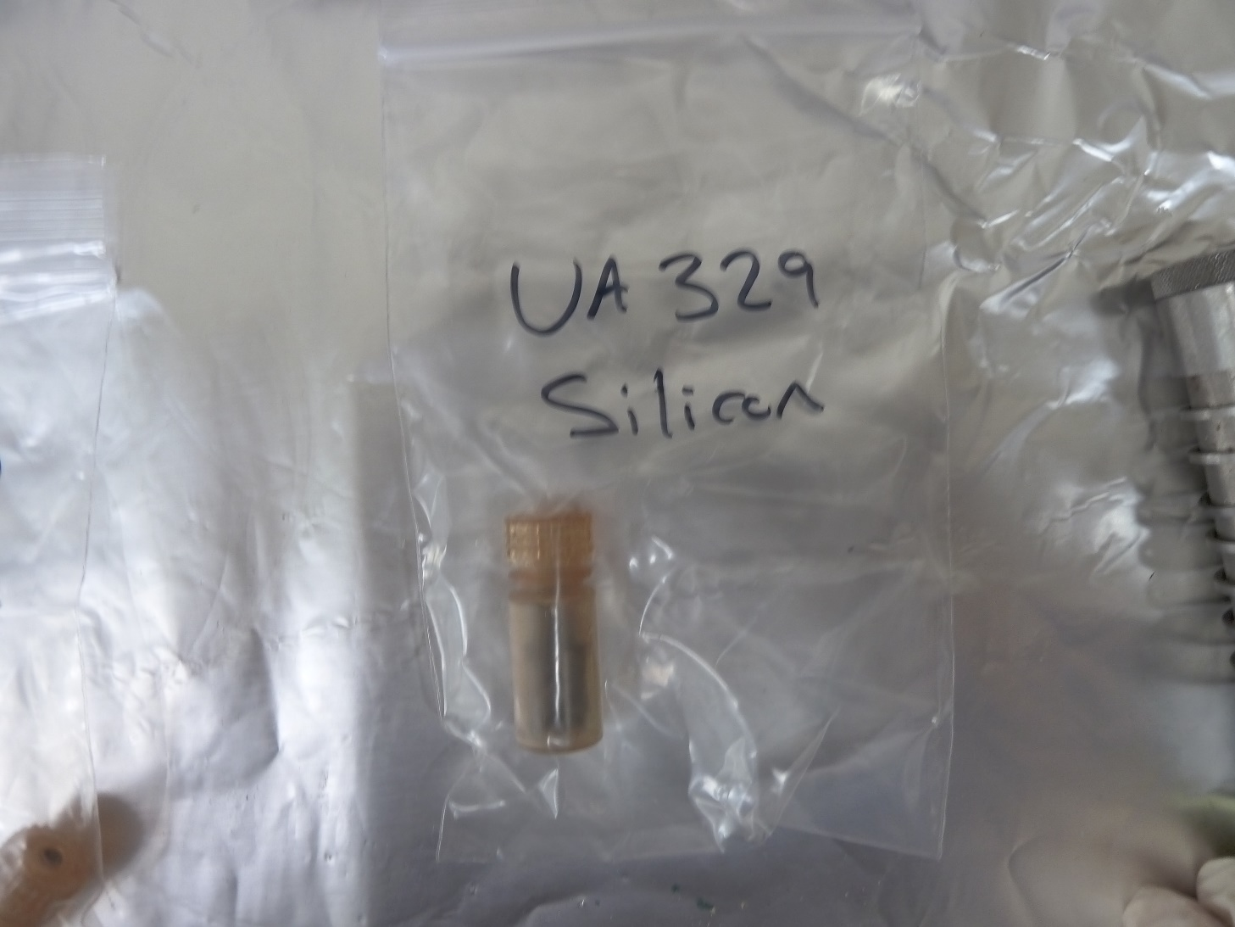
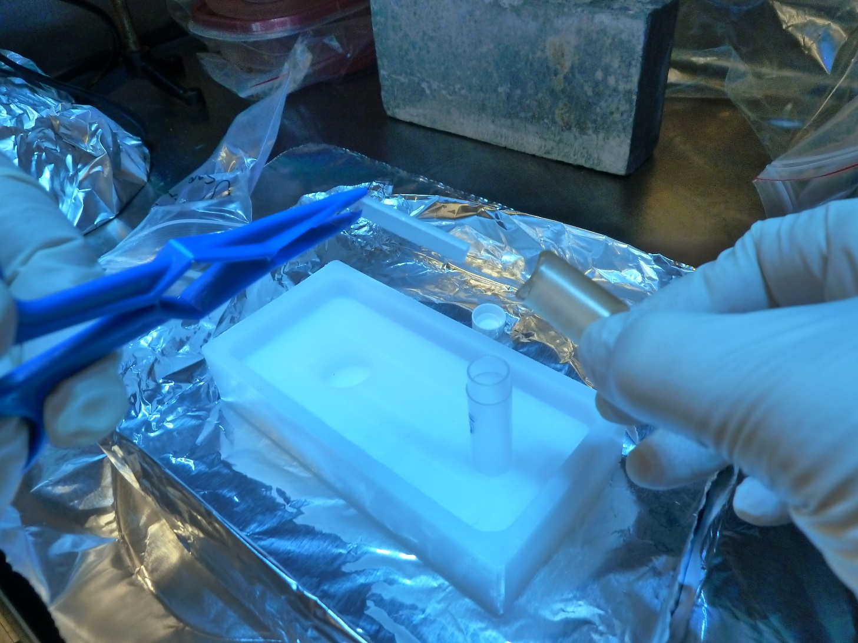
Sample recovery
After recovery from the reactor, the samples are allowed to cool down for 0.5 – 1 days and then shipped back to UA via Fedex.
They are removed from their co-activated PE vial and transferred into a clean counting PE vial. This is done in a fume hood rated for handling of open radioactivity. Recovery usually takes 1 – 2 hr.
Samples typically contain $\sim$MBq of all kinds of radioactivity.

Slide 16
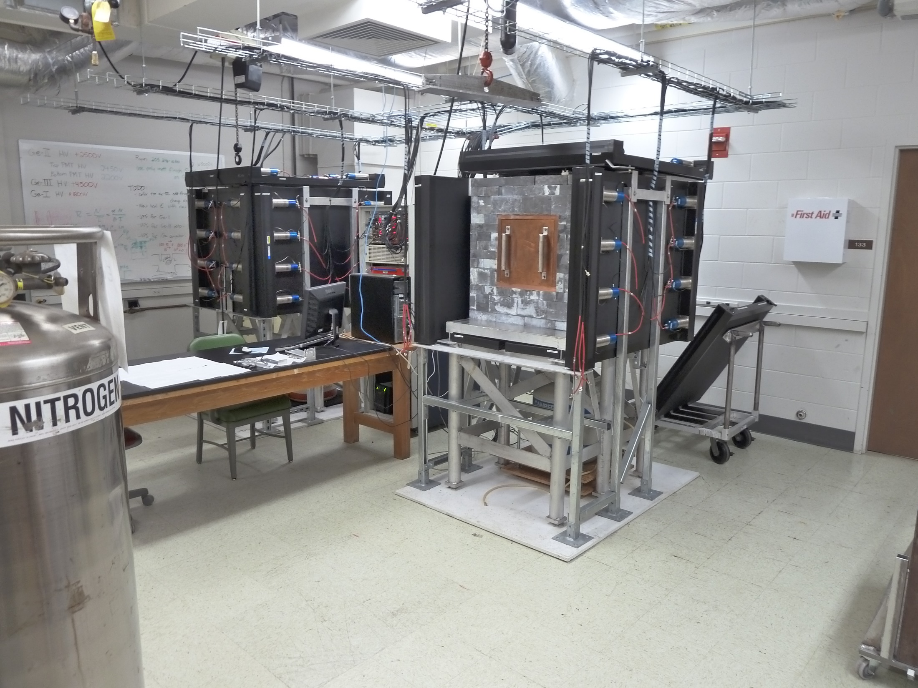
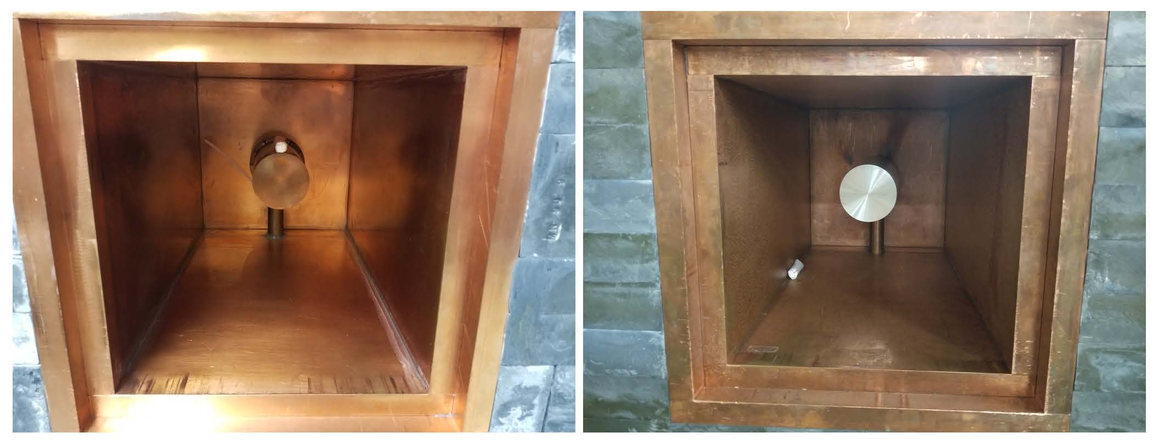
γ-counting
Two large, shielded low background Ge detectors are available for sample counting. Plus one smaller device.
GEANT4 detector models used to convert rates into activities.

Slide 17
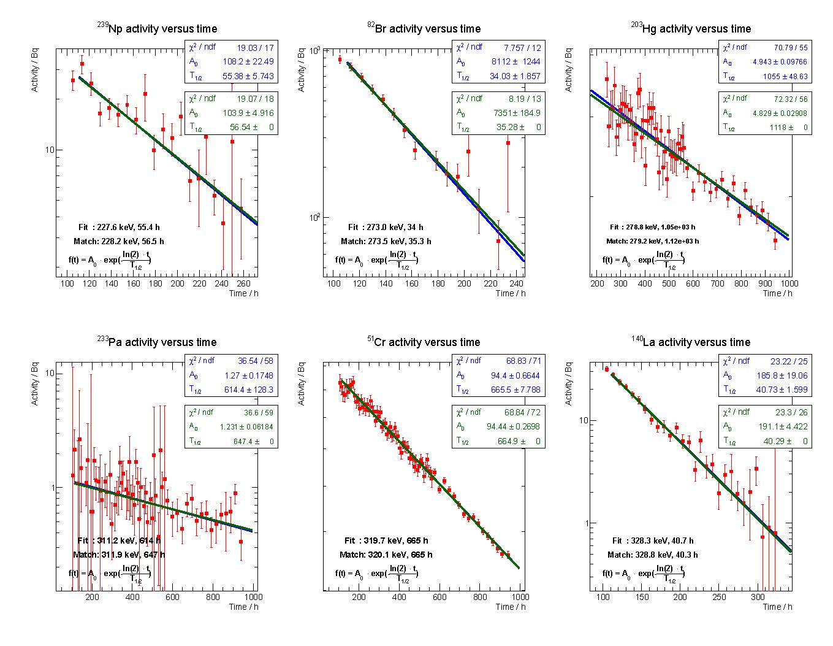
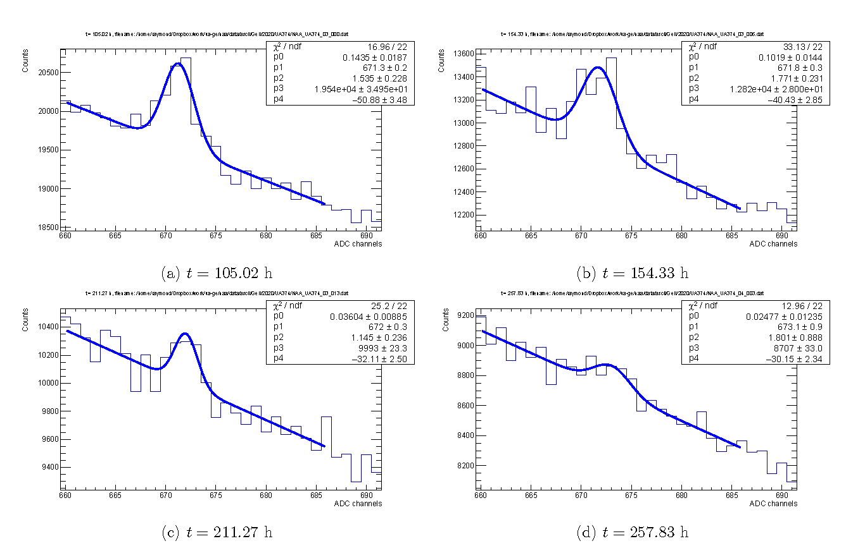
Example: activated Kapton (UA374, 2020)
Double differential energy and time fit of 228 keV peak from ²³⁹Np decay.
Quantitative activity analysis, using GEANT4-based efficiency correction, from fit to fixed, tabulated decay time.
Double differential analysis gives good selectivity when peaks are observed, and better limits when they are not.
UA374 was found to have $\left(1.30±{0.06}^{stat}±{0.09}^{sys}\right) ppb$ of ²³⁸U

Slide 18
NAA versatility, materials assayed at UA
nEXO (33 material assays): CMOS chips, SiPMs, PE HV cable, Si wafer, quartz, sapphire, Kapton, Torlon, SiC
With straight counting: ²³²Th / ²³⁸U sensitivities 0.09 / 0.28 ppt
EXO-200 (69 material assays): Teflon, HFE, Si, superinsulation, aluminum, epoxy, urethane potting, PE insulator, silcon, polyimide, charcoal, quartz, polycarbonate, polyflon, neoflon, Vespel, acrylic, lead, optical fiber, p-terphenyl
With straight counting: ²³²Th / ²³⁸U sensitivities 0.78 / 0.26 ppt
With sample pre-concentration: ²³²Th / ²³⁸U sensitivities 0.015 / 0.015 ppt
LZ: Teflon, cable insulation
KamLAND: PPO, liquid scintillator, cable insulation
With post activation actinide separation via ion exchange columns: ²³²Th / ²³⁸U sensitivities 0.0055 / 0.008 ppt

Slide 19
How to do better?

Slide 20
Enhanced sensitivity through γ-γ-coincidences
Sapphire (Al₂O₃) is a material of interest to nEXO. It doesn’t dissolve in mineral acids $→$ no ICP-MS. NAA sensitivity to ²³⁸U limited to about 10 ppt by side activities, especially ${}_{}^{27}{Al\left(n, α\right){}_{}^{24}{Na}}$ plus co-activated chemical impurities.
Reduce background: use simultaneous emission and detection of:
106 keV & 228 keV γs
106 keV & 277 keV γs
However, reduced background comes along with reduced counting efficiency $→$ estimate expected gain via Monte Carlo simulation.

Slide 21
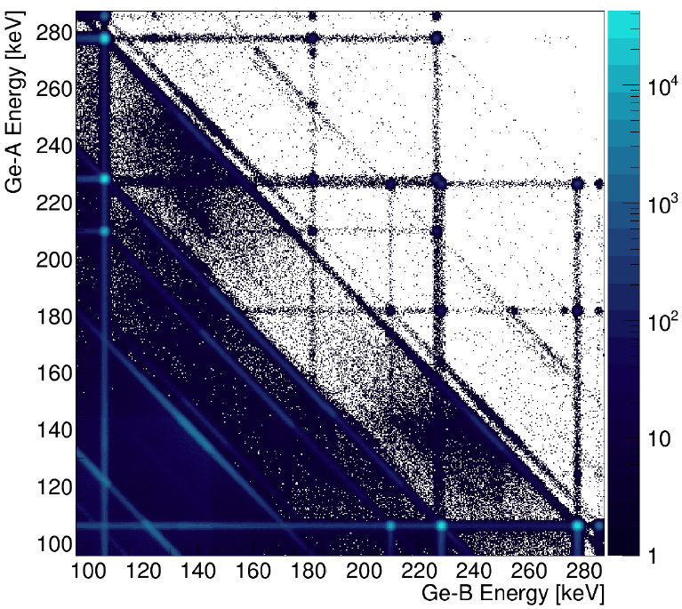
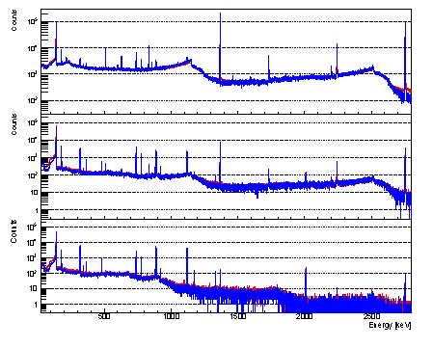
Enhanced sensitivity through γ-γ-coincidences
Based on previous NAA: the background is composed of a multitude of γs, decaying with various half-lives. $→$ Simulate time variable signal and background.
Nuclide | Half-life | Activity at t=0 [Bq]
²⁴Na | 15 h | 2.57·10⁵
⁷²Ga | 14.1 h | 1.1·10⁴
⁹⁹Mo | 65.9 h | 3.0·10³
⁵¹Cr | 27.7 d | 349
⁴²K | 12.32 h | 83
⁴⁶Sc | 83.79 d | 58
¹⁸¹Hf | 42.39 d | 7
⁶⁰Co | 1925 d | 2
²³⁹Np | 56.5 h | variable
Simulation
UA data
66 h
148 h
247 h

Slide 22
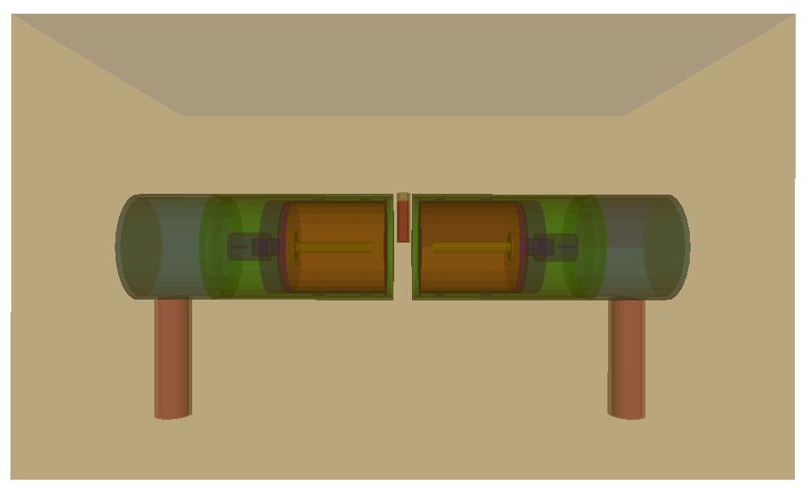
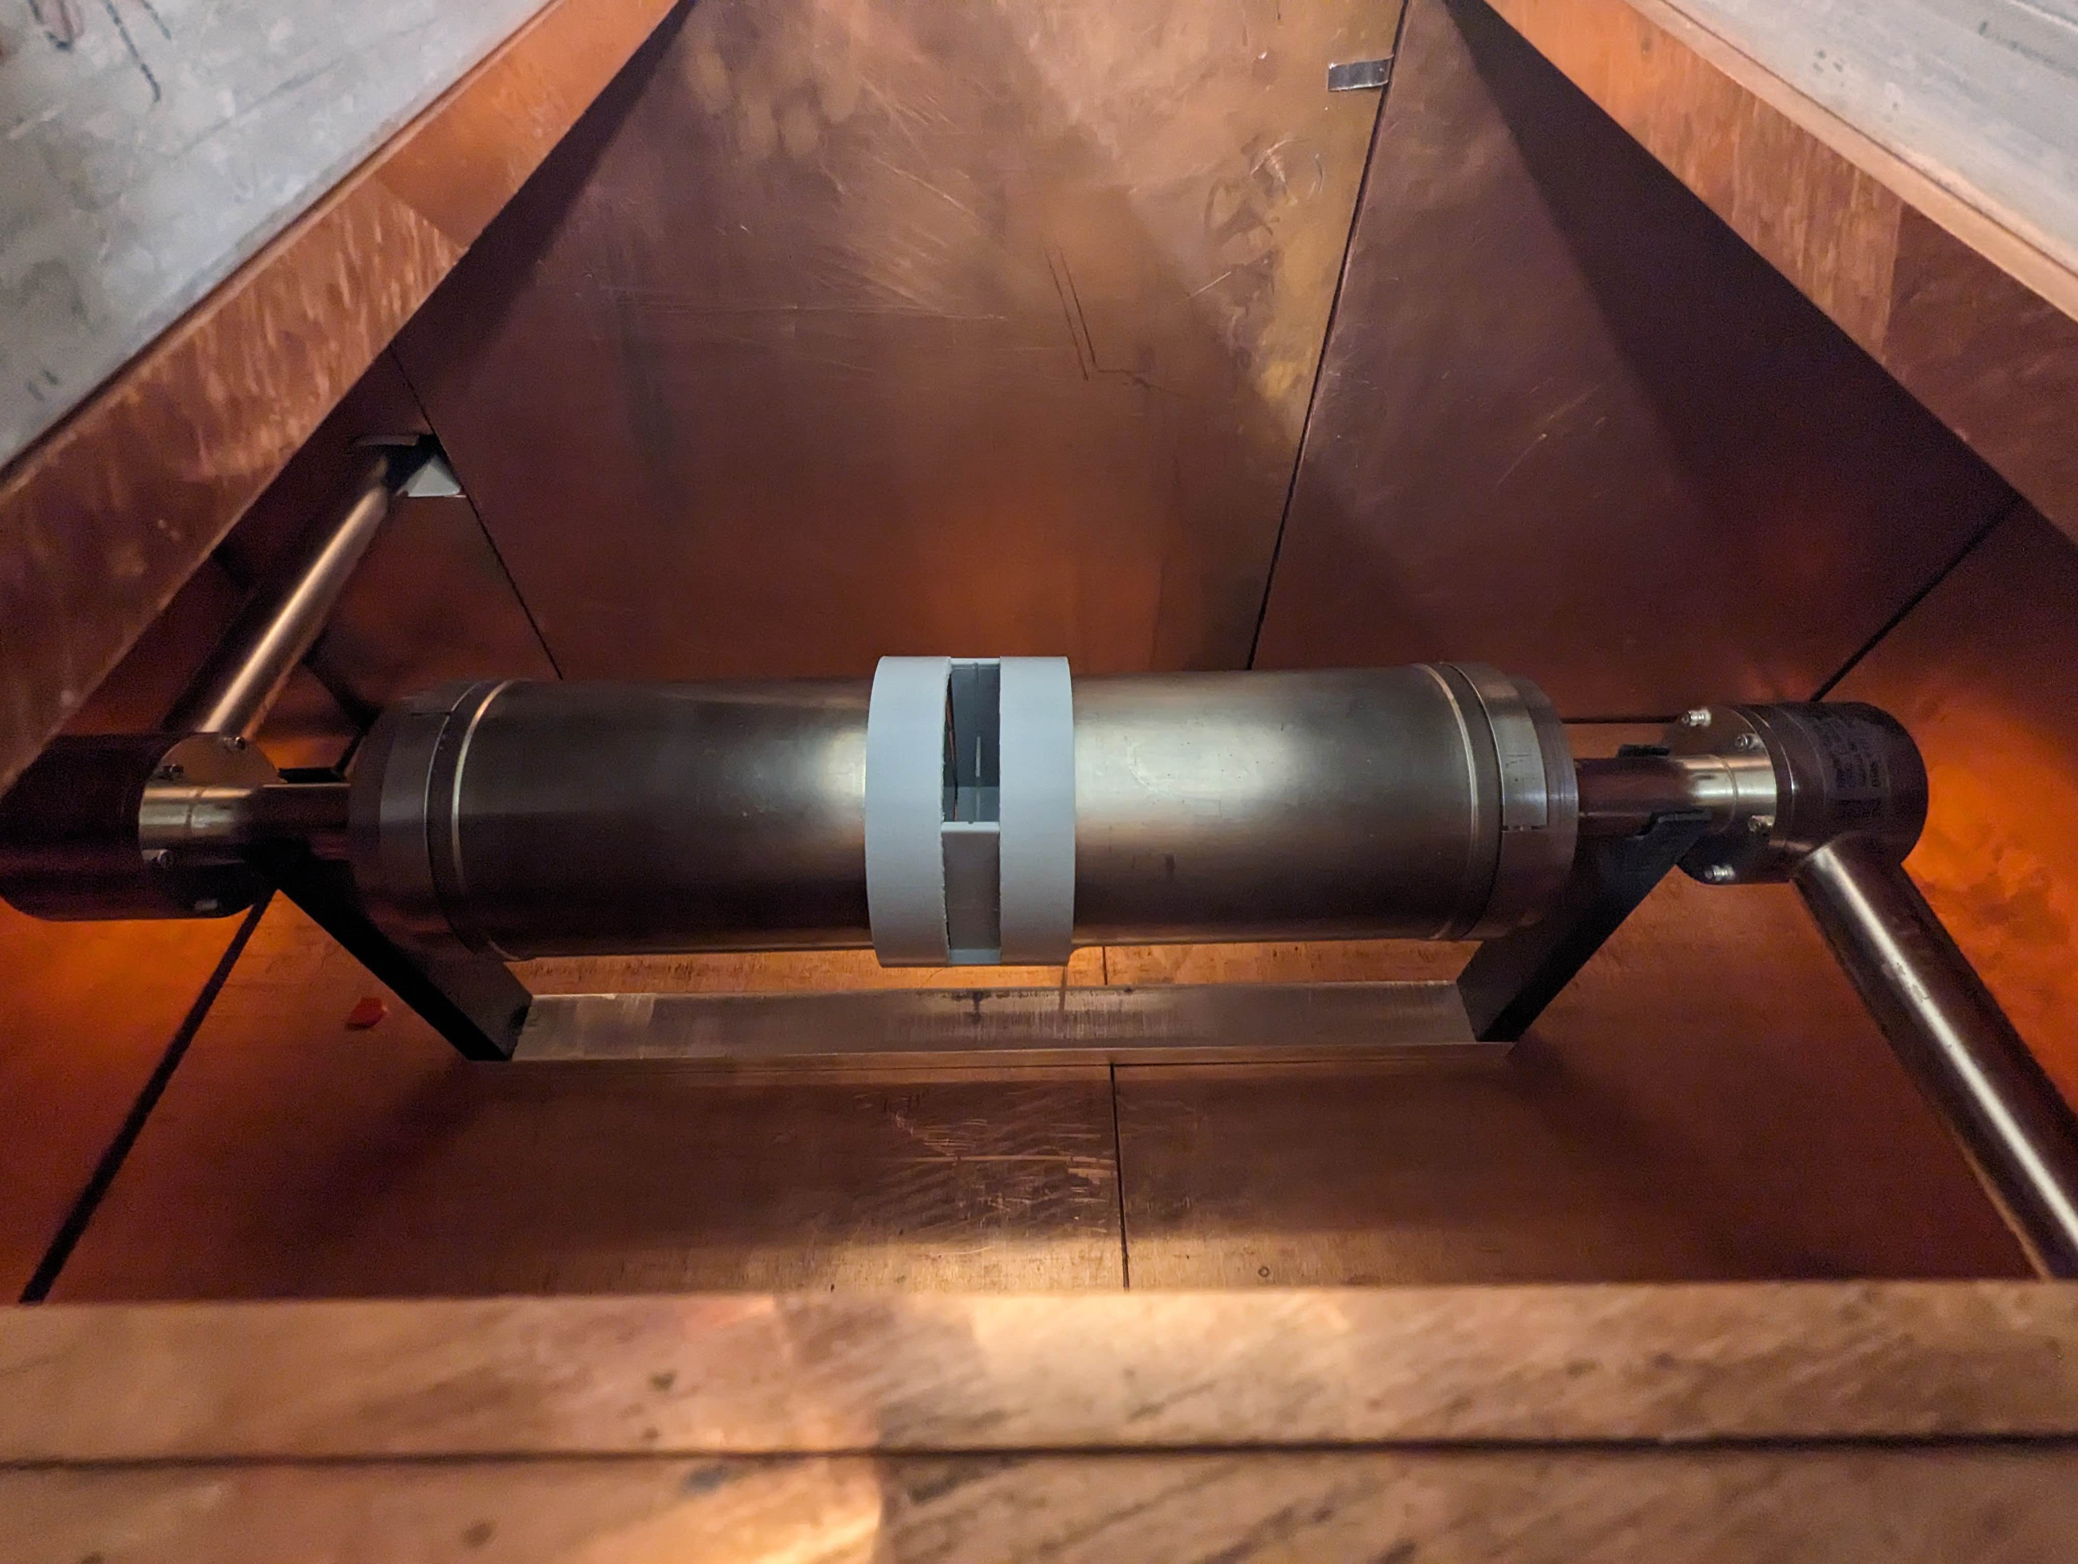
Enhanced sensitivity through γ-γ-coincidences
GEANT4 detector model
Dual Ge detector setup at TUNL used to count sapphire sample activated at MITR May 2024

Slide 23
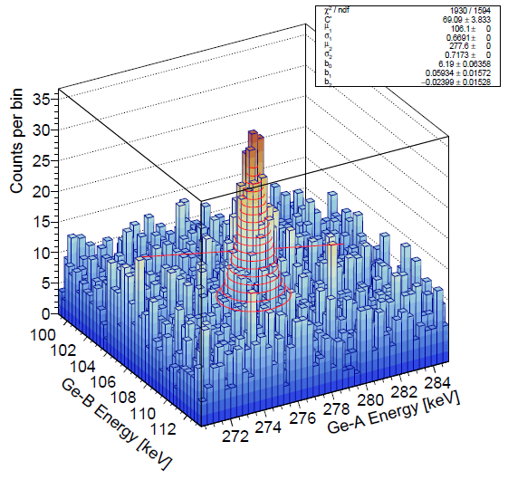
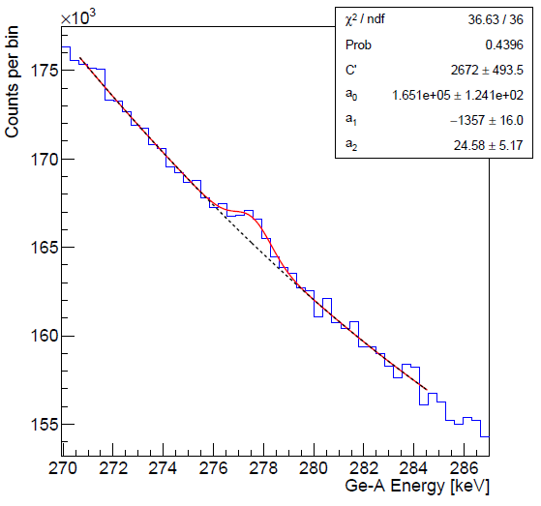
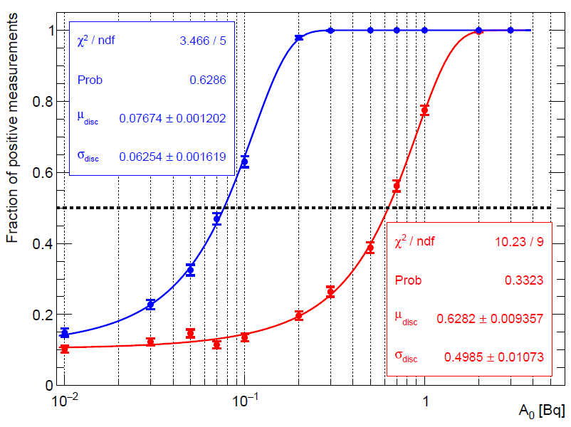
Enhanced sensitivity through γ-γ-coincidences
Simulation of all observed side activities and their decay. Add a 3 Bq ²³⁹Np activity.
Single γ-counting: substantial background
γ-γ-coincidence counting: improved S:B ratio
γ-γ-coincidence counting: 8-times better MDA
coincidences
singles
R.H.M. Tsang. O. Nusair. A. Piepke. JINST 16 P10007 (2021)

Slide 24
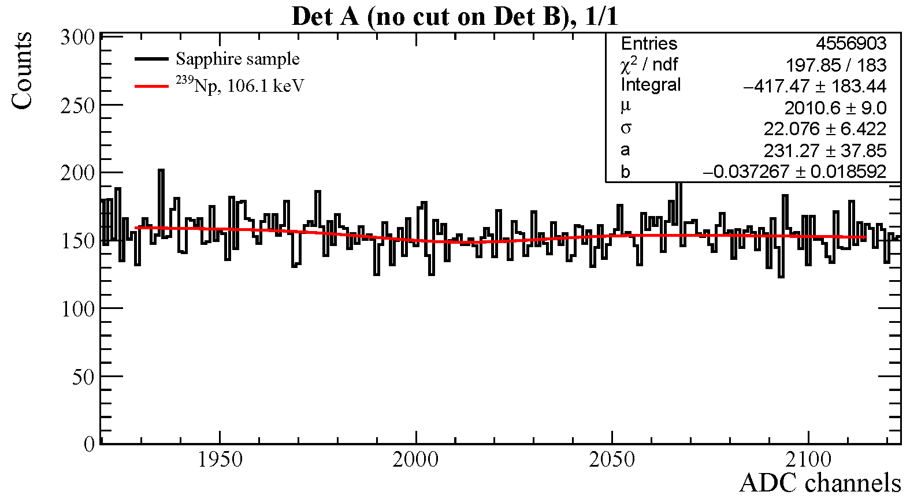
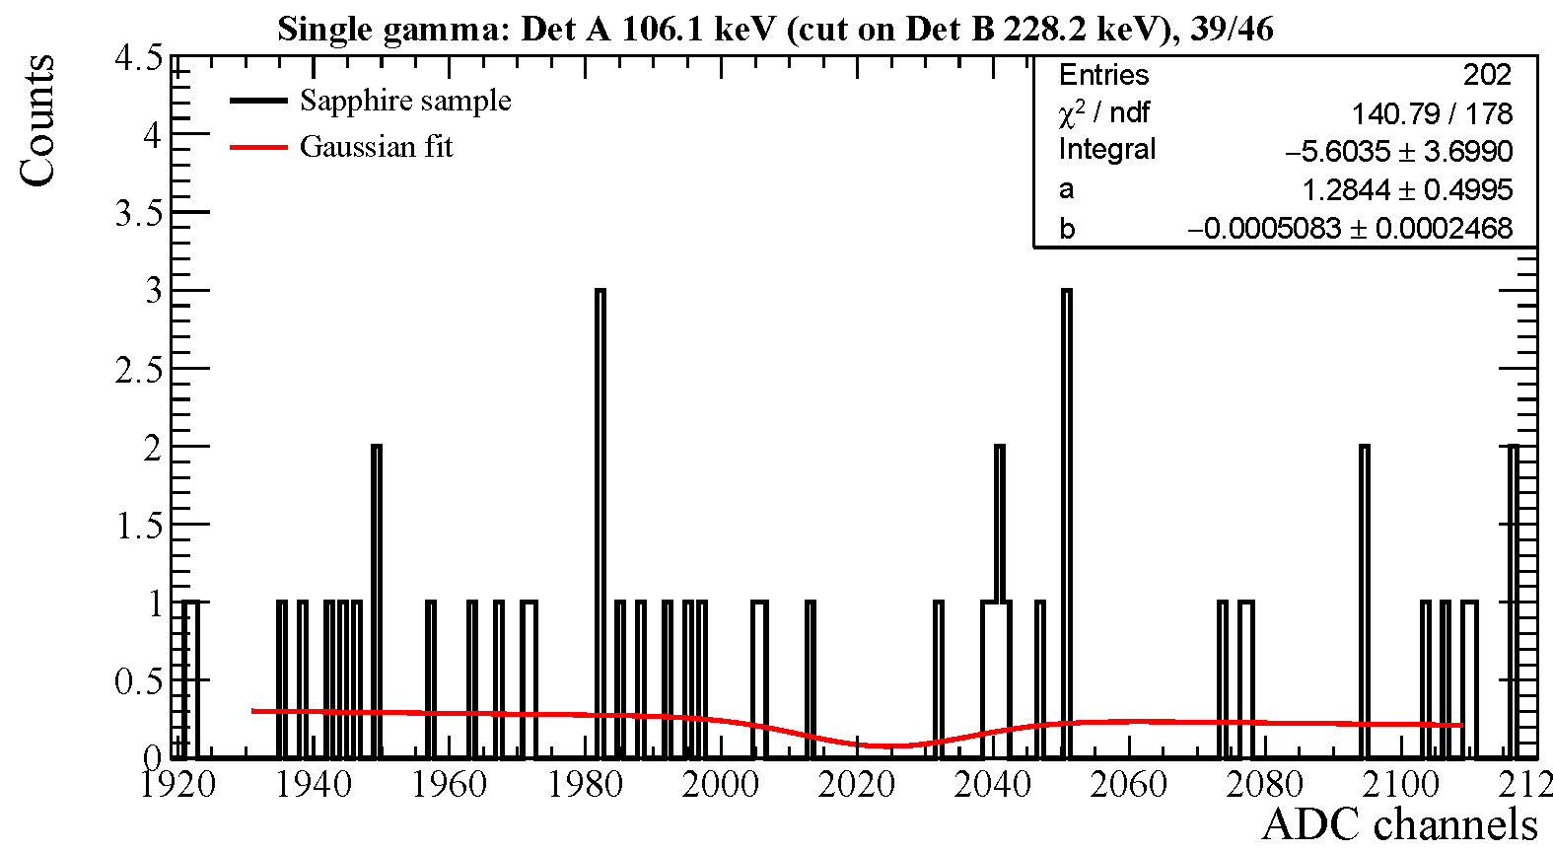
Enhanced sensitivity through γ-γ-coincidences
Approach tested in 5/2024 activation of a nEXO sapphire sample. Counting performed with dual Ge-detector system at TUNL. Data analysis is still ongoing.
106 keV γ single detector counting (run 162, 1 h): substantial background
106 keV γ requiring coincidence with 228 keV γ (run 162, 1 h): strong rate suppression
As expected: there is a substantial background reduction.
Is there also efficiency?
Participants: D. Chernyak, T. Daniels, S. Finch, R. MacLellan, A. Piepke, R. Tsang

Slide 25
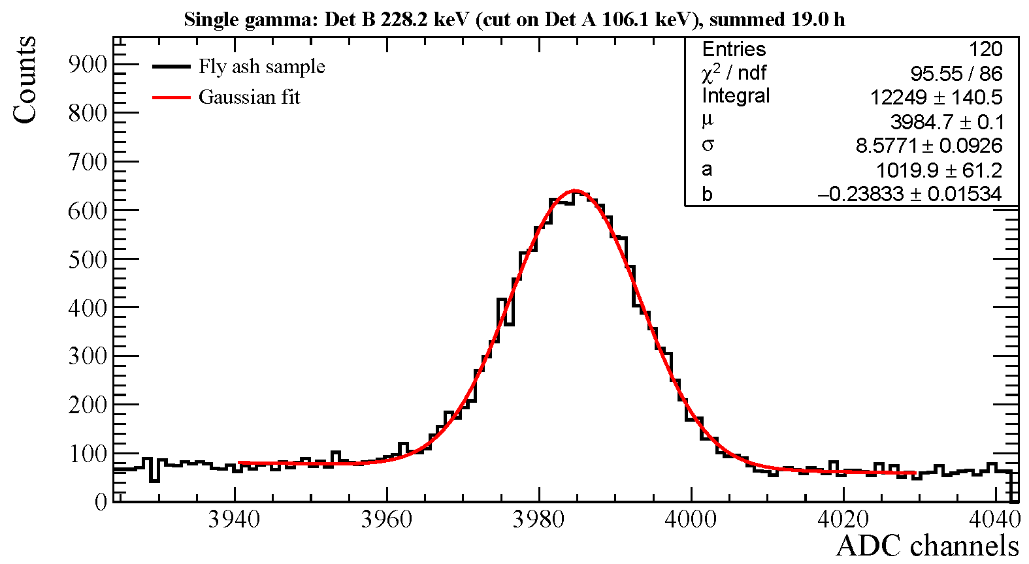
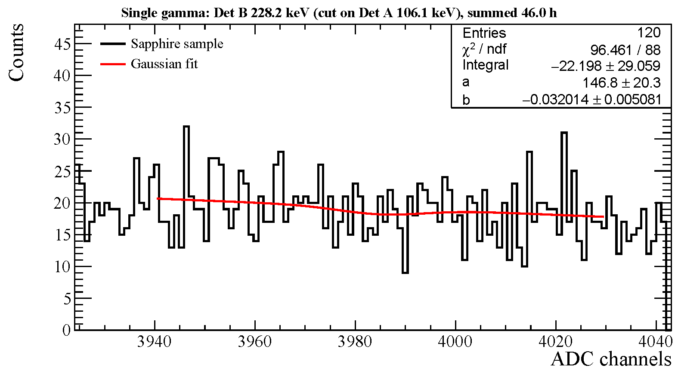
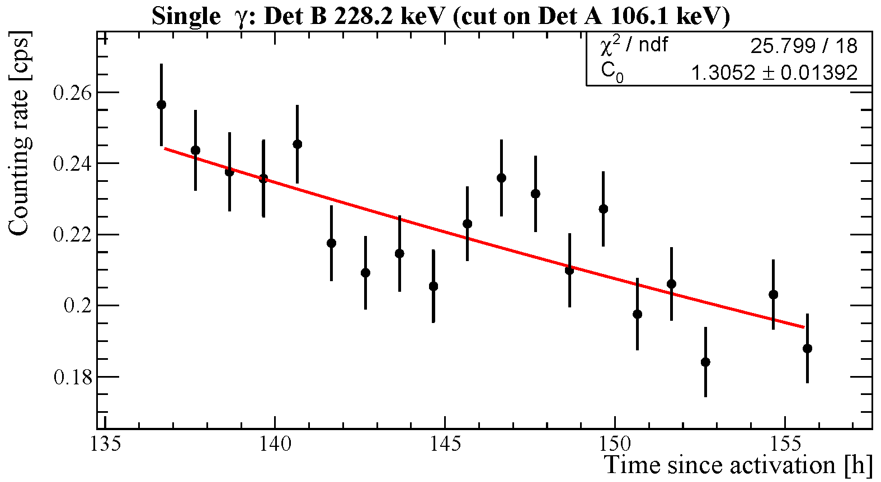
Enhanced sensitivity through γ-γ-coincidences
Fly ash reference sample: clear coincidence signal, for the expected peak energies PLUS decaying with the ²³⁹Np half live.
Sapphire: no coincidence signal $→$ put limit on ²³⁸U

Slide 26
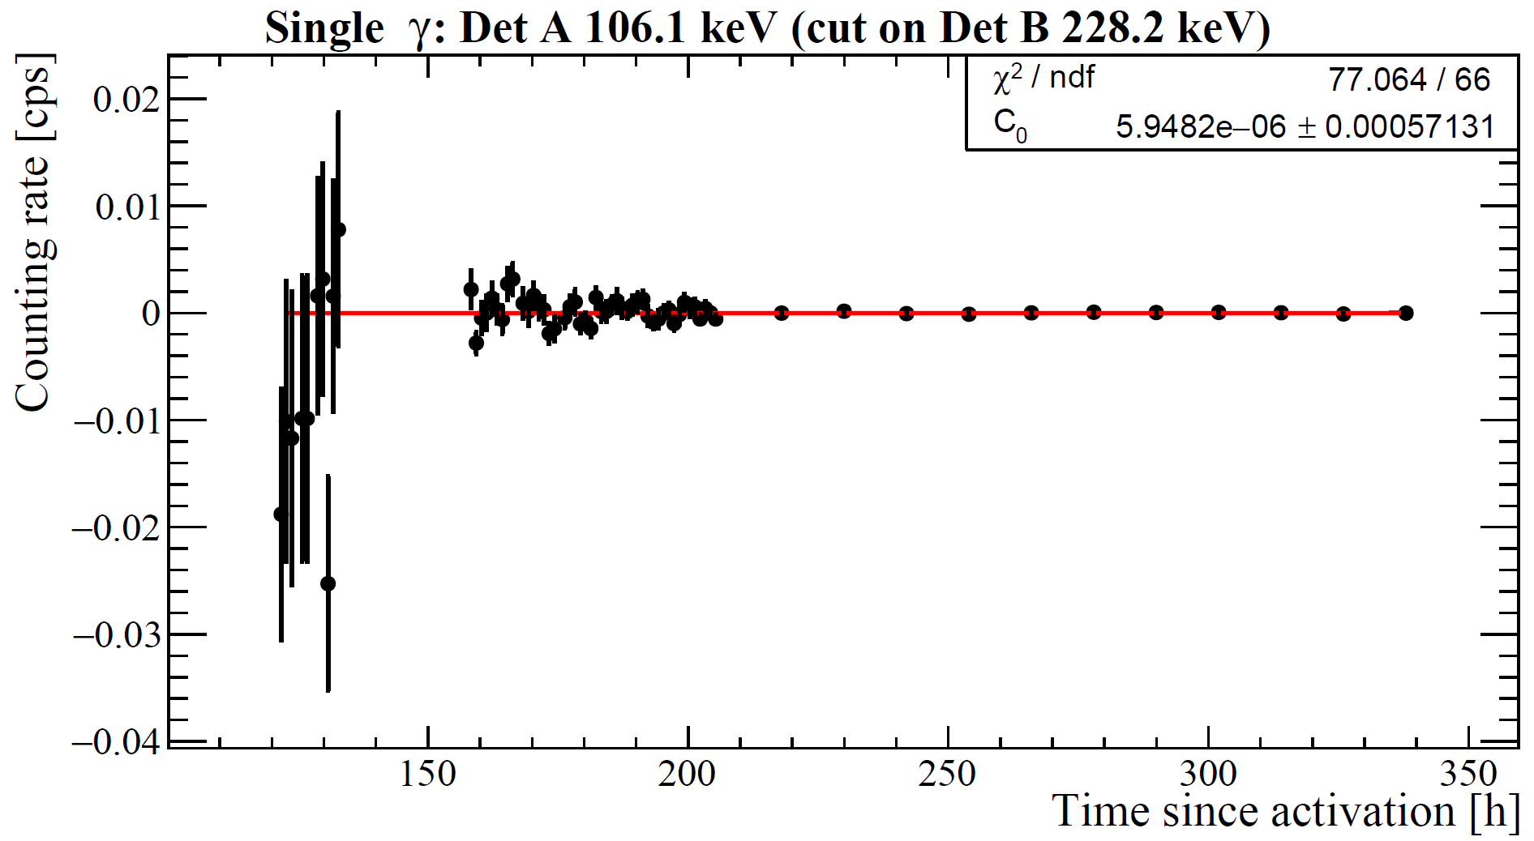
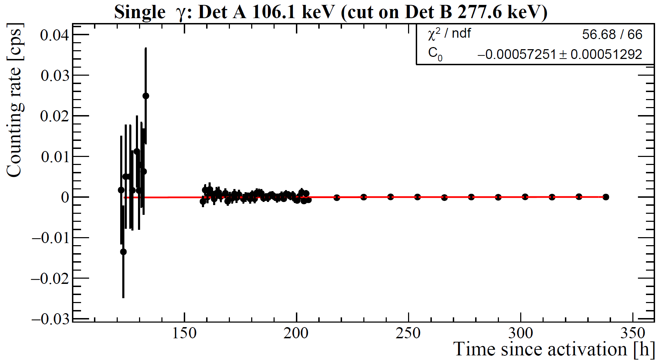
Enhanced sensitivity through γ-γ-coincidences
No ²³⁹Np observed in the coincidence data. Derived preliminary ²³⁸U concentration limit: $<1.46 ppt$ ($−1.22±1.53 ppt$)
Corresponds to approximately $≤0.26 Bq$
Largest side activity ²⁴Na: $≈14 MBq$
Preliminary
Result obtained in 2017 singles counting analysis of the same sample:
$<10.6 ppt$ ($4.8±{3.5}^{stat}±{0.5}^{syst} ppt$)
²³²Th: $<0.51 ppt (−0.8±{0.3}^{stat}±{0.08}^{syst}$)
Coincidence counting gives a factor $7.3$ improvement over singles counting, close to Monte Carlo expectation of $8.2$.

Slide 27
Conclusion
Neutron activation is a versatile analysis tool. It complements ICP-MS.
As ICP-MS measures the long-live heads of the decay series. Assumption on decay chain equilibrium are often needed to use in background estimation.
Straight γ-counting reaches ppt or sub-ppt sensitivity. Often limited by side activities.
We have shown that γ-γ-coincidence counting suppresses side activities, boosting ²³⁸U sensitivity close to an order of magnitude.

Slide 28
Appendix

Slide 29
The problem
Components near the sensitive detector often need to have ²³²Th / ²³⁸U content below 1^{(fused silica)}, 0.1, 0.01^{(copper)} ppt. What are the corresponding decay rates?
Nuclide | Concentration [ppt] | Specific activity [decays/(day·kg] | Average time [days] between decays for 1 kg sample | Number of atoms in 1 g sample
²³²Th | 1 | 0.35 | 2.9 | 2.6·10⁹
 | 0.1 | 0.035 | 29 | 2.6·10⁸
 | 0.01 | 0.0035 | 285 | 2.6·10⁷
²³⁸U | 1 | 1.1 | 0.94 | 2.5·10⁹
 | 0.1 | 0.11 | 9.4 | 2.5·10⁸
 | 0.01 | 0.011 | 94 | 2.5·10⁷
¹³⁶Xe 2νββ | 80% | 3.1
A relatively large number of atoms contained even in 1000 times smaller sample.
$→$ Atom counting is an alternative:
ICP-MS
NAA
Decay counting runs out of steam at such small activities, not even considering background.
Making samples much larger is impractical as radiation won’t come out efficiently due to self absorption and diminishing solid angle. Ge detector efficiencies are small.

Slide 30
NAA basics
Reaction | Boost ${τ_{target}}/{τ_{product}}$ | Thermal n cross sec [barn]
$$n+{}_{}^{41}K→{}_{}^{42}K+γ\begin{matrix}β \\ → \\ 17.8 h\end{matrix}{}_{}^{42}{Ca}+γ$$ | 8.85·10¹¹ | 1.46
$$n+{}_{}^{232}{Th}→{}_{}^{233}{Th}+γ\begin{matrix}β \\ → \\ 31.5 m\end{matrix}{}_{}^{233}{Pa}\begin{matrix}β \\ → \\ 38.9 d\end{matrix}{}_{}^{233}{U+γ}$$ | 1.90·10¹¹ | 7.3
$$n+{}_{}^{238}U→{}_{}^{239}{U+γ\begin{matrix}β \\ → \\ 33.8 m\end{matrix}{}_{}^{239}{Np}\begin{matrix}β \\ → \\ 3.40 d\end{matrix}{}_{}^{239}{Pu}+γ}$$ | 6.93·10¹¹ | 2.69
In all 3 cases:
Large live time boost
Large n-capture cross section
Sufficient live time of product to allow transport
Final decay emits γ-radiation, enabling use of Ge detectors. In case of ²³⁹Np decay: γ-cascade.

Slide 31
Math notes
Thermal component, follows Maxwell-Boltzmann distribution, describes bulk of the neutrons $\left(E_{n}<1 eV\right)$:
$n_{th}\left(E, T\right) dE=n_{th}∙\frac{2}{\sqrt{π}∙{\left(k_{B}∙T\right)}^{3/2}}∙\sqrt{E}∙e^{−E/{k_{B}∙T}} dE$ Maxwell-Boltzmann neutron density per volume
$E$: neutron kinetic energy
$T$: neutron temperature taken to equal water temperature
$k_{B}$: Boltzmann constant
$n_{th}=\int_{0}^{∞}{n_{th}\left(E, T\right) dE}=\sqrt{\frac{π∙m_{n}}{8∙k_{B}∙T}}=Φ_{th}$ integral neutron density, $Φ_{th}$ integral thermal neutron flux, $m$: neutron mass.
$Φ_{th}\left(E, T\right) dE=v∙n_{th}\left(E, T\right) dE=Φ_{th}∙\frac{E}{{\left(k_{B}∙T\right)}^{2}}∙$ $e^{−E/{k_{B}∙T}} dE$ Thermal neutron flux, $v=\sqrt{\frac{2∙E}{m}}$ neutron velocity
${\left\langle v\right\rangle }_{th}=\int_{0}^{∞}{v∙n_{th}\left(v, T\right) dv}=\sqrt{\frac{8∙k_{B}∙T}{π∙m}}$ Average neutron velocity $⇒Φ_{th}={\left\langle v\right\rangle }_{th}∙n_{th}$

Slide 32
Math notes
Epi-thermal neutrons “abruptly turn on” in heavy water reactors at $5.3∙k_{B}∙T=0.029 eV$ (for $T=340 K$). At turn-on still much smaller than thermal neutron flux component.
$Φ_{et}\left(E\right) dE\sim \frac{dE}{E}$ Flux is know to have 1/E dependence
$\int_{E_{low}}^{E_{high}}{\frac{dE}{E}}=ln\left(\frac{E_{high}}{E_{low}}\right)$ Integral epi-thermal neutron flux. Chose $E_{low}=0.5 eV$ and $E_{high}=10 MeV$. Limits defined by cross section tables.
$Φ_{et}\left(E\right) dE=\frac{Φ_{et}}{ln\left(\frac{E_{high}}{E_{low}}\right)}∙\frac{dE}{E}=\frac{Φ_{et}}{16.81}∙\frac{dE}{E}$ Epi-thermal flux-integral normalized energy distribution.

Slide 33
Math notes
Fast fission neutrons follow the Watt spectrum:
$Φ_{ff}\left(E\right) dE=\sqrt{\frac{4}{π∙a^{3}∙b}}∙e^{−\frac{a∙b}{4}−\frac{E}{a}}∙\sinh\left(\sqrt{b∙E}\right) dE$ For ²³⁵U fission $a=0.98 MeV$ and $b=2.249 {MeV}^{−1}$

Slide 34
Rate estimation via average cross sections
We use average cross sections from JENDL-4.0 database. JENDL-5 is available.
=n-capture rate
$$\left\langle σ_{th}\right\rangle =\frac{2}{\sqrt{π}}∙\frac{\int_{{10}^{−5}eV}^{10 eV}{Φ_{th}\left(E, T\right)∙σ\left(E\right) dE}}{\int_{{10}^{−5}eV}^{10 eV}{Φ_{th}\left(E, T\right) dE}}$$
$$T=300 K$$
= $Φ_{th}$ integral flux
$$σ_{RI}=\int_{0.5 eV}^{10 MeV}{\frac{σ\left(E\right)}{E} dE}$$
Properly normalized averages
Resonance integral: not defined as properly normalized average
$$\left\langle σ_{ff}\right\rangle =\frac{\int_{{10}^{−5}eV}^{20 MeV}{Φ_{ff}\left(E\right)∙σ\left(E\right) dE}}{\int_{{10}^{−5}eV}^{20 MeV}{Φ_{ff}\left(E\right) dE}}$$

Slide 35
Rate estimation via average cross sections
Using average cross sections and integral neutron fluxes, decay rates of an element with mean live time $τ$, after an activation of length $t_{i}$, waiting time $t$ after end of activation, and for $N_{T}$ target atoms in the sample, is given as:
$$A\left(t_{i}, t\right)=N_{T}∙\left(1−e^{−{t_{i}}/τ}\right)∙e^{−t/τ}∙\left[\left\langle σ_{th}\right\rangle ∙Φ_{th}+\frac{σ_{RI}}{16.81}∙Φ_{epi}+\left\langle σ_{ff}\right\rangle ∙Φ_{ff}\right]$$
n capture rate on target nuclide, per atom
Activity at time t after end of activation
Fraction of maximal production
Decayed fraction
Converts RI into properly normalized average cross section
No integrals need to be evaluated when using average cross sections and integrated neutron fluxes.

Slide 36
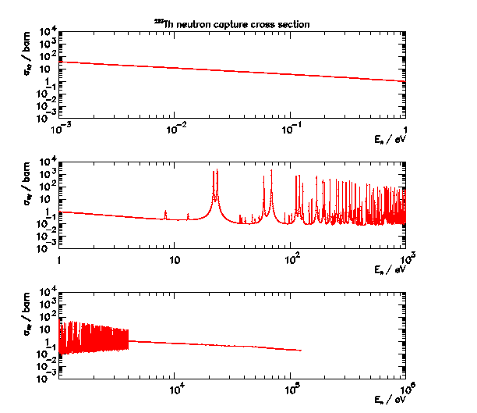
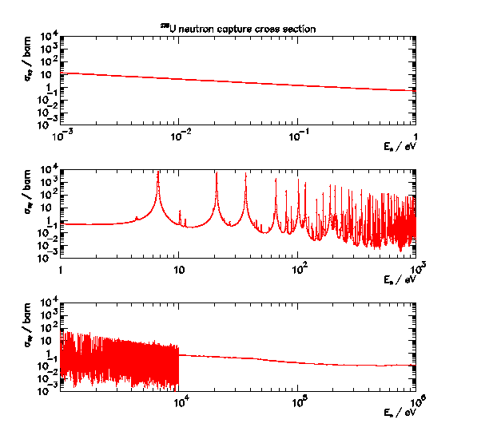
²³²Th and ²³⁸U radiative n-capture cross sections
Not having to deal with this is a significant simplification.

Slide 37
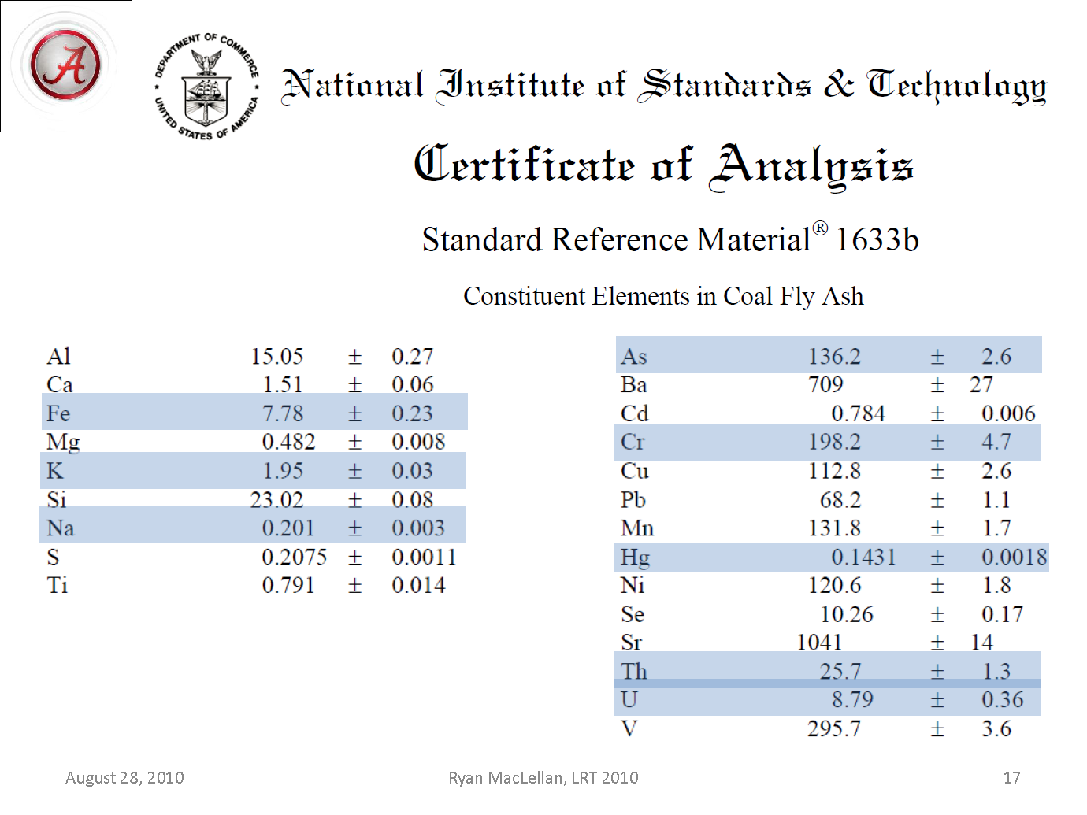
Neutron flux determination
The conversion of activities in the activated samples is done in comparison to a co-activated NIST standard material.
The three integral neutron fluxes are determined by minimizing:
Measured
NIST
JENDL-4.0
Fitted
$$χ^{2}=\sum_{j=1}^{7}{\frac{{\left(A_{j}\left(t\right)−N_{Tj}∙\left(1−e^{−{t_{i}}/{τ_{j}}}\right)∙e^{−t/τ}∙\left[\left\langle σ_{th}\right\rangle ∙Φ_{th}+\frac{σ_{RI}}{16.81}∙Φ_{et}+\left\langle σ_{ff}\right\rangle ∙Φ_{ff}\right]\right)}^{2}}{σ_{j}^{2}+σ_{NIST}^{2}}}$$
Measured
j: Na, K, Ti, Cr, Fe, Th, U

Slide 38
Conversion of activities into element concentrations
Integral fluxes from analysis of co-activated reference material (fly ash) or power-flux relation
$$N_{T}=\frac{A_{0}}{\left(1−e^{−{t_{i}}/τ}\right)∙\left[\left\langle σ_{th}\right\rangle ∙Φ_{th}+\frac{σ_{RI}}{16.81}∙Φ_{epi}+\left\langle σ_{ff}\right\rangle ∙Φ_{ff}\right] }$$
Fraction of maximal production
n capture rate on target nuclide, per atom
Average cross sections from JENDL-4.0 database

Slide 39
Elemental analysis without neutron flux fit
For elements contained in the NIST fly ash reference material (U used as example), the elemental concentration can be determined by normalization to the reference data. However, not for elements not certified in the fly ash. For those the detour via the neutron flux fit and tabulated cross sections is needed.
$$f_{U}^{S}=\frac{m_{S}^{FA}∙f_{U}^{FA}}{m_{S}^{S}}∙\frac{\left(1−e^{−{t_{i}^{FA}}/{τ_{Np}}}\right)}{\left(1−e^{−{t_{i}^{S}}/{τ_{Np}}}\right)}∙\frac{R_{0}^{S}}{R_{0}^{FA}}$$
$m_{S}^{FA}$: mass of activated fly ash sample
$f_{U}^{FA}$: uranium concentration [g/g] of fly ash sample
$f_{U}^{S}$: uranium concentration [g/g] of sample of interest
$m_{S}^{S}$: mass of activated sample of interest
$t_{i}^{FA},t_{i}^{S}$ duration of the fly ash and sample activation, respectively
$τ_{Np}$: ²³⁹Np mean live time
$R_{0}^{FA},R_{0}^{S}$: fly ash and sample counting rates
$σ$: uncertainties of corresponding parameters
$$σ_{f_{U}^{S}}=\sqrt{{\left(\frac{f_{U}^{S}}{f_{U}^{FA}}∙σ_{f_{FA}^{S}}\right)}^{2}+{\left(\frac{f_{U}^{S}}{R_{0}^{S}}∙σ_{R_{0}^{S}}\right)}^{2}+{\left(\frac{f_{U}^{S}}{R_{0}^{FA}}∙σ_{R_{0}^{FA}}\right)}^{2}}$$

Slide 40
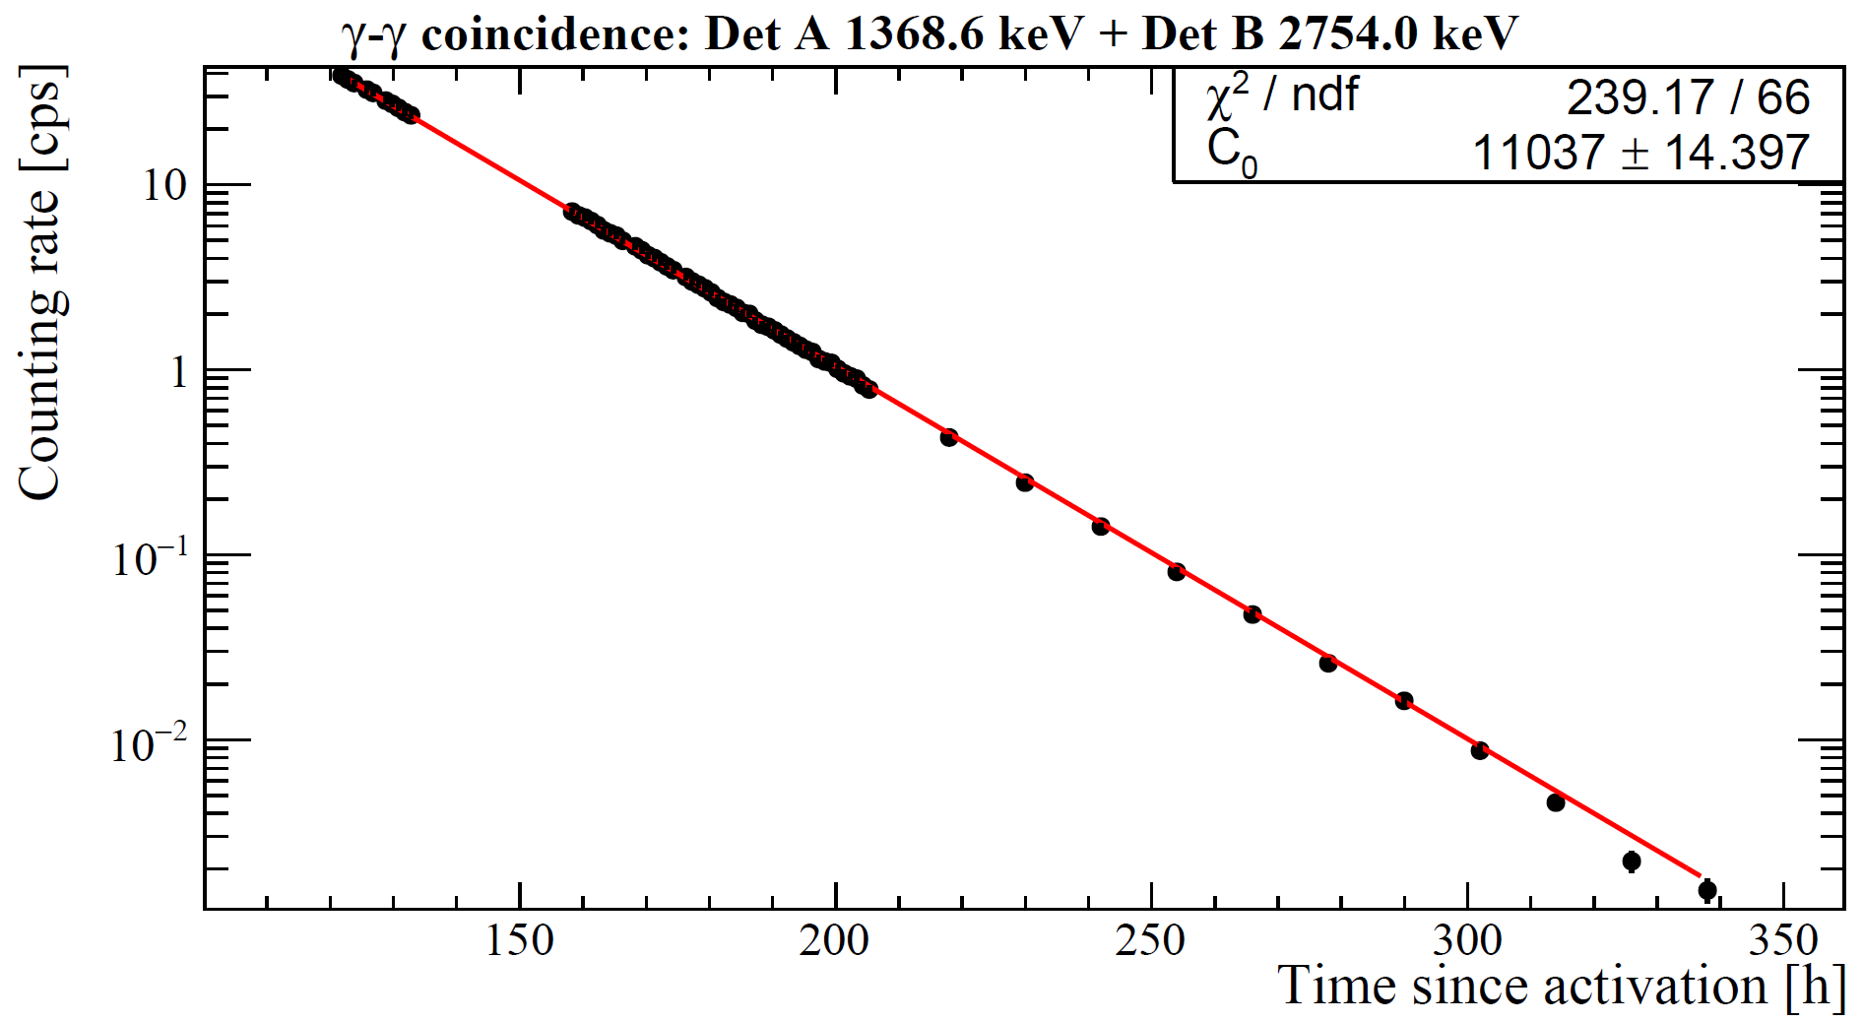
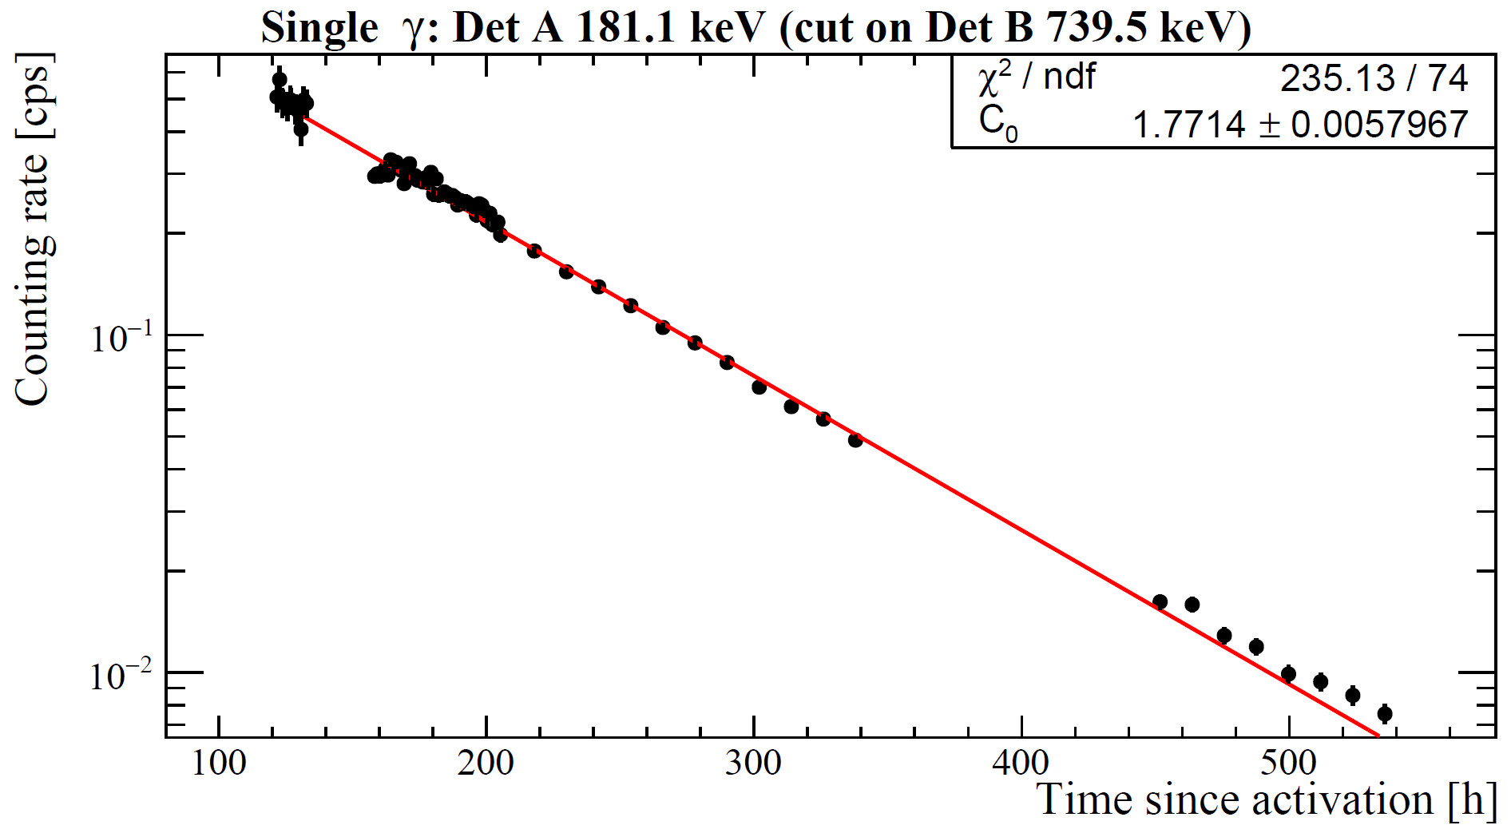
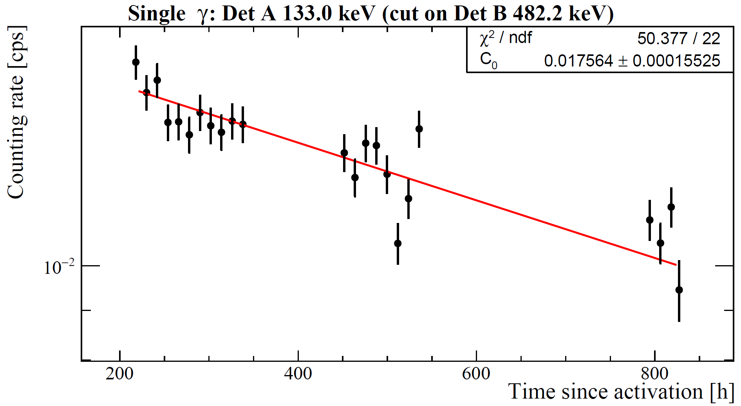
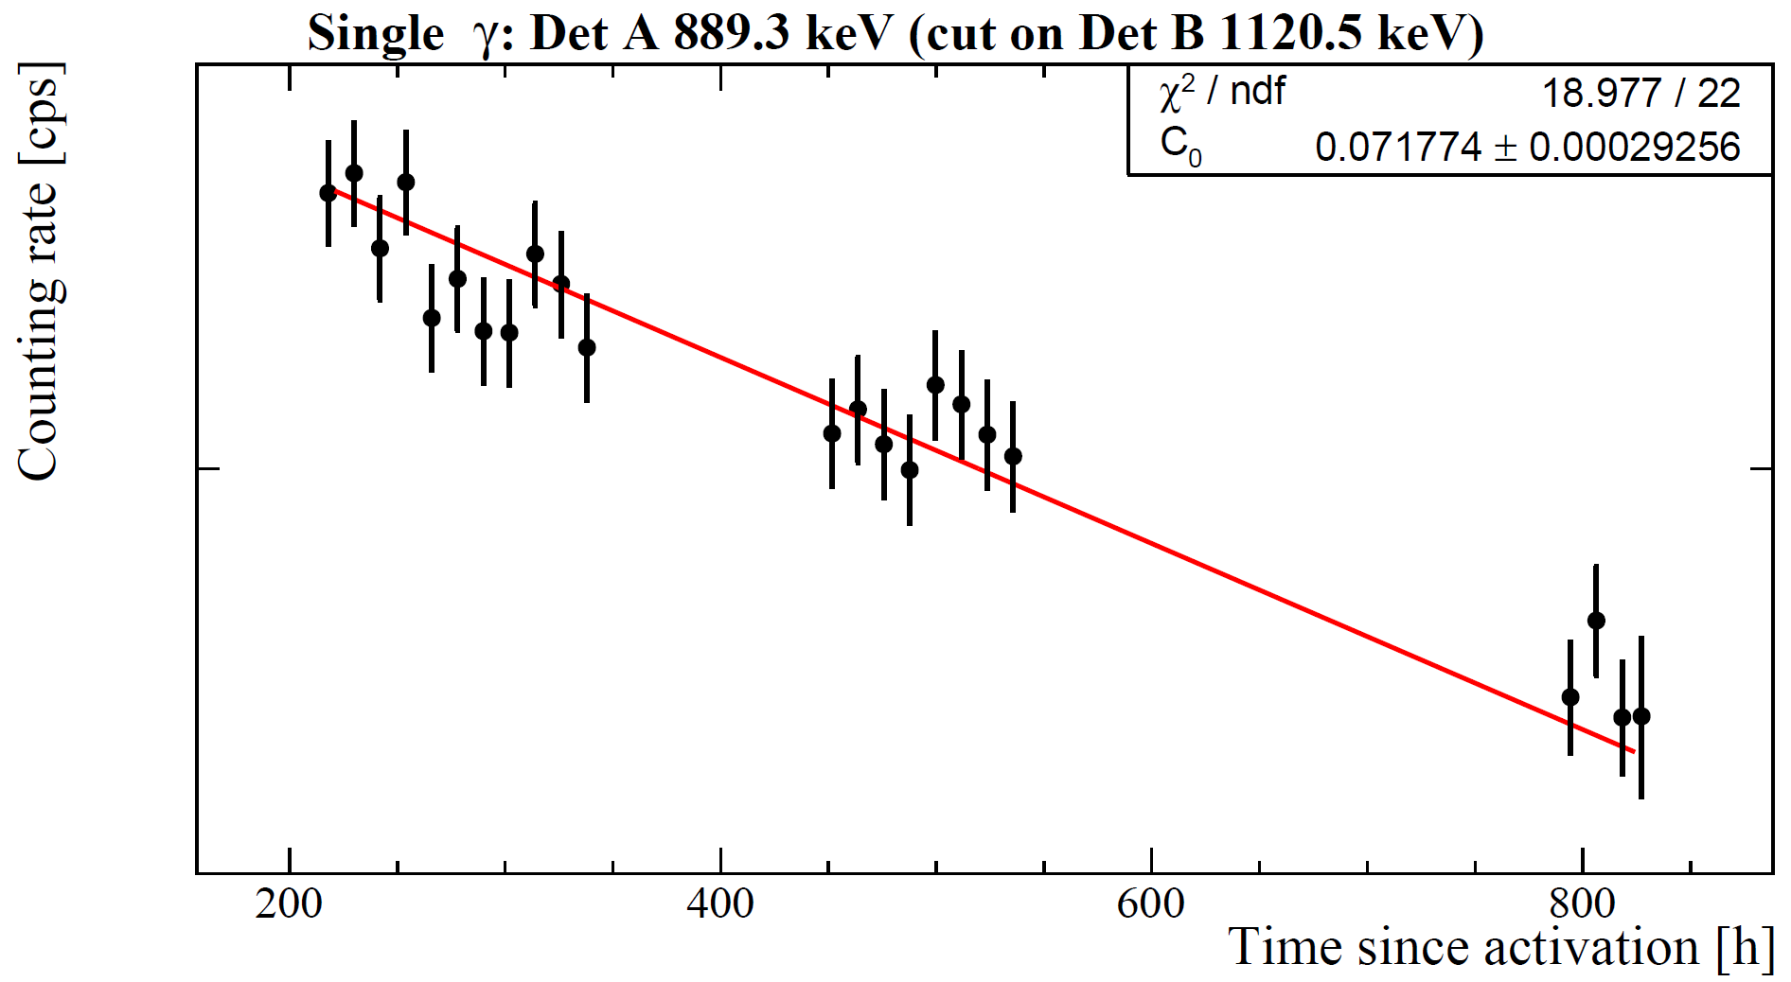
Enhanced sensitivity through γ-γ-coincidences
Coincidence signals are observed at the expected γ–energies for multiple nuclides with their corresponding half lives. ²⁴Na: about 10 MBq.
We are now working on a consistency test to observed for the same sample in a 2017 activation.
24Na coincidences
99Mo coincidences
181Hf coincidences
46Sc coincidences

