Slide 1

Study and development of new radon adsorbents
The IRENE project
José Busto
CPPM / Univ. Aix-Marseille
Krakow 3 october 2024

Slide 2

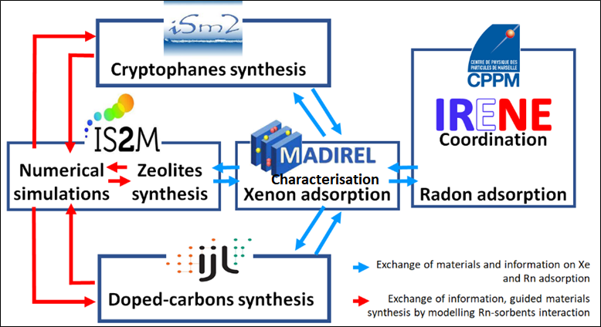
IRENE
Innovative mateRials for Extreme radoN capturE
4-year funding project (ANR)
5 labs consortium
Particle physicist + Chemist and Physico-chemist
Experimentalist + theoreticians

Slide 3
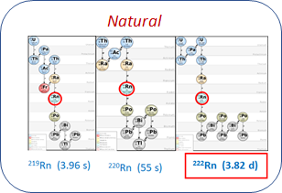
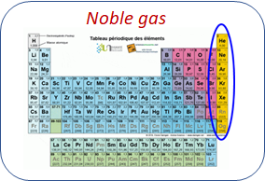
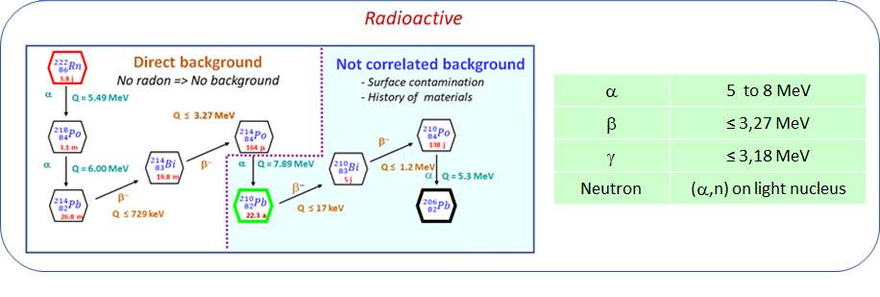
Natural, Radioactive, Noble gas
from the U and Th chains
Easy to transport, complicated to capture
Short half-life, high intrinsic activity

Slide 4
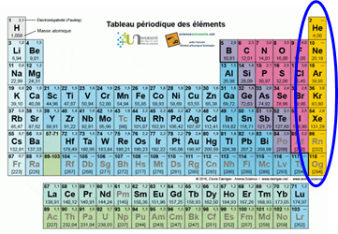
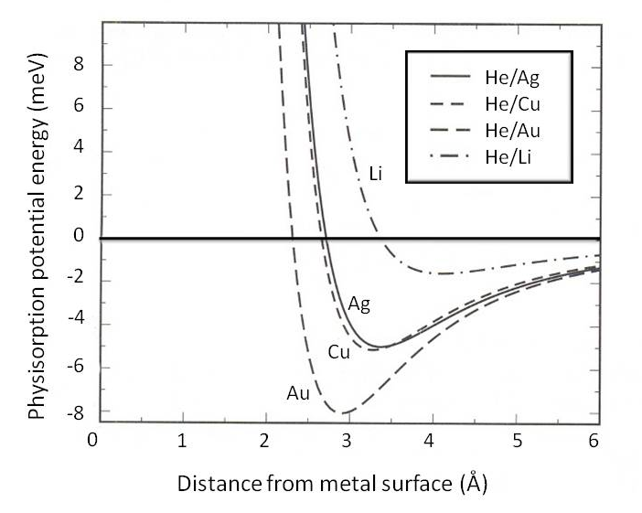
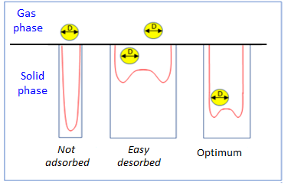
Radon Capture
Rn Noble gas
−−> no chemistry => physical process : physical adsorption
Physical adsorption : Surface capture by Van der Waals forces
−−> porous materials
But not all pores are equally effective
Need to optimise porosity

Slide 5
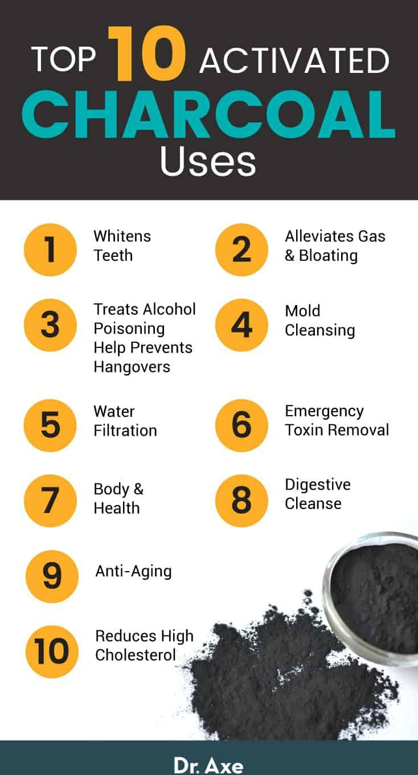
Porosity
Activated Charcoal : universal adsorbent (very big surface area (2000 m²/g),
big stability, not toxic, low cost , …)
Activated charcoal : very popular for radon capture
: dozens of papers are published

Slide 6
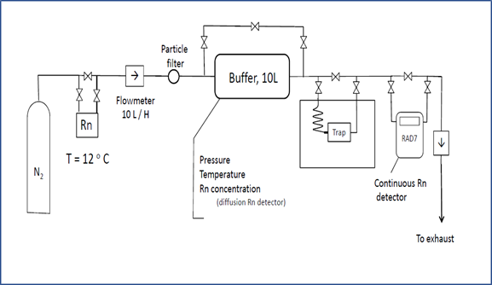
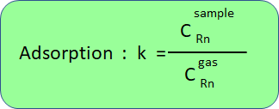
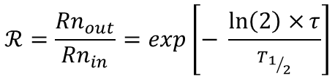

Motivation of the IRENE projet
2015 : Capture of Rn in over 60 commercial or research materials by dynamic adsorption (SuperNEMO)
- Activated charcoals
- Carbon molecular sieves
- Carbon aerogels (Granada)
- Molecular cages - CC3 (Liverpool)
- MOF
Zeolites (Al, Si) (Marseille, Mulhouse)
Dedritic polymers (Marseille )
Pressure = 1 bar
Temperature = +20°C à – 80°C
Gas : N₂, He
$$τ= \frac{m∙k}{Φ}$$
$$ℛ=\frac{{Rn}_{out}}{{Rn}_{in}}=exp\left[− \frac{\ln\left(2\right)×τ}{T_{1/2}}\right]$$
Rn retention time in the column
Rn reduction factor of the column
Adsorption factor

Slide 7
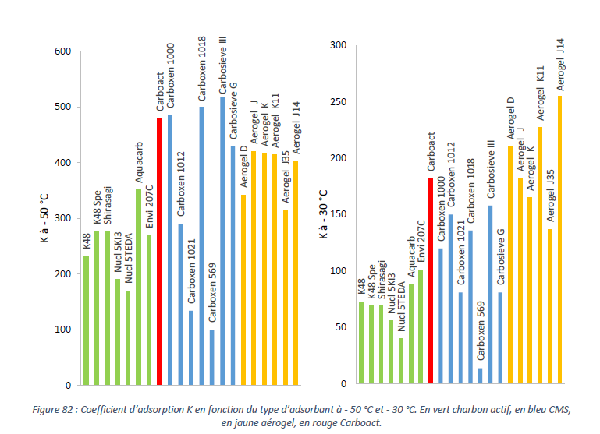
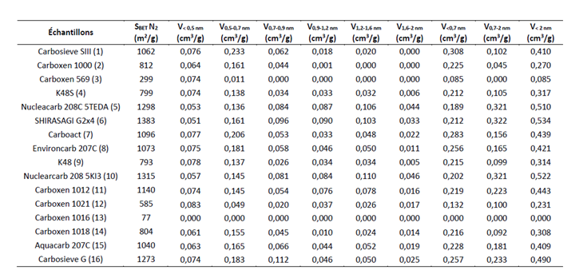
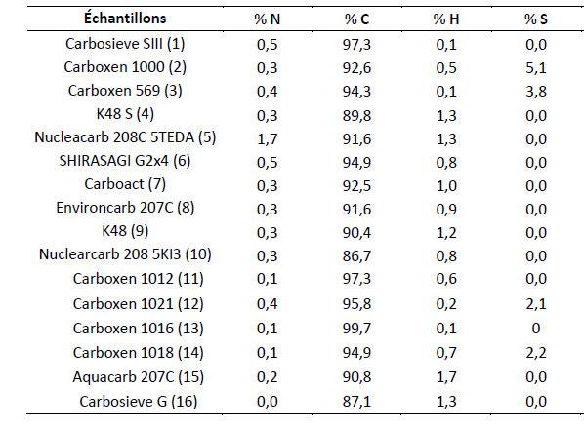
AC CMS Aerogel
Some results
- 50°C
- 30°C
Microporosity from 0.5 to 2 nm : IJL
Chemical compostion : CINaM
Adsorption @ – 50°C and -30°C in AC, CMS, Aerogels
- Optimal porosity :
0.5 - 0.7 nm (Rn 0.4 nm)
- Small effect on the chemical
composition (sulphur)

Slide 8
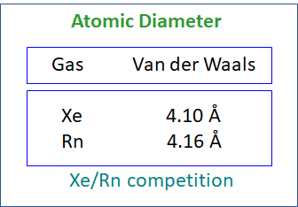
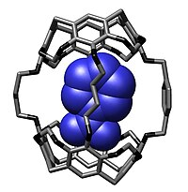
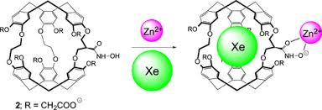

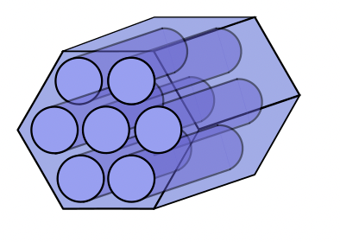
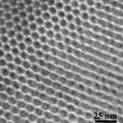
Motivation of the IRENE projet
2018 : Study of Xe / Rn adsorption with Crytophane supramolecular cages
Very efficient for molecular encapsulation .
Already used for Xe capture
Adjustable cage dimensions
Three cages were studied on two different supports
cages
supports
Silica MCM-41
Silica SBA-14
diamètre de 2,6 nm 6,5 nm.
1000 m²/g
500 m²/g

Slide 9
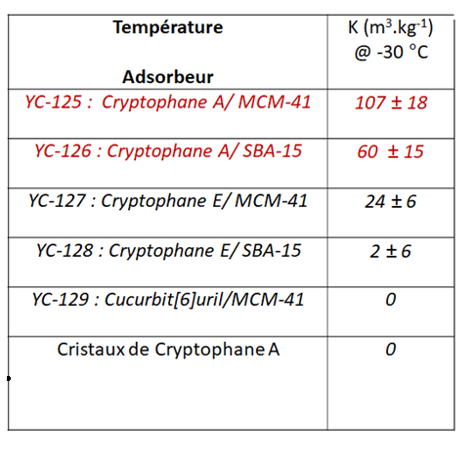
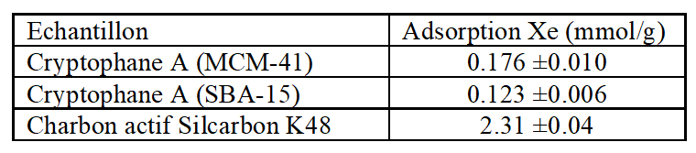
Rn adsorption in N₂ (CPPM)
Xe adsorption (MADIREL)
13.12
1,68
Rn(K48)/Xe(YC125) « selectivity » = 7.8
Very preliminary results.
- Possibility of improving the performance
Activated charcoal Silcarbon K48 180 ± 25
(type and size of cage, chemical composition, support).

Slide 10

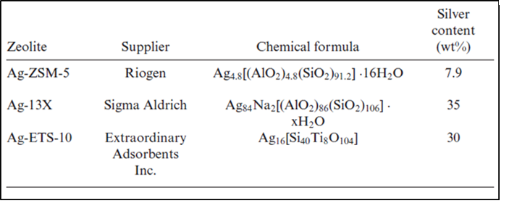
Motivation of the IRENE projet
2020 : Study of radon capture on commercial silver zeolites by dynamical adsorption

Slide 11
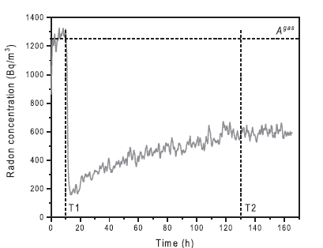
Adsorption on silver zeolites
(2020 -2023)
- Closed circuit: very high adsorption (very long measurement time)
Breakthrough curbe @-30°C in
0.2 g ETS-10-Ag, 60 l/h N₂

Slide 12
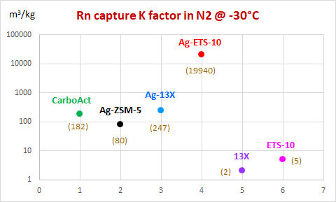

Some results
1 Reference charcoal (CarboAct®)
3 Commercial Ag zeolites
Ag-ZSM-5
Ag-13X
Ag-ETS-10
Active Charcoal
Ag Zeolite
$$K=\frac{Rn in the Adsorbent}{ Rn in the Gas}$$
[m³/kg]

Slide 13
Some results
1 Reference charcoal (CarboAct®)
3 Commercial Ag zeolites
Ag-ZSM-5
Ag-13X
Ag-ETS-10
Active Charcoal
Ag Zeolite
~ 100
$$K=\frac{Rn in the Adsorbent}{ Rn in the Gas}$$
[m³/kg]

Slide 14
Some results
1 Reference charcoal (CarboAct®)
3 Commertial Ag zeolites
Ag-ZSM-5
Ag-13X
Ag-ETS-10
2 NO Ag zeolite
13X
ETS-10
Active Charcoal
Ag Zeolite
Zeolite NO Ag
$$K=\frac{Rn in the Adsorbent}{ Rn in the Gas}$$
[m³/kg]
Huge impact of silver on adsorption

Slide 15

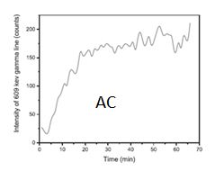
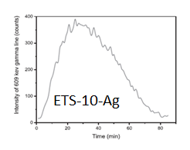
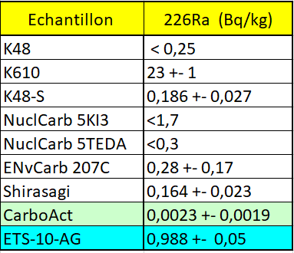
Some results
High sensibility to the water
=> Very dry gas
High concentration of ²²⁶Ra
=> high emanation
Rn reach equilibrium
Rn is empty by water
Evolution of the γ line at 609 keV of 214Bi in AC and ETS-10
with a flow of dry air + Rn

Slide 16
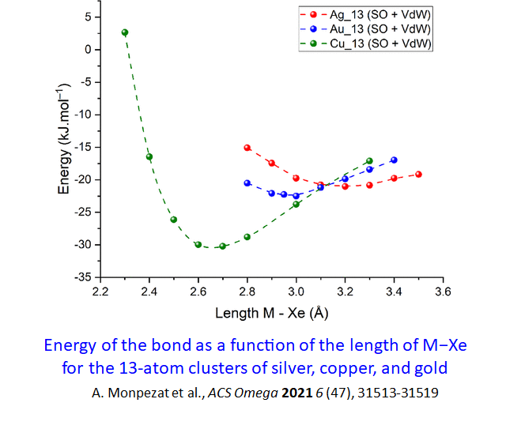
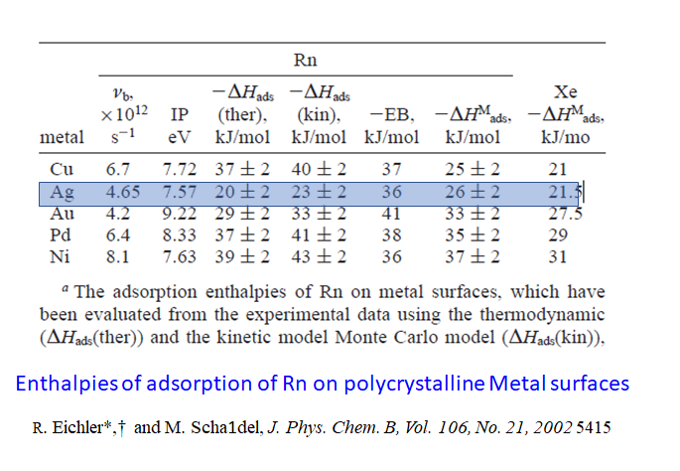
Potential improvement
Cu and Ni seem to be better candidates than Ag, and are less expensive !

Slide 17
The IRENE project
Project submitted to the ANR in 2022
Project start in February 2024
Project philosophy
-Feedback between the 5 laboratories
-Modelling as a guide
-Three families of adsorbents (Zeolites, Cages, Carbon-based)
-Xenon as a reference gas
-Radon capture in N2, He, and Xe

Slide 18

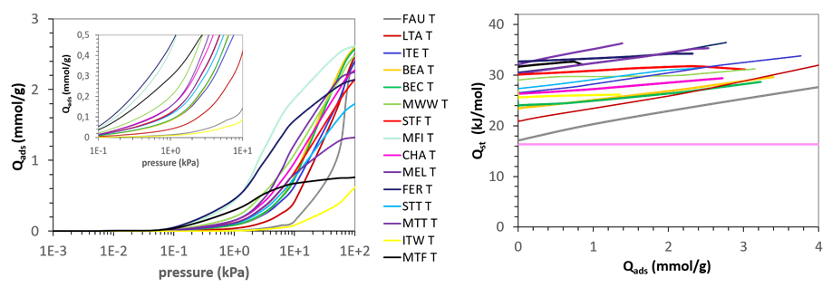
Some preliminary results from simulation
XRD, SEM/EDX analysis of ETS-10 and ZSM-5 zeolites
The samples used (ETS-10, ZSM-5) could be improved by eliminating non-adsorbent phases (quartz, alumina, etc.).
The contribution of silver to the capture of radon needs to be better understood (Ag⁺, nanoparticles )
Monte Carlo simulation of adsorption of Rn & Xe in zeolites
Simulated Rn adsorption isotherms @ 298K & isosteric heats of adsorption

Slide 19
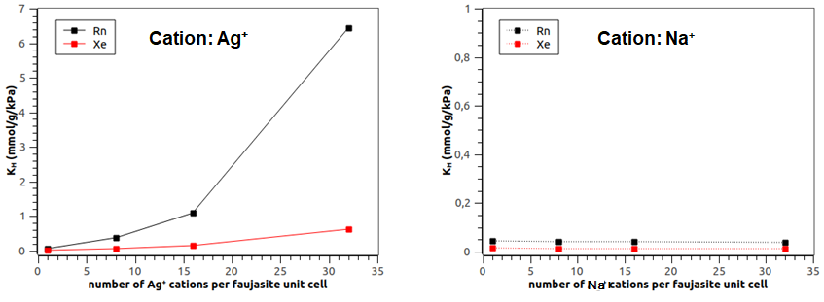
Some preliminary results from simulation
How chemical composition of zeolite influences Rn & Xe adsorption

Slide 20
Conclusion
Low-energy and low-counting rate experiments require materials with extreme purity and ultra-low radon
concentration.
Traditionally, activated carbons has been used to capture radon with a good efficiency. However the
purification levels reached are not always sufficient.
Materials with adsorption capacities more than 100 times higher than the best active carbons are now
commercially available but they do not have the necessary purity levels and their performance are not well
understood.
-Possible improvements in radon capture can be reached by choosing the right chemical composition and
good porous structure.
-The objective of the IRENE project is to tackle the problem of radon capture in microporous materials
in a scientific and coherent way, thanks to a unique consortium of physical chemists and particle physicists

Slide 21

Thank you for your attention
IRENE

