Slide 1
A gaseous time projection chamber with Micromegas readout for low-radioactive material screening
Shanghai Jiao Tong University
Wenming Zhang
October 1st, 2024
Low Radioactivity Techniques (LRT2024)
Notes:
Good day, everyone. (My name is Wenming Zhang from Shanghai Jiao Tong University.) Today, I would like to present our research on a gaseous time projection chamber with Micromegas readout for low-radioactive material screening.

Slide 2
1
Research Background
2
Technology of Low-background Alpha Detector
3
Detector Construction and Testing
4
Conclusion
Notes:
The presentation is divided into four parts. First, we will discuss the research background and current status of our topic. Then, we will delve into the technology of the low-background alpha detector. Next, we will present the setup and testing of the detector. Finally, we will draw conclusions from our research.

Slide 3
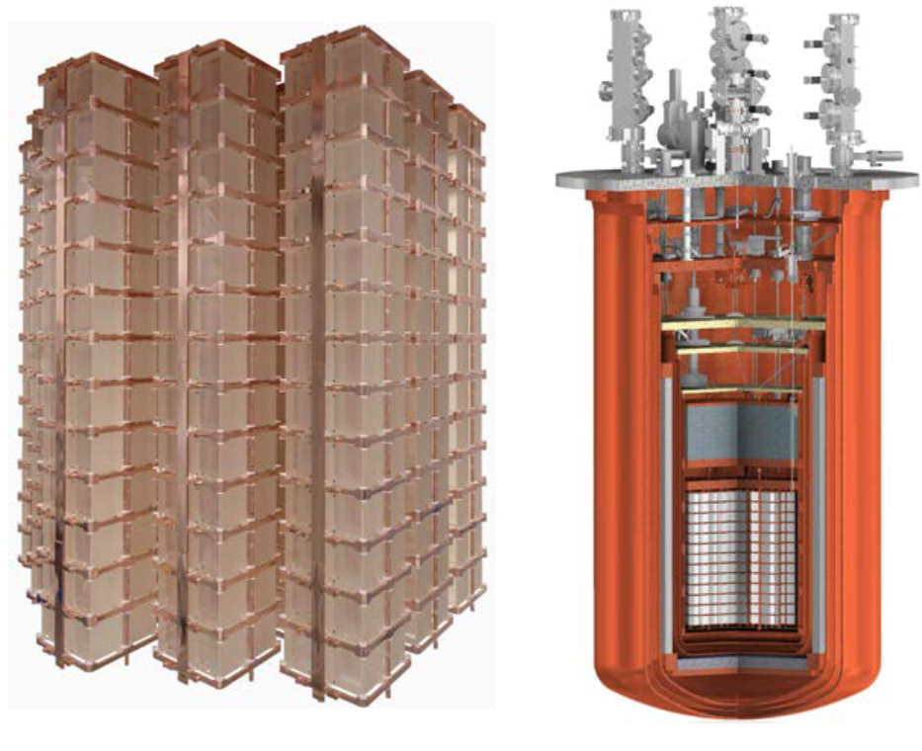
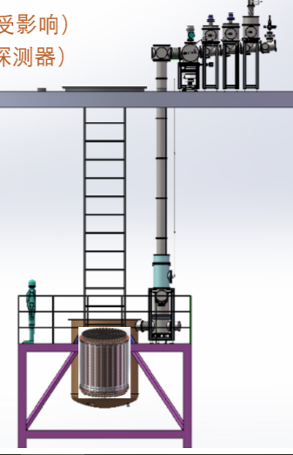
Underground rare event detection and background
Neutrinoless double beta decay detection
Neutrino detection
CUORE
200 kg ¹³⁰Te
$\overline{ν_{e}}== ν_{e}$
Crystal and copper surface contamination
JUNO
20 kt Liquid Scintillator
Radon on organic glass sphere surface bring contamination
Dark matter detection
Radioactivity background
PandaX-4T
4 t liquid xenon (TPC)
WIMP
Copper and Teflon surface contamination
Radon from detector and pipeline surfaces
Cosmic rays and their derivatives
Lab environment (high-energy gamma, neutron）
Internal and surface radioactivity of detector materials introduce background (radon exhalation)
The background is crucial as the signals are rare and determines the experiment sensitivity.
Notes:
For underground rare event detection experiments, the signals are extremely rare. For example, in the neutrinoless double beta decay experiment, the international collaboration group CUORE uses 200 kg of Te-130 to build a cryogenic calorimeter, expecting to find a possible decay signal within a few years. Another example is the dark matter detection experiment PandaX-4T, which uses 4T of liquid xenon to search for the dark matter candidate particle WIMP. Rn-222 has become one of its main backgrounds, and Rn-222 mainly comes from the outgassing on the surface of the detector materials and pipelines. For neutrino detection experiment JUNO, radon on organic glass sphere surface bring contamination and the contamination can easily enter the detection sensitive area. Therefore, for this type of rare signal experiment, the background level is crucial. The measurement and screening of the radioactivity on the surface of the detector materials have also become a real demand.

Slide 4
Status of Low-Background Measurement Techniques
Detection Technology | Measurement Object | Sensitivity | Remarks
Inductively Coupled Plasma Mass Spectrometry | Heavy elements in high-purity oxygen-free copper | ppt | Complex chemical pretreatment
Neutron Activation Analysis (NAA) | ²³⁸U and ²³²Th in Teflon | sub-ppt, ppt | Utilizes neutron irradiation
High-Purity Germanium Gamma Detector | ²³⁸U and ²³²Th in high-purity oxygen-free copper | 1-10 uBq/kg sub-ppb, ppb | Non-destructive testing, high energy resolution
betaCage | Radioactivity on the surface of large-area materials | - | Proposed by the CDMS collaboration
SuperNEMO BiPo-3 detector | ²⁰⁸Tl and ²¹⁴Bi Inside thin film materials | Background ²⁰⁸Tl : 0.9±0.2 uBq/m² ²¹⁴Bi：1.0±0.3 uBq/m² | Developed by the SuperNEMO collaboration
UltraLo-1800 | Radioactivity on the surface of large-area materials | Background 1.4 uBq/cm² | XIA commercial detector
Notes:
At present, there are various low-background measurement techniques, such as the well-known inductively coupled plasma mass spectrometer, neutron activation analysis, high-purity germanium detector, etc., which are mainly for the radioactive measurement of bulk materials. There are also measurement techniques for the radioactivity on the surface of materials, such as the betaCage, the BiPo-3 detector developed by the SuperNEMO collaboration group, and the commercial detector Ultralo-1800 in the United States.

Slide 5
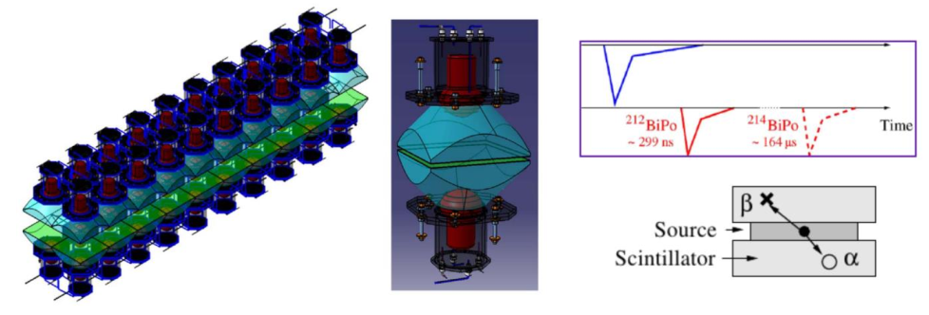
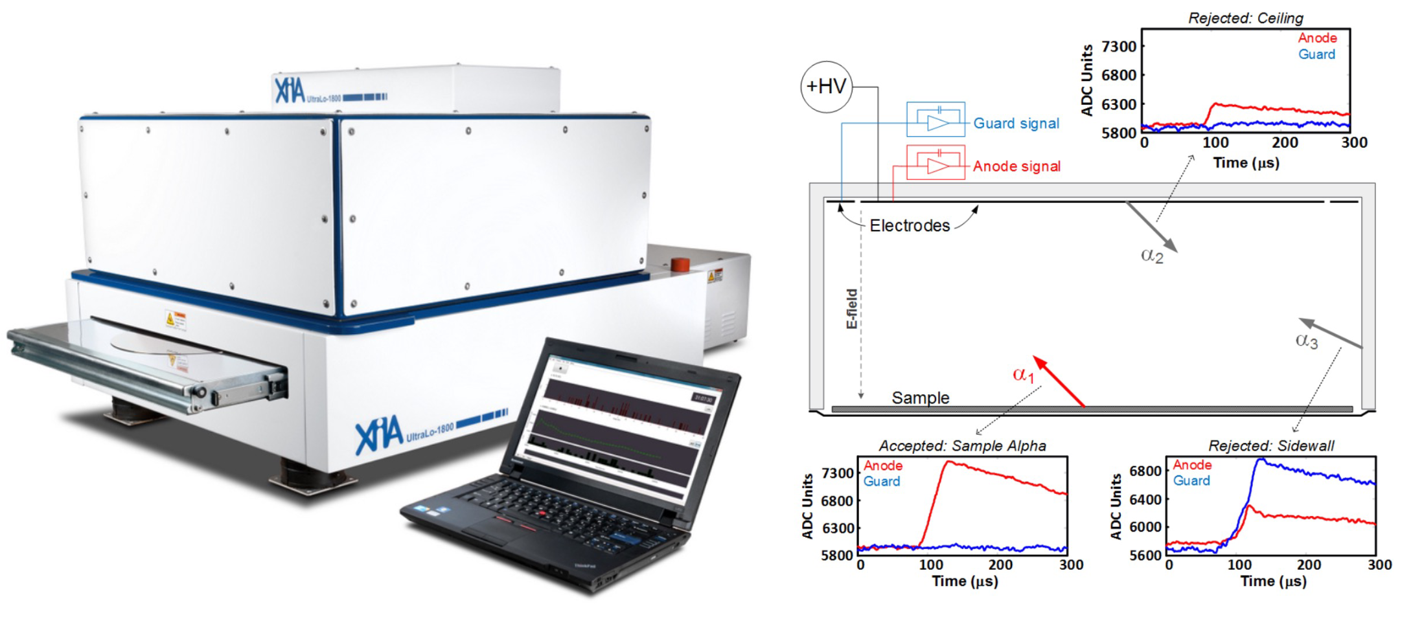
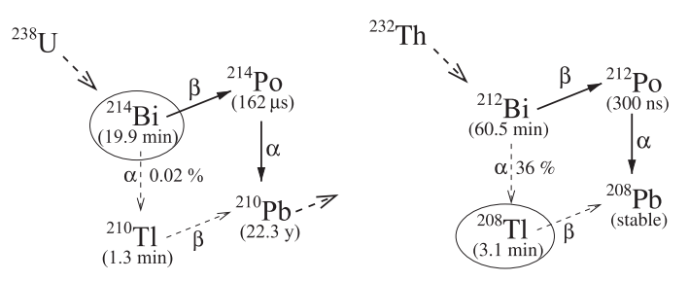
Status of Low-Background Measurement Techniques
XIA: UltraLo-1800
SuperNEMO: BiPo-3 detector
Ionization Chamber
Scintillator
Identify the alpha signals using pulse waveforms (rise time, amplitude, and shape).
Background 0.14 u$Bq/{cm}^{2}$，for alpha measurement of semiconductor.
Measurement area: 1800 cm²
Background ²¹⁴Bi: 1.0±0.3 μBq/m²
Background ²⁰⁸Tl: 0.9±0.2 μBq/m²
Measurement Area: 3.6 m²
Notes:
Let me introduce these two detectors, Ultralo-1800 and BiPo-3. Ultralo-1800 is an ionization chamber with readout electrodes on both the anode at the top and the sidewalls of the ionization chamber. It uses pulse waveform technology to identify alpha signals from the sidewalls, anode, and cathode, and the measurement area reaches 1800 square centimeters. It is one of the charged particle spectrometers with the best background level at present. BiPo-3 is a plastic scintillator detector with many arrays of plastic scintillators arranged at the top and bottom. It uses the time-correlated alpha and beta signals generated by the cascade decay of Bi and Po elements to infer the radioactive content of the corresponding nuclides, and the measurement area reaches 3.6 square meters.

Slide 6
1
Research Background
2
Technology of Low-background Alpha Detector
3
Detector Construction and Testing
4
Conclusion

Slide 7
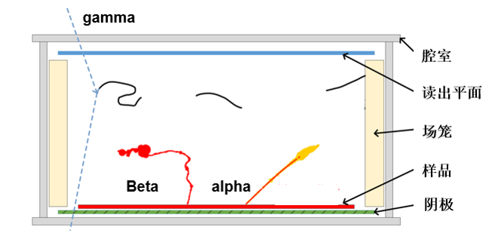
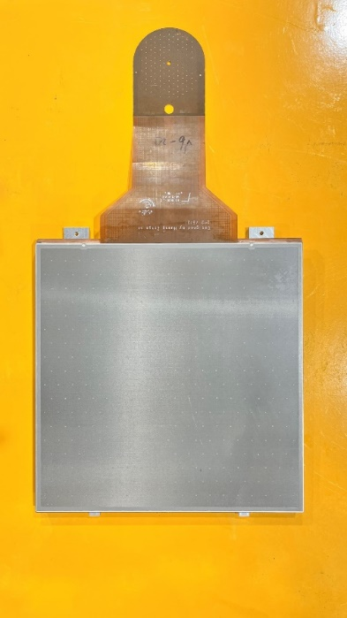
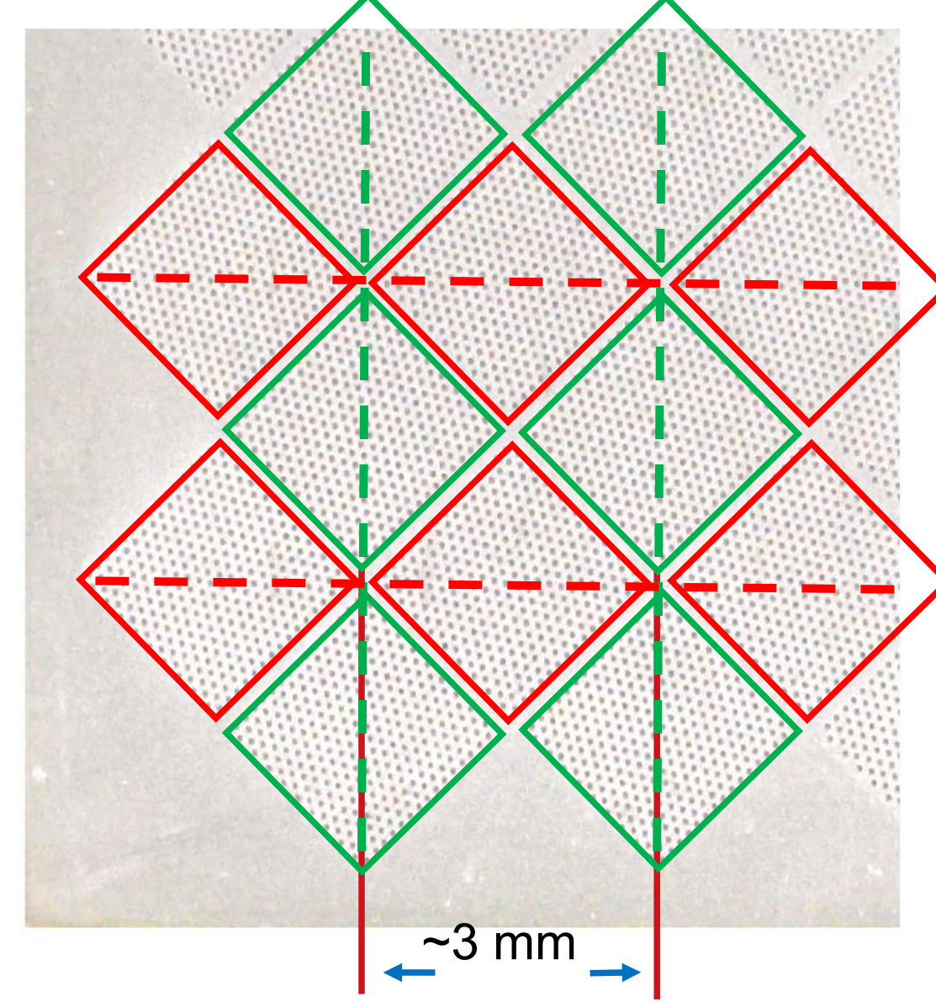
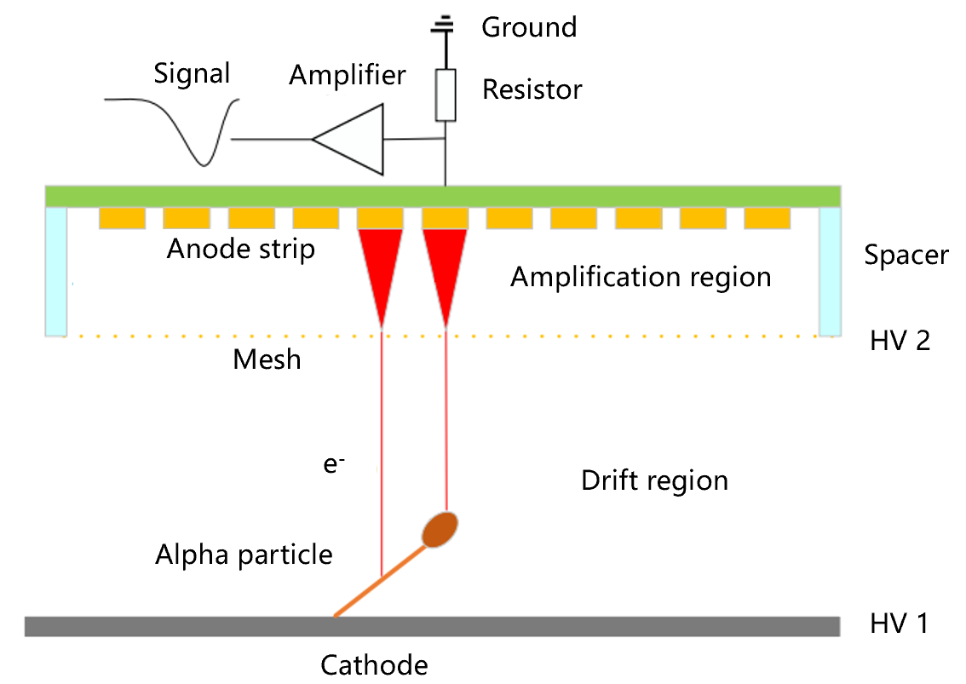
Technology of Gas TPC and Micromegas
Gas Time Projection Chamber (TPC)
Micromegas
Readout: 20×20 cm²
FENG J, ZHANG Z, LIU J, et al. A thermal bonding method for manufacturing Micromegas detectors[J]. 2021, 989: 164958.
Samples placed inside, record particle energy, track information
Thermal bonding Micromegas, strip readout
Notes:
Our goal is to build a charged particle spectrometer for the measurement and screening of radioactivity on the surface of materials, expecting to have better signal-background discrimination ability and better detection sensitivity compared to these previous detectors. Therefore, we combine the gas time projection chamber technology and the micromegas detector for research and development. When in use, the sample is placed inside the TPC, and the alpha and beta particles released from the surface of the sample deposit energy in the gas to leave tracks, and the ionization electrons are multiplied and collected by the micromegas detector at the readout plane. The micromegas detector used is the thermal-bonding Micromegas technology from the University of Science and Technology of China. The readout area of a single Micromegas module is 20 * 20 square centimeters, and there are 64 strip reads in each X and Y direction, with a spacing of 3 mm between the strips, and the thickness of the avalanche gap reaches 100 microns.

Slide 8
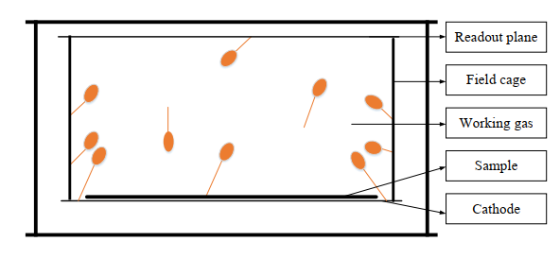
Trajectory Reconstruction and S-B Discrimination
Signal-Background Discrimination Method - Track-related
Alpha tracks from top to bottom
Z-axis
θ
Alpha tracks from bottom to top
α particle tracks are almost straight, with a Bragg peak at the track end.
The starting position of the track --- Identify the background near the field cage.
The track direction --- Identify the background of the readout plane and half of the gas background.
The number of triggered strips --- Identify short tracks of particles, which are likely from the gas and readout plane.
Notes:
Based on these technologies, we have developed a signal-background screening method related to the track. We know that the track of an alpha particle is almost a straight line, and there is a Bragg peak at the end of the track. Using this feature, we can distinguish the starting point and direction of the track. For example, in the two track projection diagrams on the right, one is from top to bottom, and the other is from bottom to top. Firstly, by using the position of the track starting point, the background near the field cage can be removed, as shown in this red part. Then, by using the direction of the track, the background from the readout plane and half of the gas can be removed, as shown in the blue and green parts. Finally, some short-track particles can be removed according to the number of triggered strips.

Slide 9
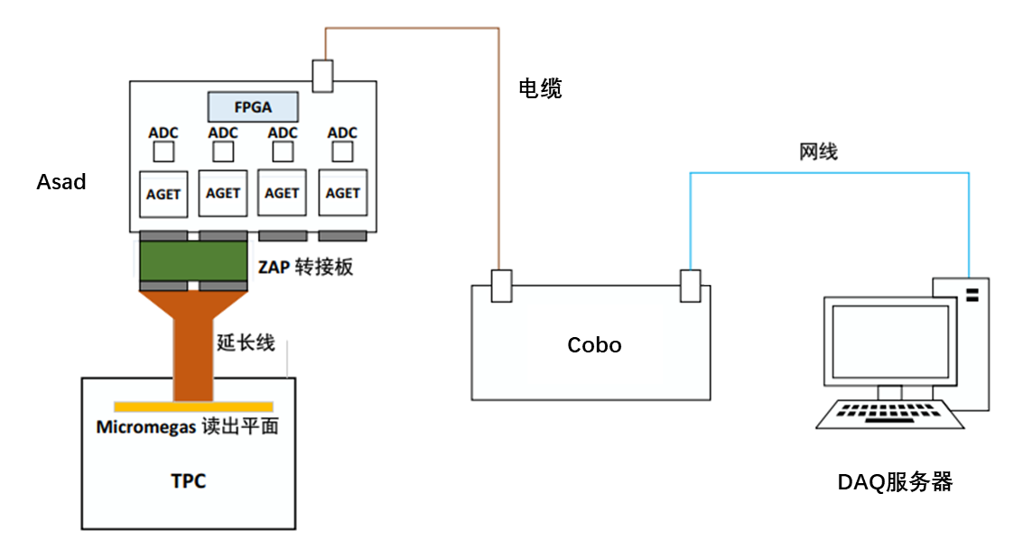
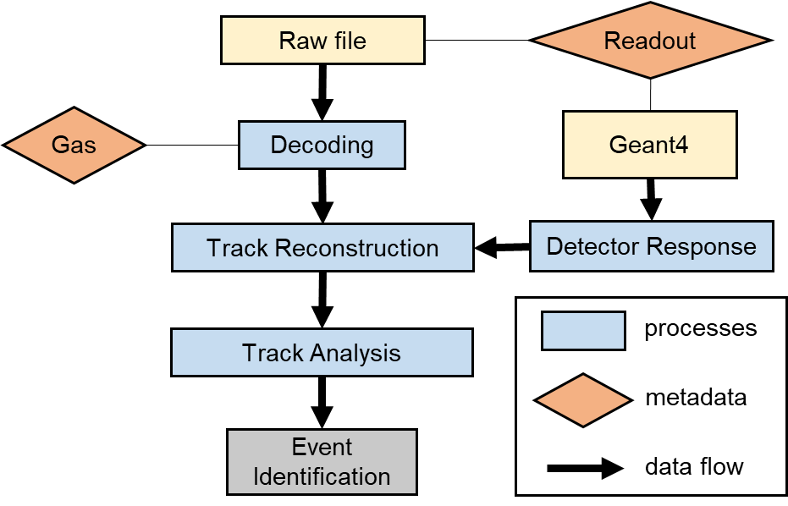
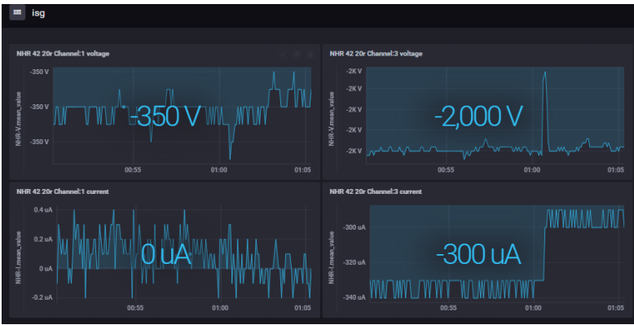
Subsystems of the Detector
Data Acquisition System
(Cobo-Asad, Concentration Board , ASIC Support and Analog-Digital conversion)
Data Analysis Framework
(REST, Rare Event Search Toolkit)
Slow Control Monitoring System
(voltage, current, and pressure)
Notes:
At the same time, we have built subsystems for the detector, including a data acquisition system based on cobo-asad electronics, a slow control system for monitoring voltage and current, and a root-based data analysis framework REST.

Slide 10
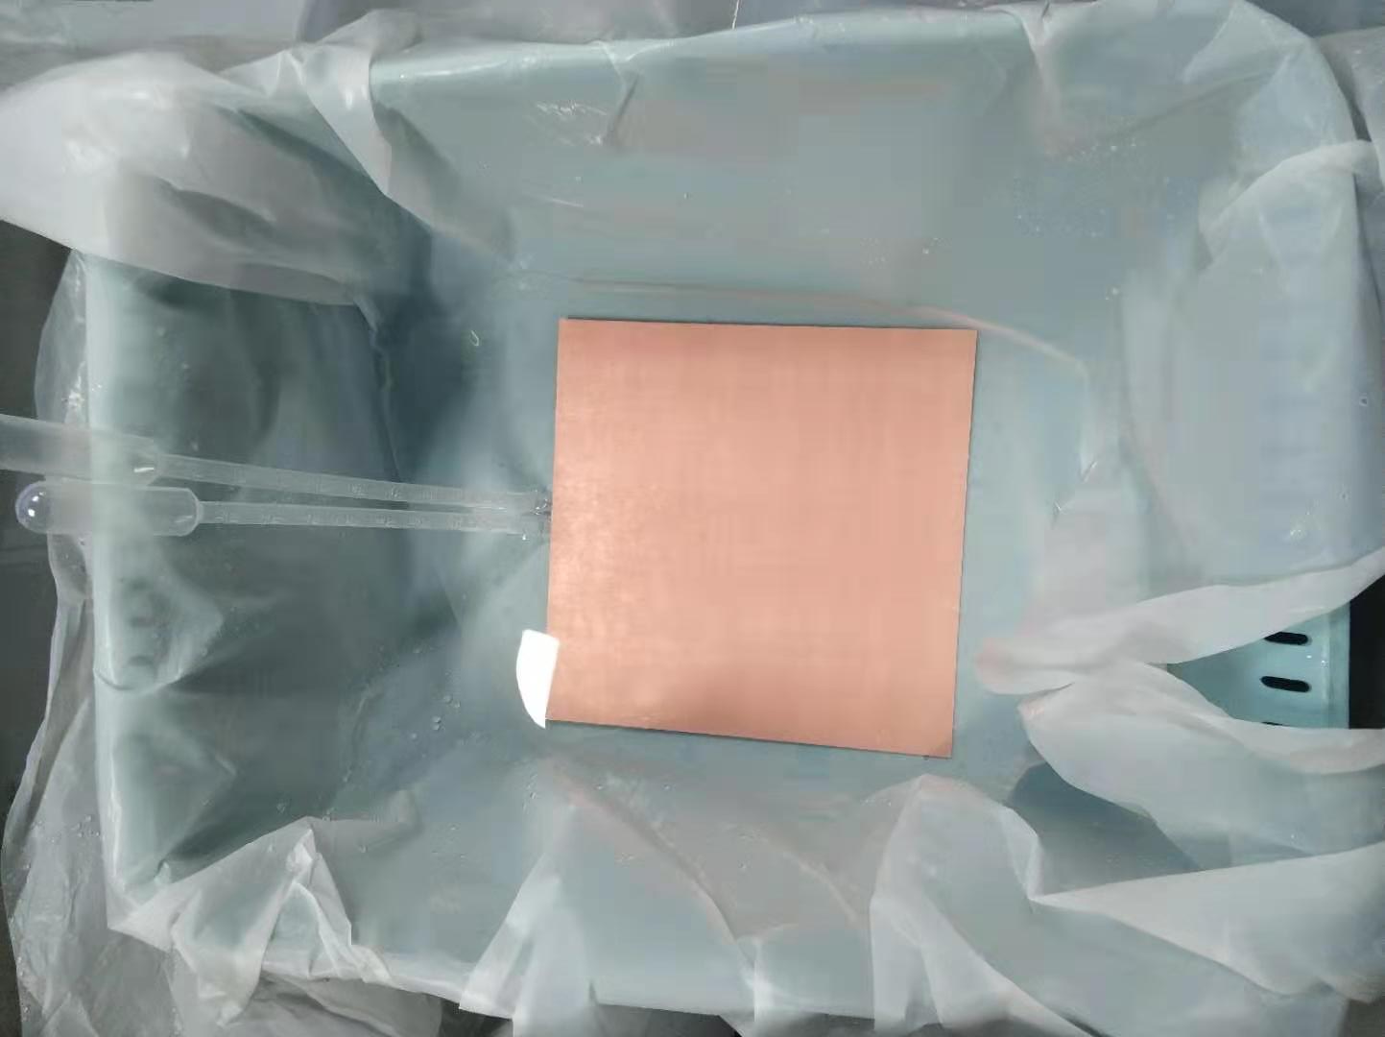
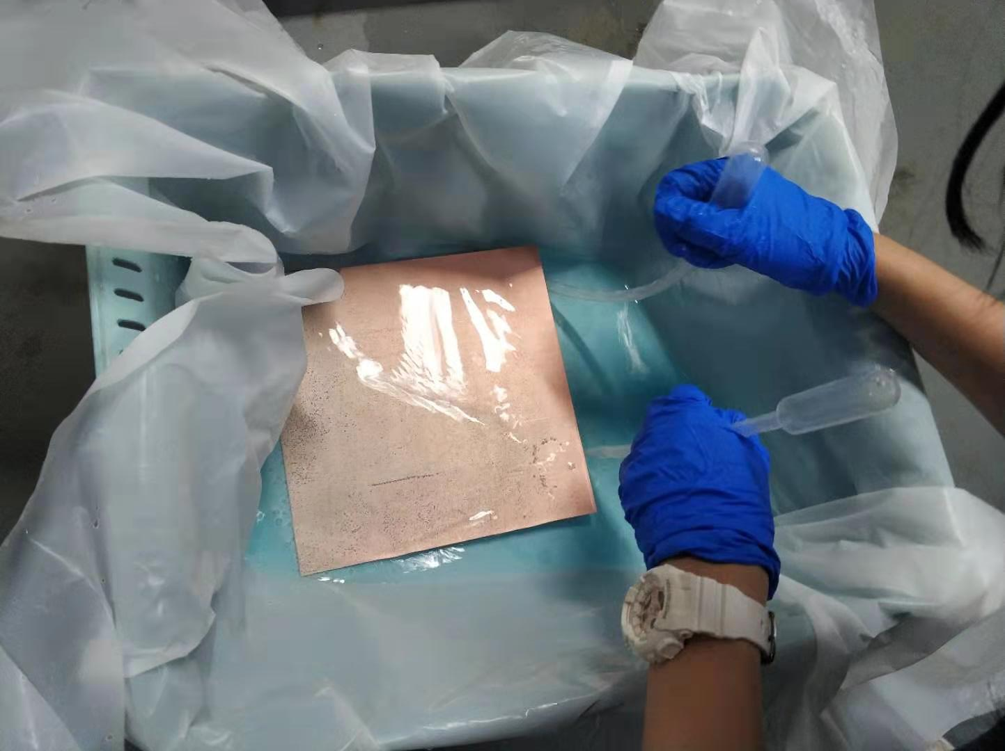
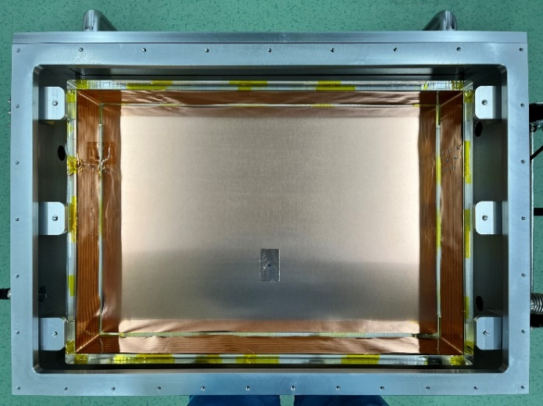
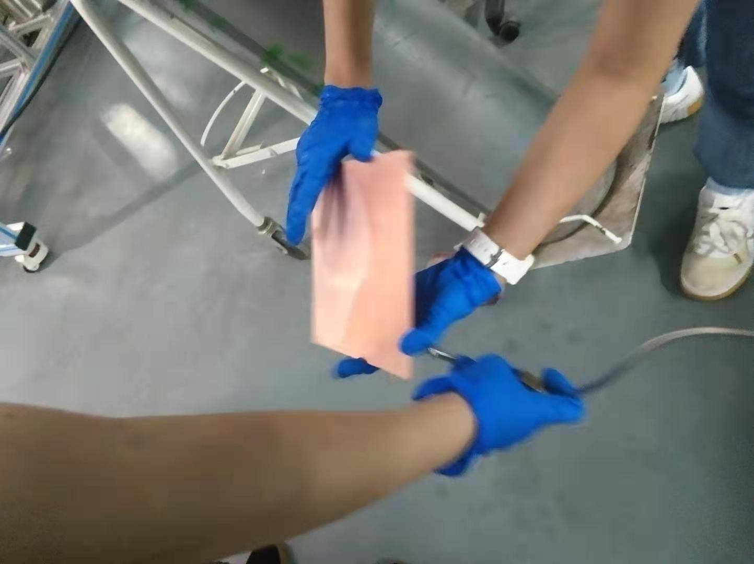
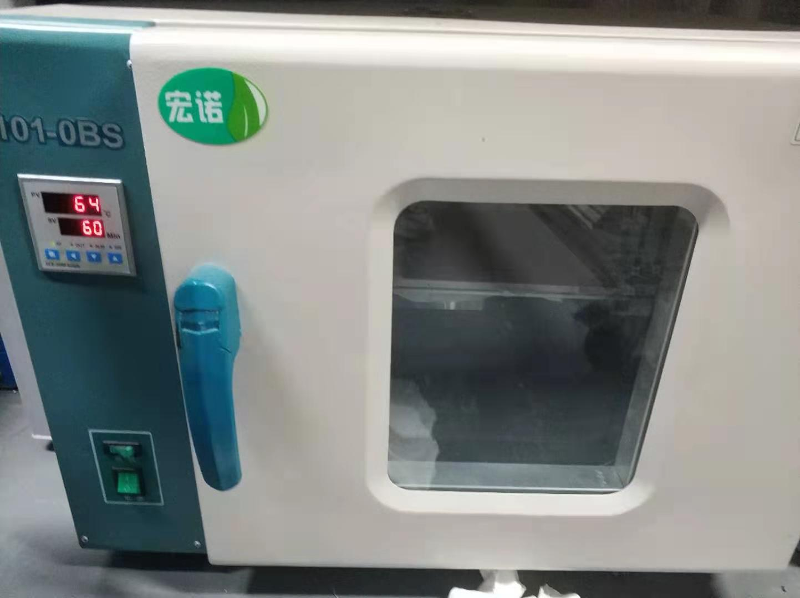
Low-Background Treatment of Detector Materials
Treatment of low-background detector material components
Oxygen-free copper cathode: Degrease (Alconox) -> Acid wash -> Rinse with ultrapure water -> Dry with nitrogen gas -> Dry in the oven
Acrylic + Flexible PCB field cage: Wipe with Alconox -> Clean with ultrapure water -> Dry with nitrogen
Aluminum inner wall: Wipe with Alconox -> Clean with ultrapure water -> Dry with nitrogen gas
Gas: Getter purification
Detector internal structure
Copper cathode treatment process
Notes:
We have performed low background treatment on key material components of the detector, including oxygen free copper cathodes, field cages composed of acrylic and flexible PCBs, and gases. Using different methods such as degreasing, acid washing, and getter treatment. The processing flow of copper cathode is shown in the right figure.

Slide 11
1
Research Background
2
Technology of Low-background Alpha Detector
3
Detector Construction and Testing
4
Conclusion

Slide 12
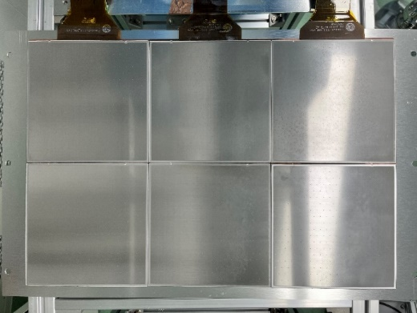
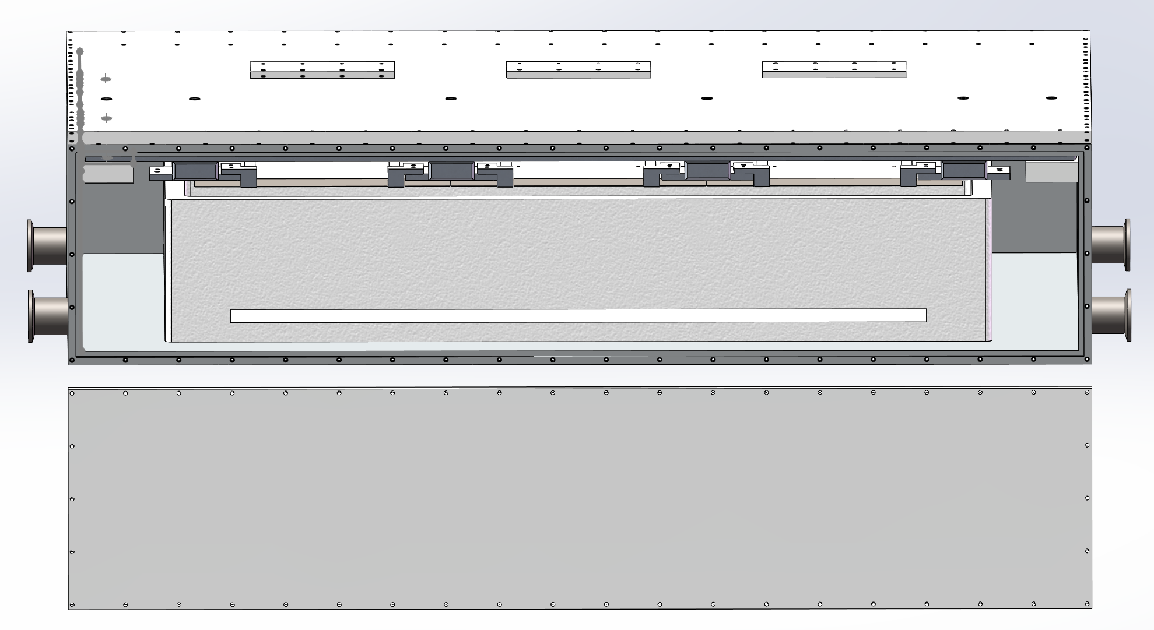
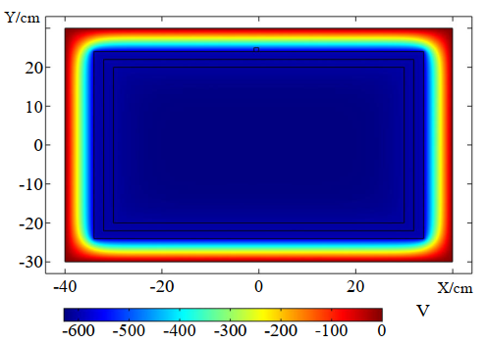
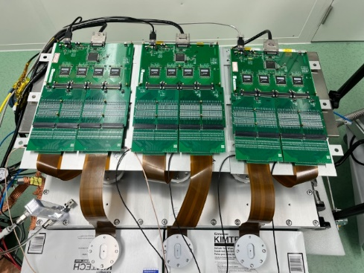
Construction of the Charge Particle Detector
Charged Particle detector
Readout plane - Micromegas
Internal detector photo
Time Projection Chamber (0.5-1.5 bar Argon/Xenon)
Readout plane：2400 cm² （2×3 Micromegas）
Drift distance：10 cm (Volume: 24 L)
Flexible PCB field cage
Samples are placed directly on the cathode to ensure complete deposition of alpha energy.
E-field distribution in the X-Y plane
External detector photo
Notes:
Based on these technologies and methods, we have built a charge particle detector. It is an aluminum alloy cavity, combined with charge readout modules at the top, a flexible PCB field cage at the middle, and a copper cathode at the bottom. The charge readout uses 6 Micromegas module, with a readout area of 2400 square centimeters. Samples are placed directly on the cathode to ensure complete deposition of alpha energy. To ensure the gas quality, the detector adopts a flow-type operation mode. These are some pictures of the detector.

Slide 13
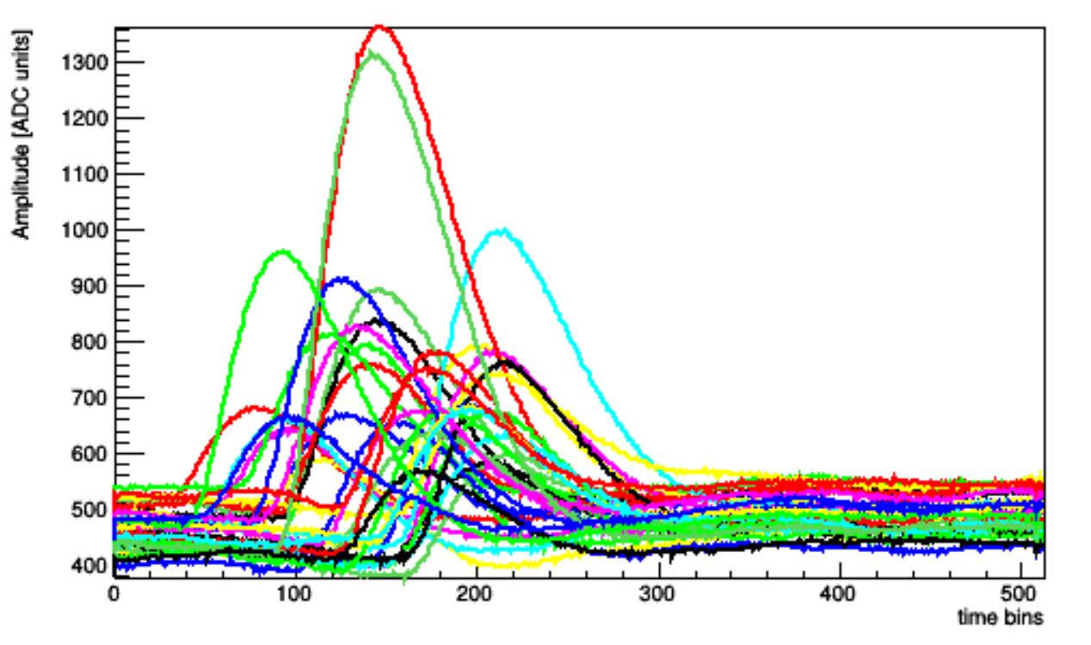
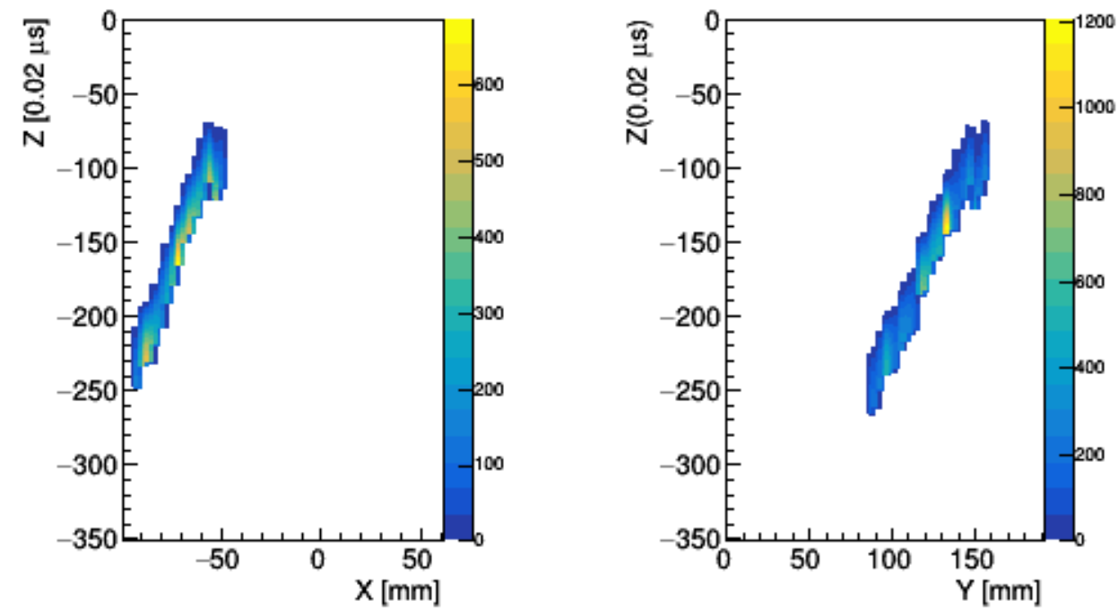
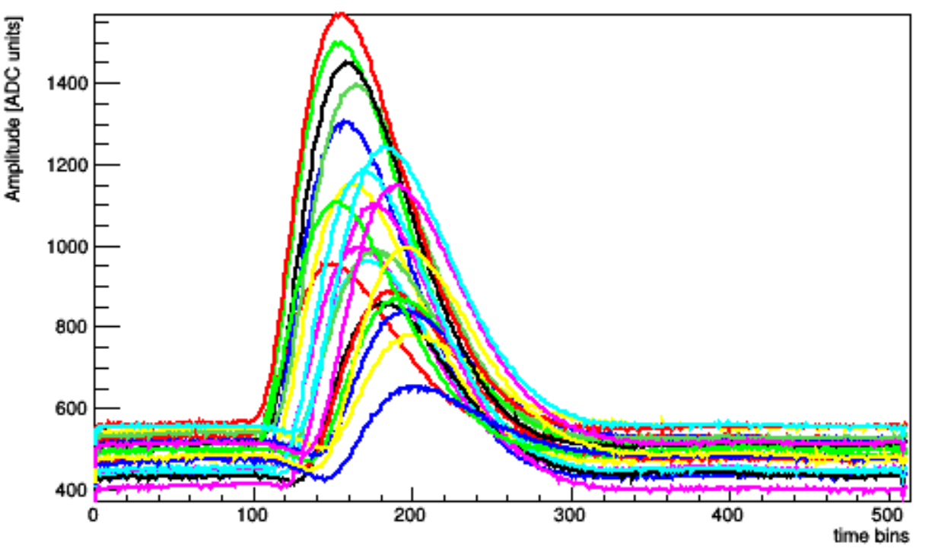
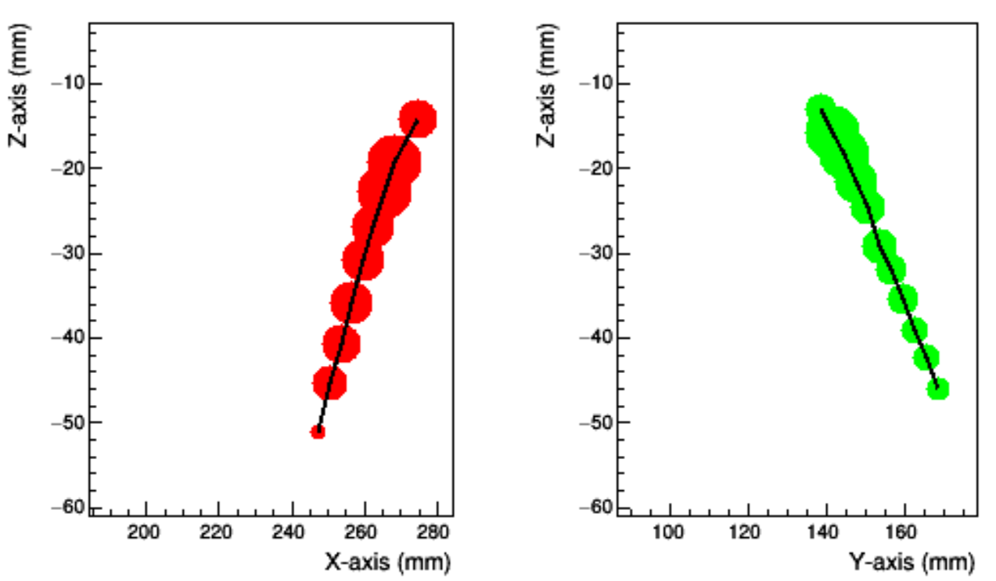
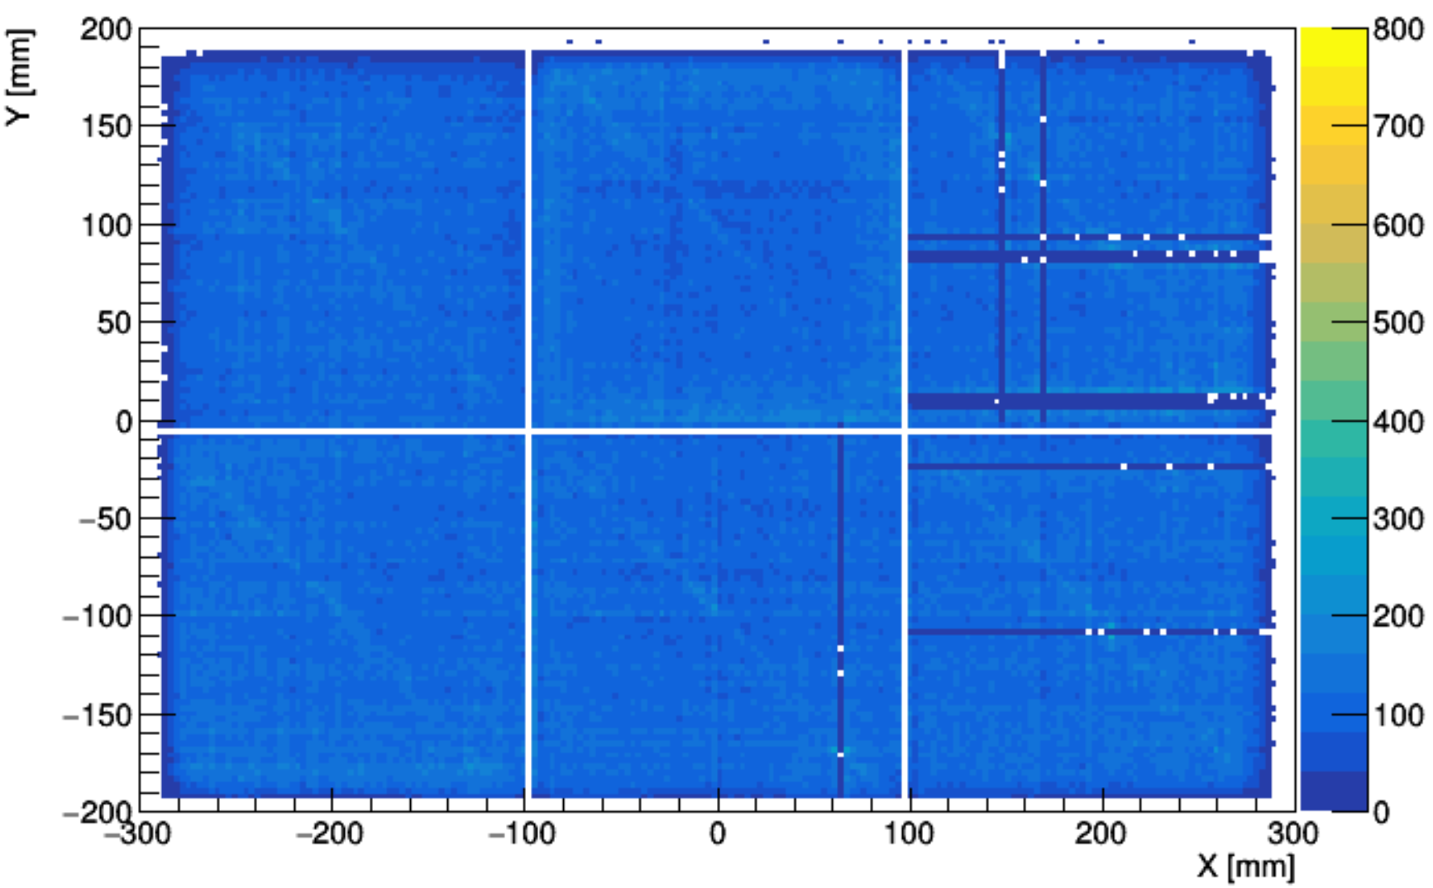
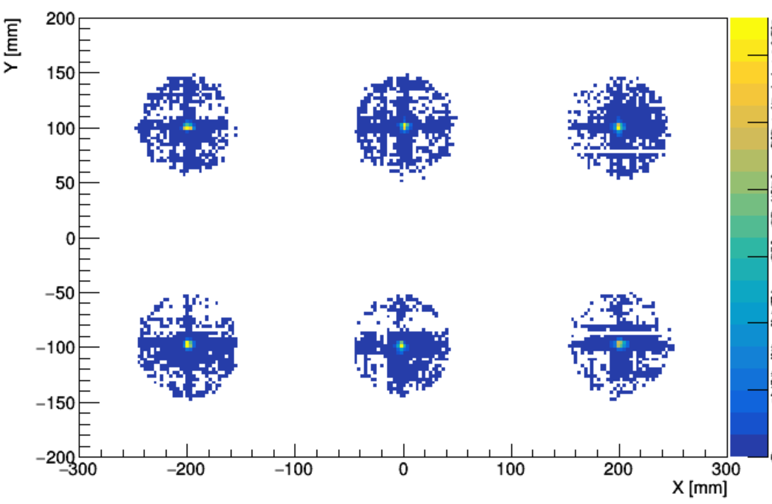
Testing of the Charge Particle Detector
Cosmic ray Muon test
Alpha calibration (Am-241 source)
Muon track starting point distribution map
Alpha track starting point distribution map
Check the detector and monitor its long-term stable operation.
Calibrate each Micromegas module with the Am-241 source.
Notes:
After the detector was built, we have conducted a series of preliminary tests. Firstly, we collected cosmic ray muons to ensure the long-term stable operation of the detector. Above is the muon waveform and track pictures collected by the detector, and below is the two-dimensional hit map of the muon. Some of the bad channels above are due to the connection problem of electronic board. Then, we used the Am-241 source for alpha calibration. This is the alpha track starting point distribution map of the Am-241 source. The alpha waveform and track from the radioactive source is shown in the figure.

Slide 14
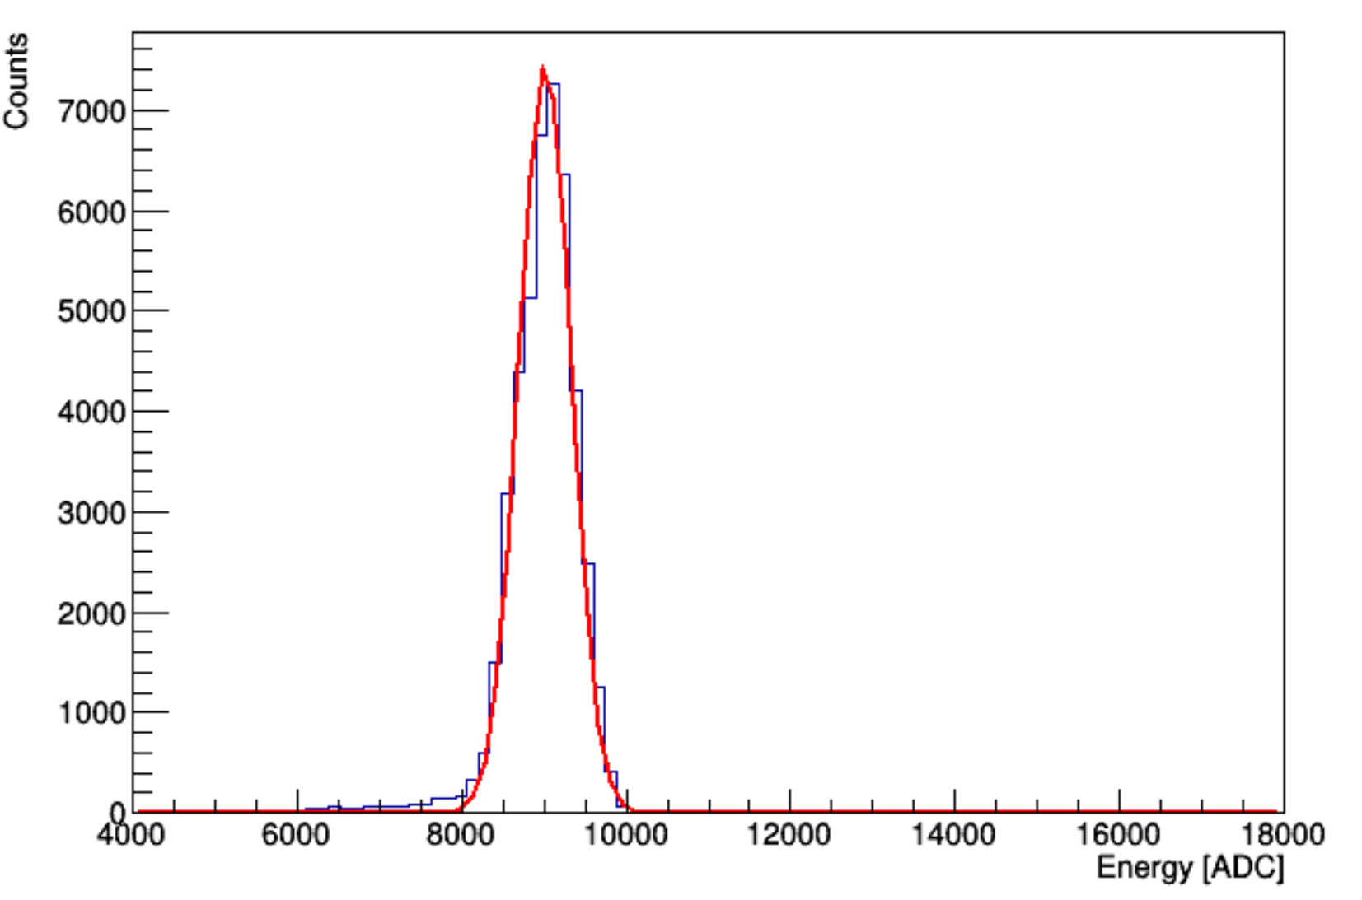
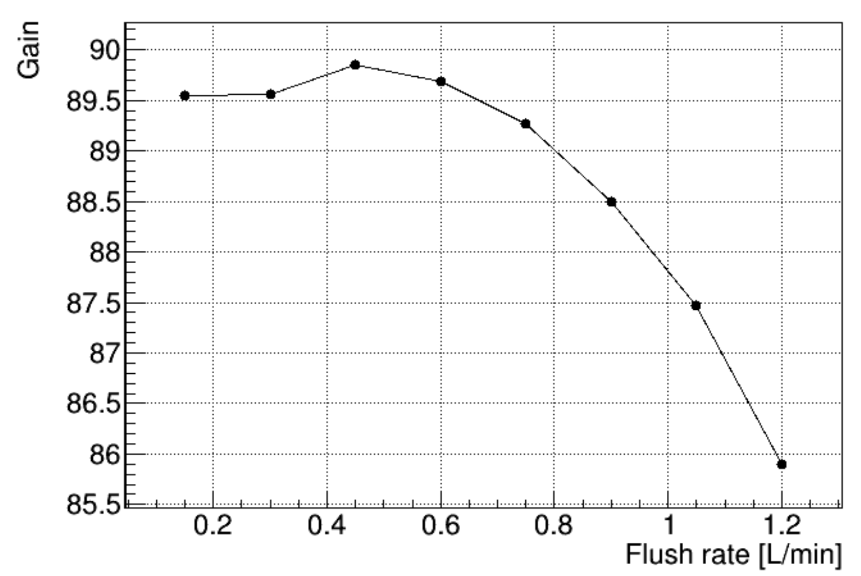
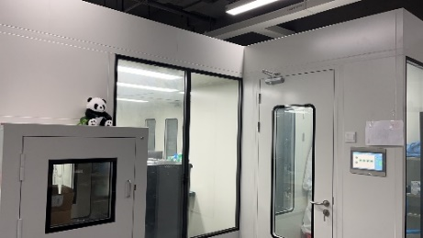
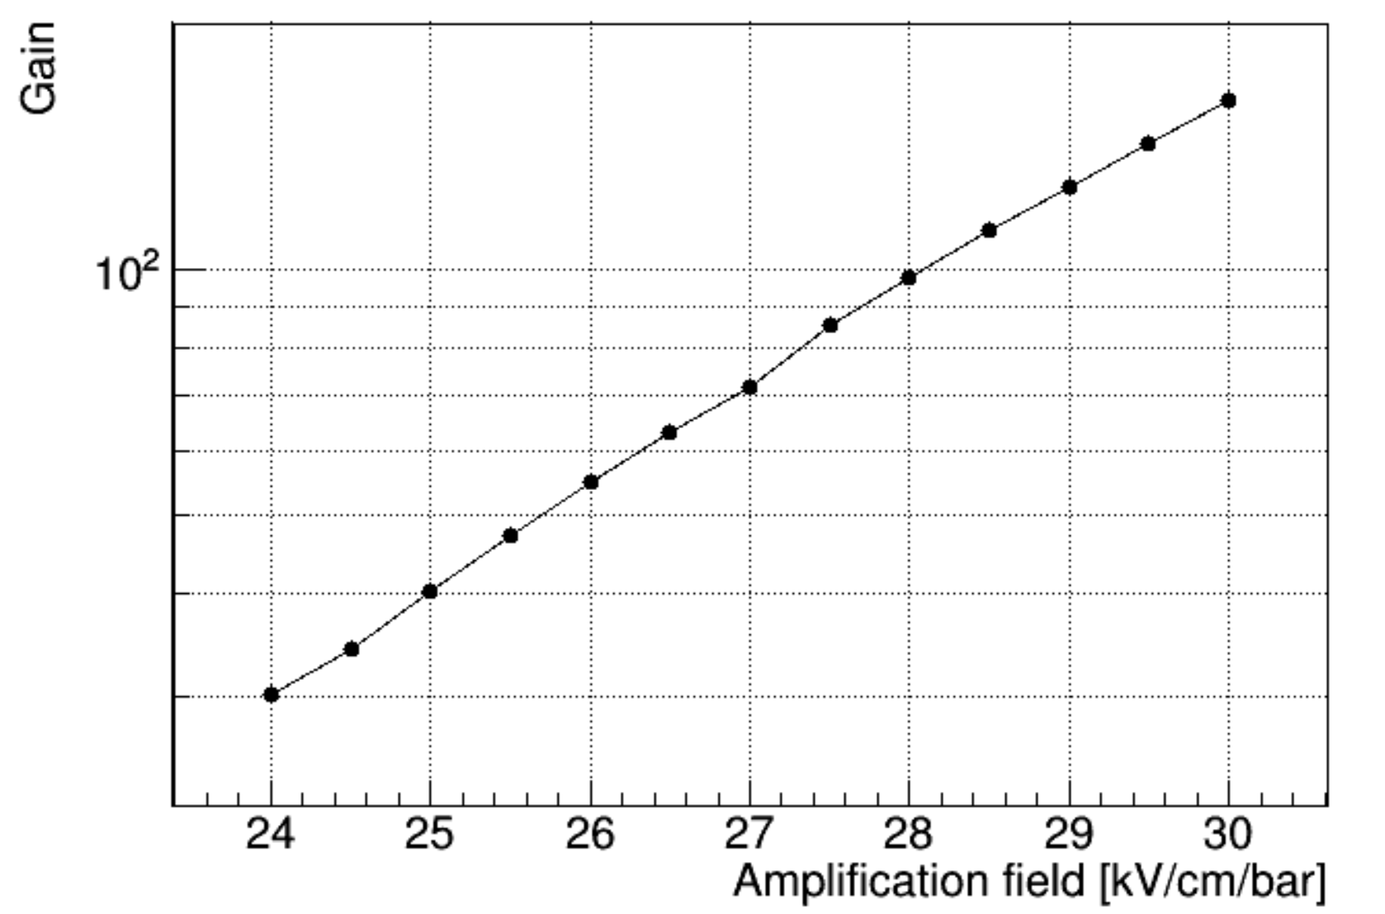
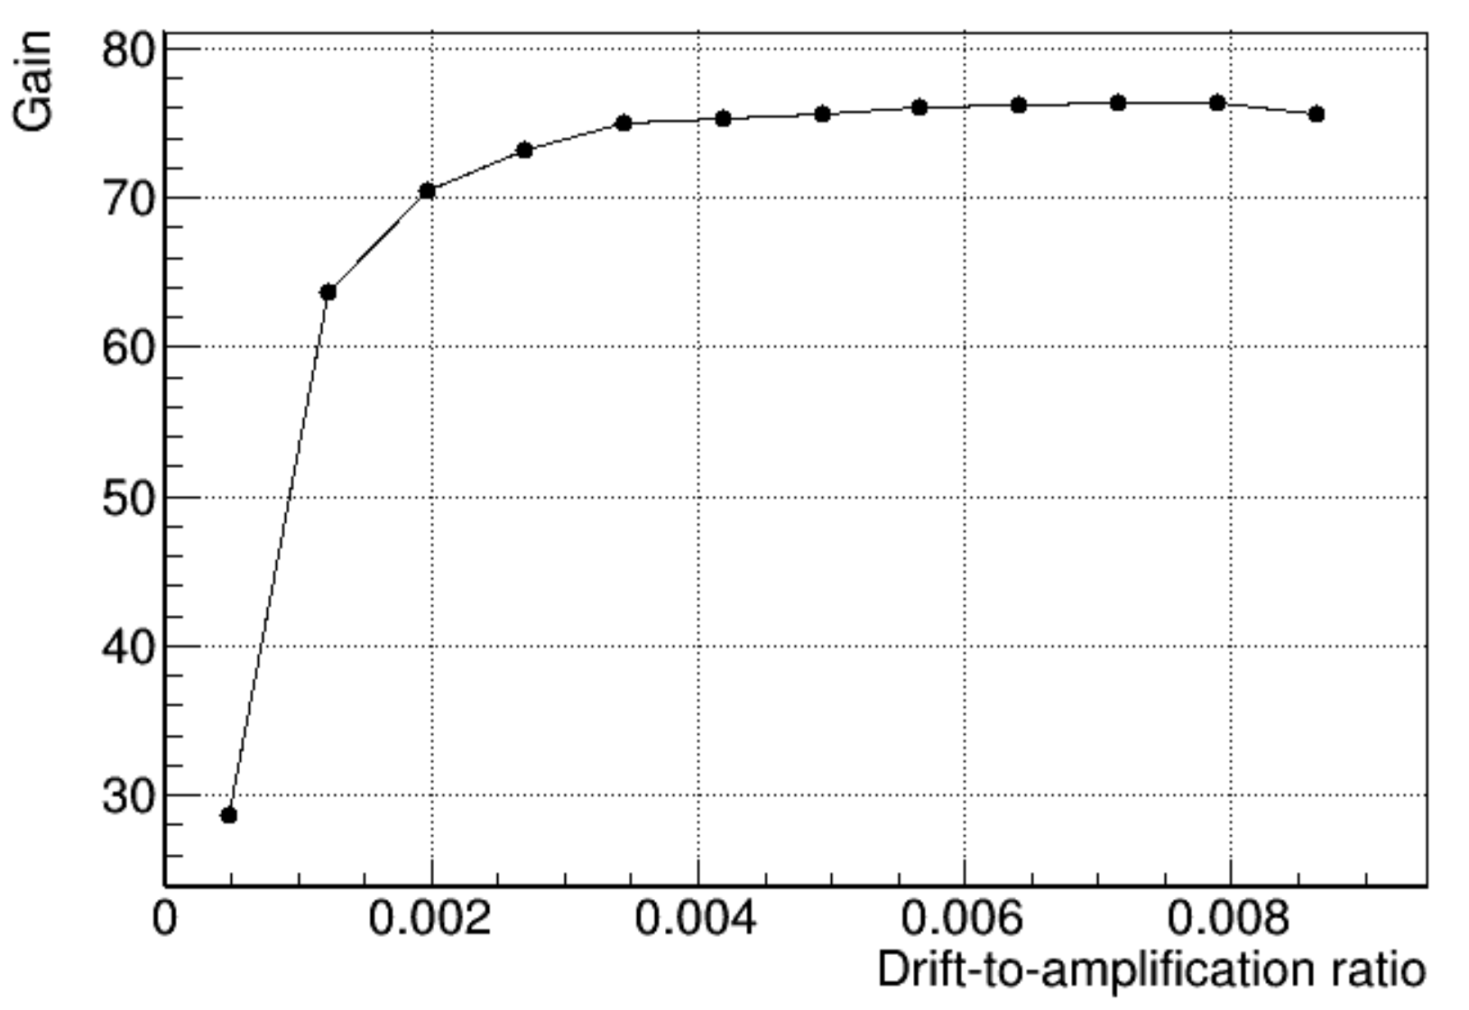
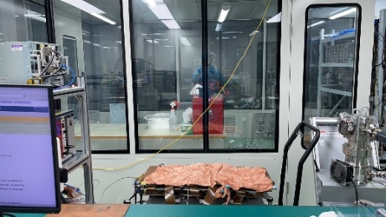
Testing of the Charge Particle Detector
Alpha calibration (Am-241 source)
Gas--- 1bar Ar-7%CO₂（0.1 L/min）
Calibrate the detector with the 5.485 MeV energy peak of the Am-241 to optimize the working conditions of the detector.
Spectrum of Am-241
9.5% FWHM at 5.485 MeV
Gain evolves with flow rates
Cleanroom
Gain evolves with amplification fields
Gain evolves with drift fields
Notes:
We conducted alpha calibration to optimize the operating conditions of the detector. In a mixed gas of argon plus 7% carbon dioxide, the energy resolution reaches 9.5% at 5.485 MeV. This is the energy spectrum of the source. We also studied the detector gain evolving with the amplification fields, drift fields, and gas flow rates. Finally, the optimal working conditions of the detector were determined. This is the cleanroom where we work.

Slide 15
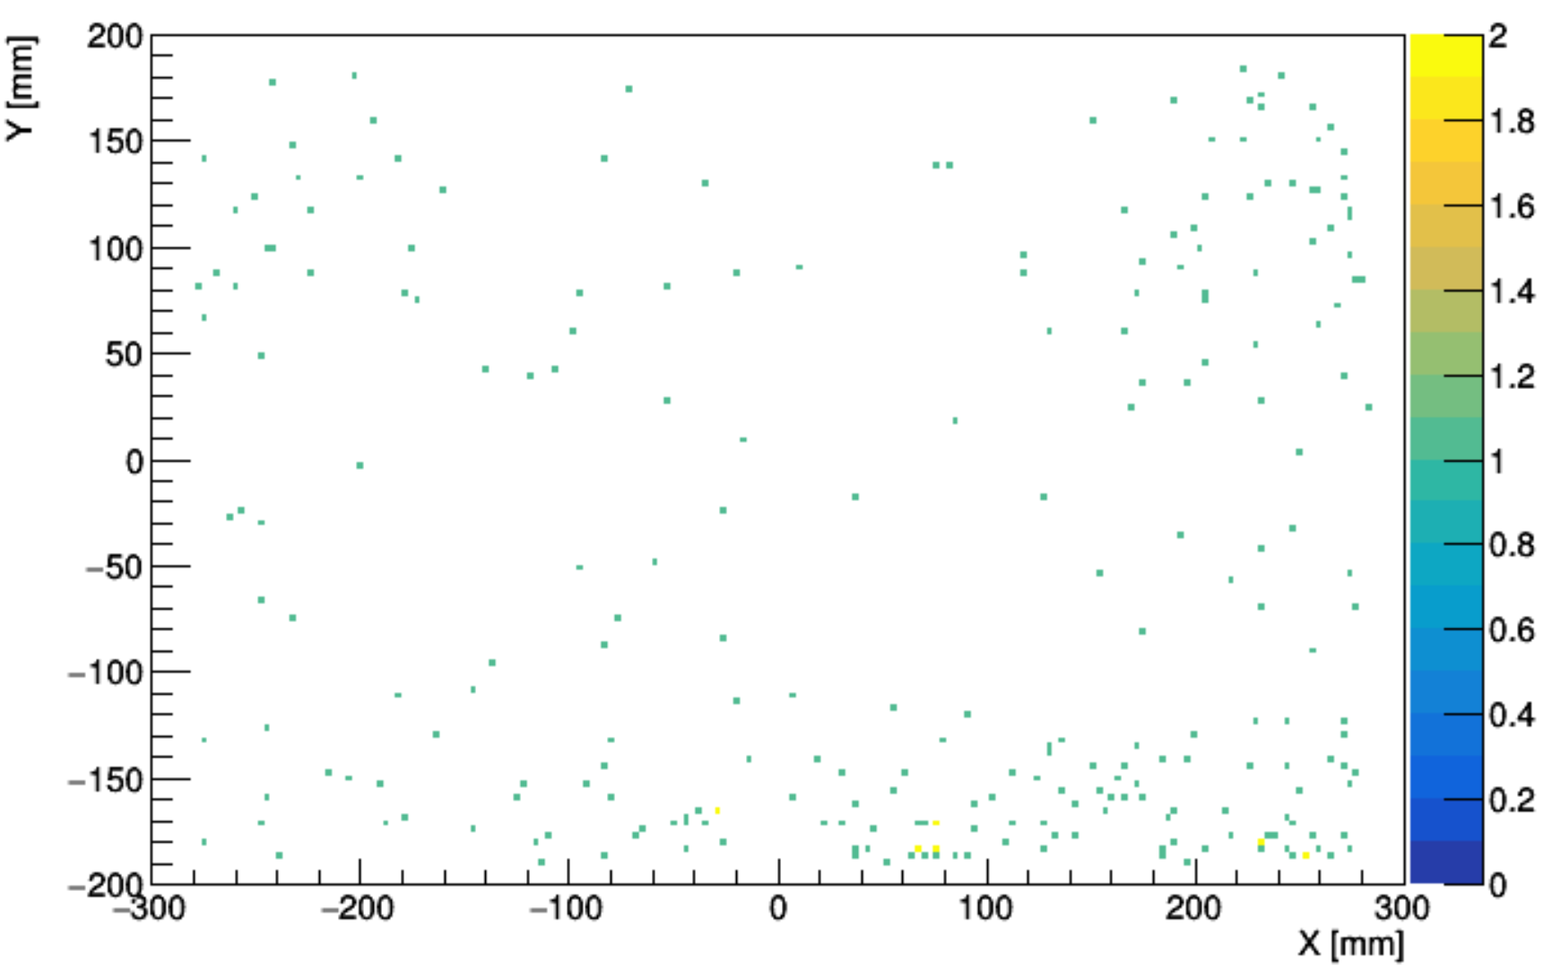
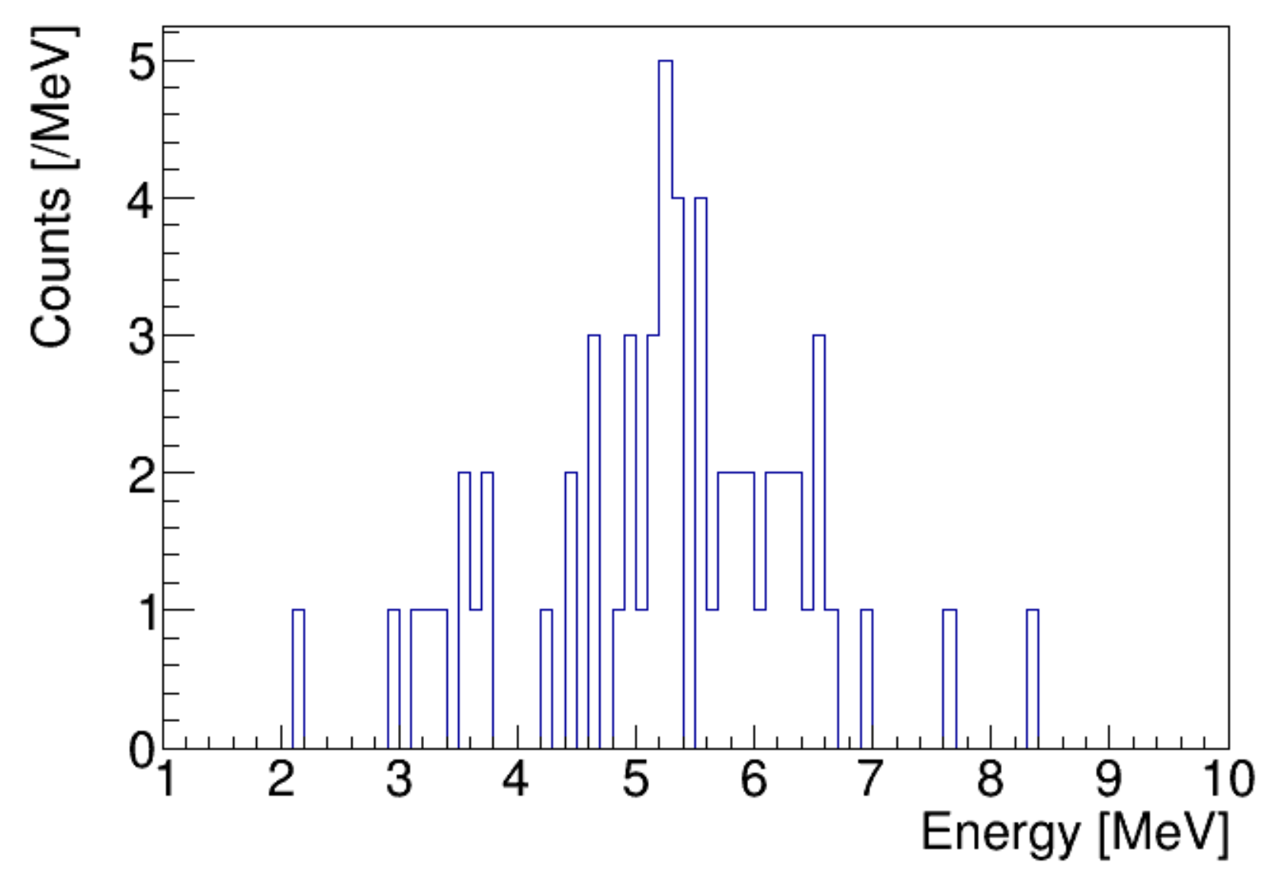
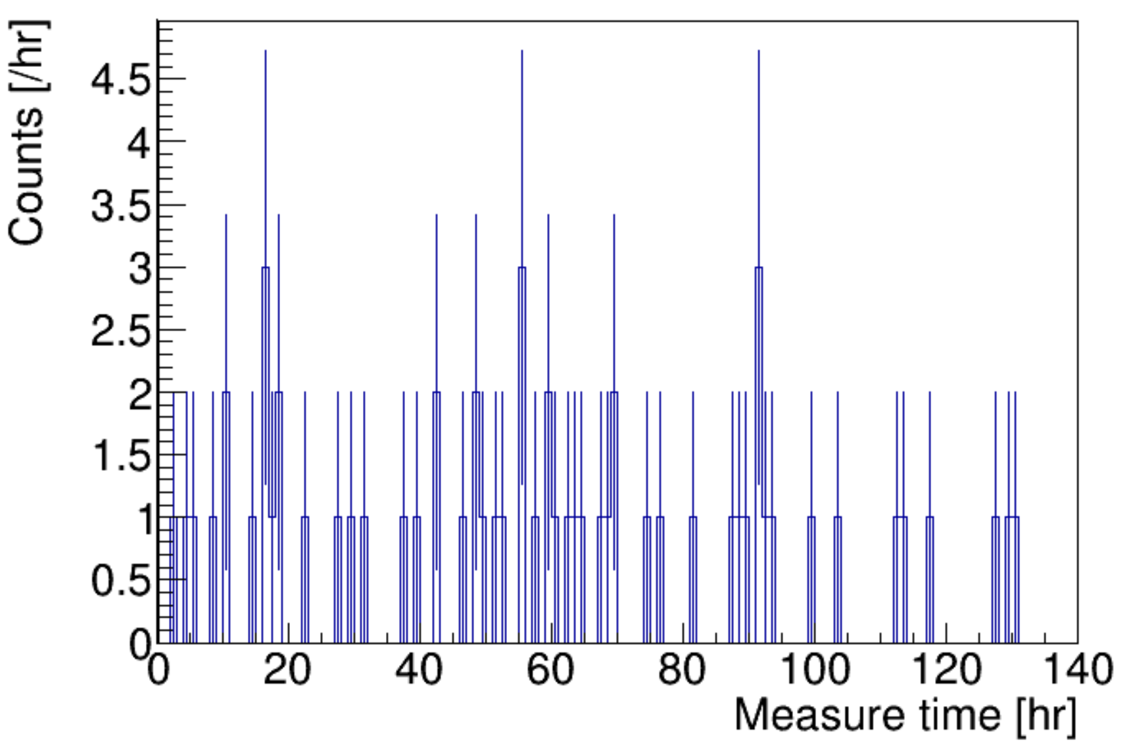
Background Measurement of the Detector
Intrinsic alpha background of the detector
Gas--- 1bar Ar-7%CO₂（0.1 L/min）
Background spectrum
Background counting rate
Alpha track starting point distribution map
Alpha background (Copper cathode + Gas): (0.14 ± 0.02)×10⁻⁶ Bq/cm²
Multiple rounds of alpha background test of the detector（uBq/cm² ）
Argon gas filled for a month
Pickling copper cathode
Replace field cage with less acrylic
1.29 ± 0.06
0.82 ± 0.06
0.47 ± 0.03
0.14 ± 0.02
（Track-related cut for α signals：Energy cut 1-10 MeV, track direction upwards, FV cut 2.7 cm to exclude backgrounds from the field cage）
Notes:
Then we conducted a preliminary test on the intrinsic alpha background of the detector. During the background test, no samples were placed, and the remaining background events after signal-background screening mainly came from the copper cathode plus gas. The obtained background level is not higher than 0.14 μBq ∙ cm⁻², which is basically the same as the UltraLo1800 mentioned earlier. These are the track distribution map, energy spectrum, and counting rate obtained from the examples of background testing. The track-related cut for alpha signals including energy cut from 1 to 10 MeV, track direction upwards, fiducial volume cut 2.7cm to exclude backgrounds from the field cage. We conducted several test rounds to reduce the detector background, step by step, including pickling copper cathode and replacing the field cage with less acrylic material. (85%)

Slide 16
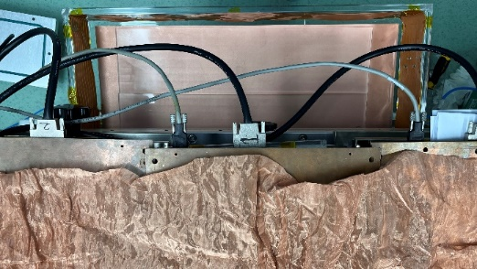
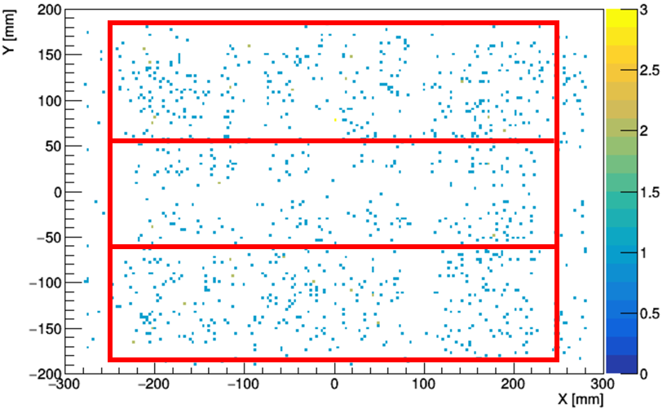
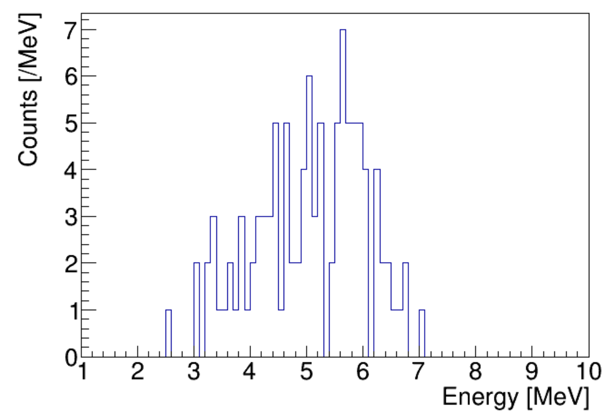
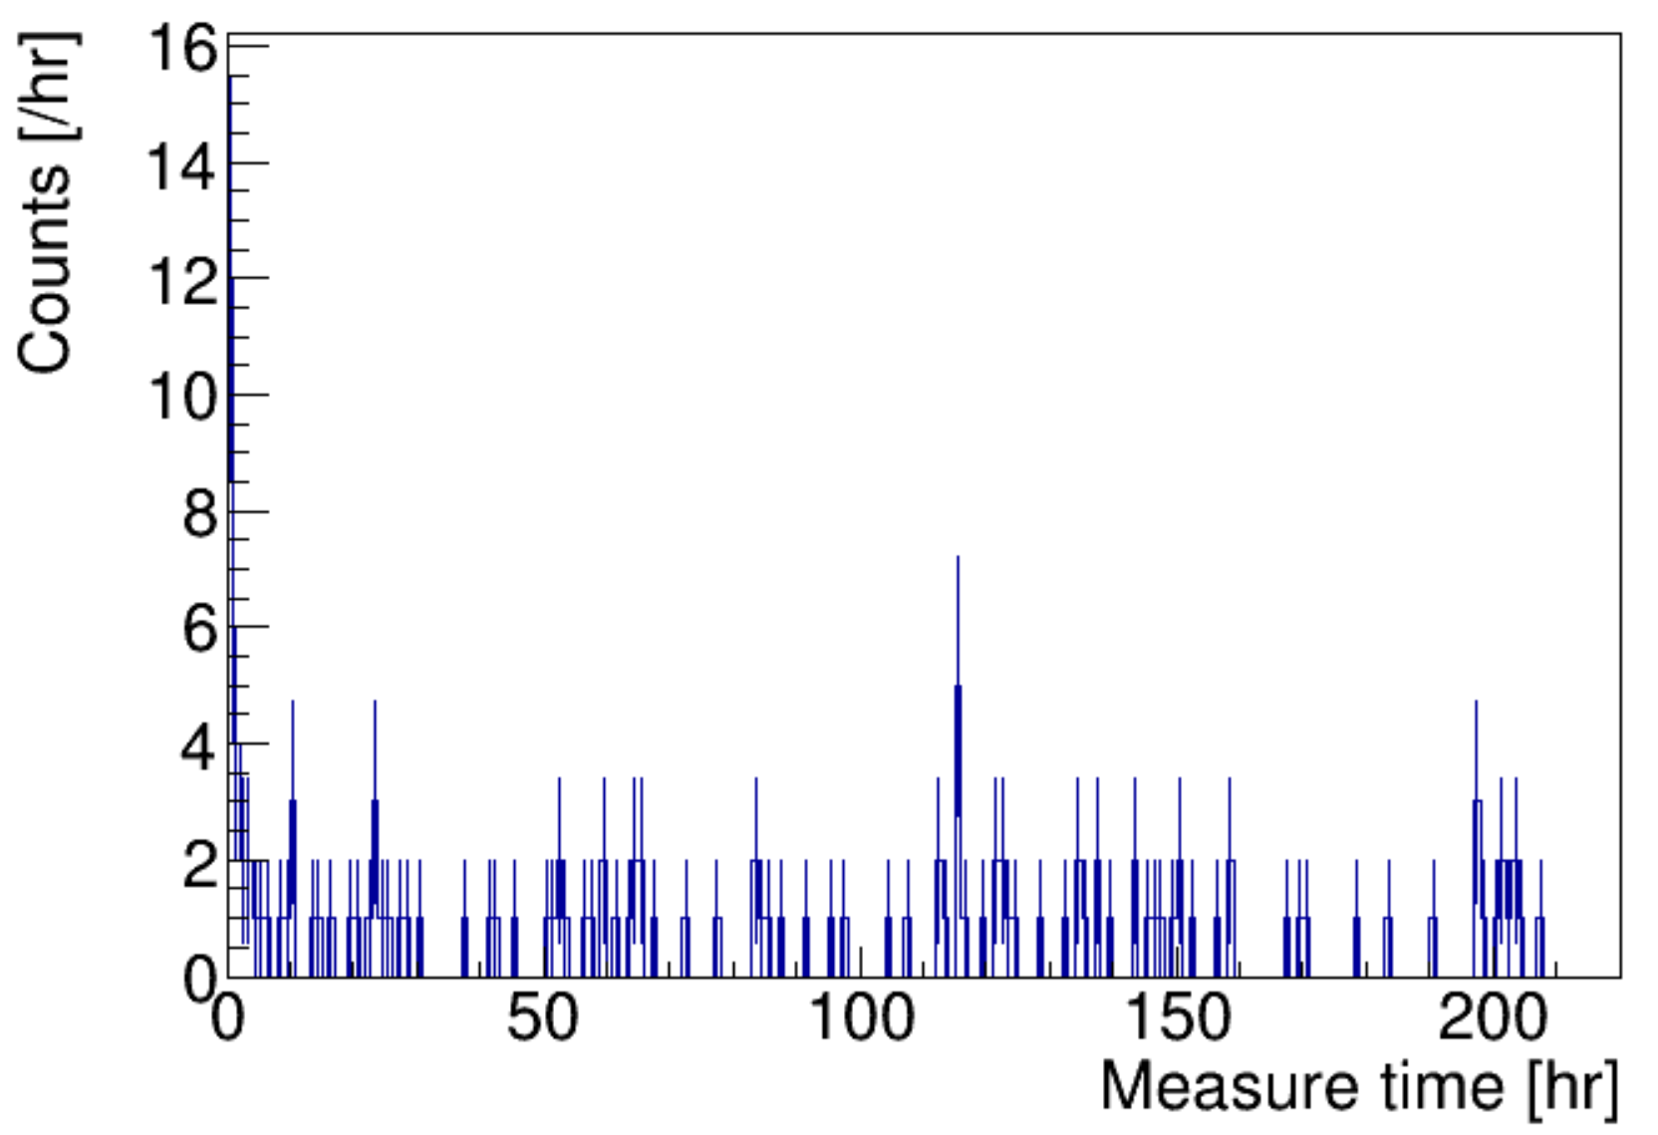
Measurement of Acrylic Surface Radioactivity
Gas--- 1bar Ar-7%CO₂（0.1 L/min）
Acrylic sample test (JUNO production)
Sample spectrum
Sample counting rate
Alpha track starting point distribution map
α contamination (Acrylic+ Gas): 0.91 ±0.03 uBq/cm²
α background (Cathode + Gas): 0.14 ± 0.02 uBq/cm²
Estimated α background of Acrylic sample: 0.77 ~ 0.91 uBq/cm²
3 pieces of Acrylic samples: 1730 cm², exposed in the underground lab, Rn~180 Bq/m³
Gas --- 1bar Ar-7%CO₂（0.1 L/min）
Assuming the gas background is 0.14 ± 0.02 μBq/cm²
Assuming the gas background is 0
Notes:
After background test of the detector, we conducted Acrylic sample test. The Acrylic samples were produced by JUNO collaboration. This is an example of acrylic sample test. We placed three pieces of Acrylic samples onto the detector cathode. Alpha contamination of the Acrylic plus gas is about 0.91 uBq/cm². According to the previous measured alpha background of cathode plus gas, 0.14 uBq/cm². We get an estimated α background of Acrylic sample: form 0.77 to 0.91 uBq/cm². Assuming the gas background is 0.14, we got lower limit 0.77. Assuming the gas background is 0, we got upper limit 0.91.

Slide 17
Measurement of Acrylic Surface Radioactivity
Acrylic sample α test (JUNO production)
 | No sample | Acrylic 1 (Exposed in the underground lab - Rn~250Bq/m³) | Acrylic 2 (Wiped with dust-free paper) | Acrylic 3 (Cleaned with alcohol) | Acrylic 4 (Rinsed with pure water + nitrogen gas)
Measure area [cm²] | 1889 | 1730 | 1730 | 1270 | 1270
Measure time [hr] | 187 | 160 | 170 | 185 | 252
Contamination (Acrylic + Gas) [uBq/cm²] | - | 0.91 ± 0.03 | 0.45 ± 0.03 | 0.18 ± 0.03 | 0.25 ± 0.03
Background (Copper cathode + Gas) [uBq/cm²] | 0.14 ± 0.02 | - | - | - | -
Estimated contamination of Acrylic [uBq/cm²] | - | 0.77 ~ 0.91 | 0.31 ~ 0.45 | 0.04 ~ 0.18 | 0.11 ~ 0.25
（Track-related cut for α signals：Energy cut 1-10 MeV, track direction upwards, FV cut 2.7 cm to exclude backgrounds from the field cage）
Notes:
Finally, we have summarized the results of acrylic sample tests. The results indicate that for radioactive contamination on the surface of the sample, alcohol cleaning of the acrylic surface is more effective than wiping with dust-free paper and rinsing with pure water.

Slide 18
1
Research Background
2
Technology of Low-background Alpha Detector
3
Detector Construction and Testing
4
Conclusion

Slide 19
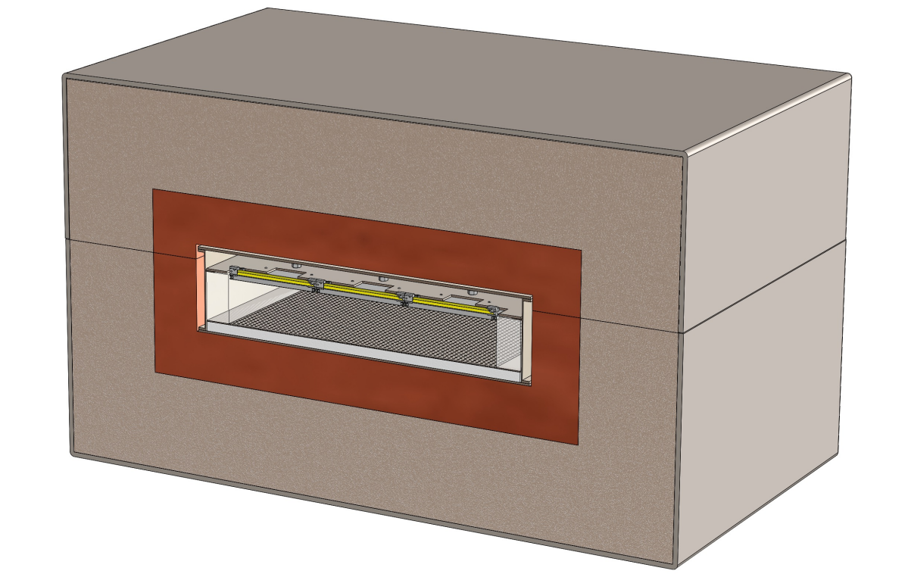
Conclusion
Ultra-Low Background Charged Particle Detector
Combining gas TPC and thermal-bonding Micromegas.
Particle track discrimination to reduce backgrounds.
Large area, high detection efficiency, high sensitivity.
Next Steps
Further reduce the intrinsic background of the detector to enhance the its sensitivity. Optimize the design and simplify the operation process.
Install shielding, and conduct low background material surface radioactivity measurement at the Jinping Underground Laboratory.
Detector and shield
Notes:
Let's make a summary. This low-background charged particle detector combines the gas time projection chamber and the thermal-bonding Micromegas technology, and can greatly reduce the background by using particle track discrimination. It has the characteristics of a large area, high detection efficiency, and high sensitivity. The next step is to reduce the intrinsic background of the detector and improve the sensitivity through low-background techniques. At the same time, a shielding body will be installed to carry out the radioactive measurement and screening of low-background materials in the Jinping Underground Laboratory.

Slide 20
Thank you for attention
Notes:
Thank you for your attention.

Slide 21
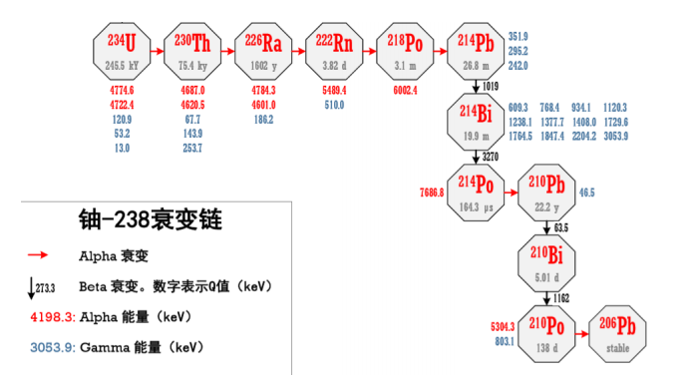
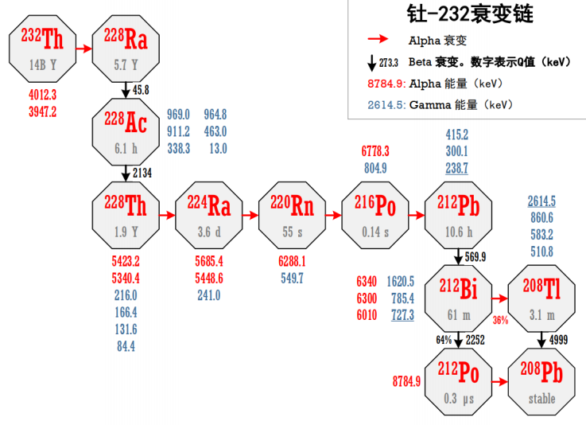
Backup

